Slide 1



Branding Yourself for a Dream Job
The Modern Resume
Steve Jones
Editor, SQLServerCentral
Database Weekly
Red Gate Software
SQL Share

Slide 2
Agenda
Why Build a Brand?
Practical Tips
  Social Networking
  Volunteering
  Leadership
  Blogging
  Authoring
  Speaking
Resume Tips
Recruiters

Slide 3
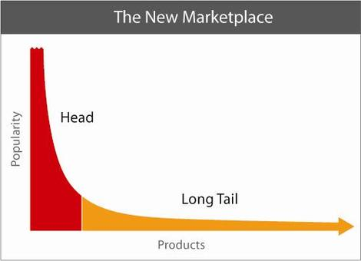
Long Tail

Slide 4
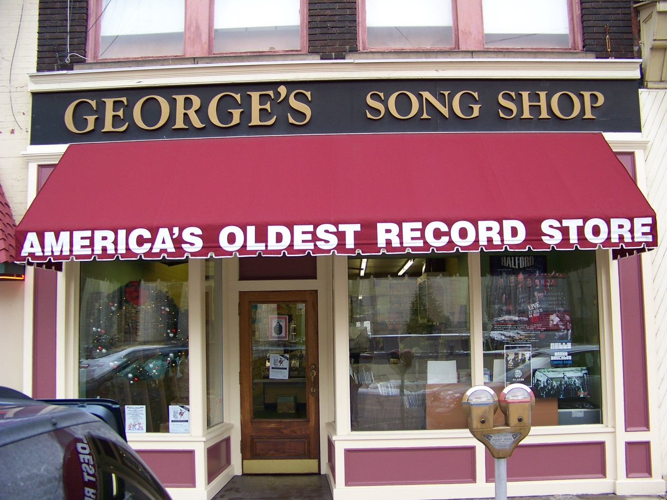

Slide 5
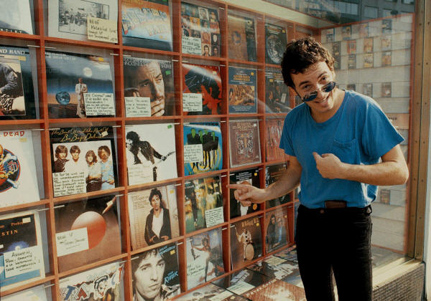

Slide 6


Slide 7
Employer Desire
Potential Employees

Slide 8

Employer Desire
Potential Employees

Slide 9

Employer Desire
Potential Employees
Potential Employees

Slide 10

Employer Desire
Potential Employees
Potential Employees

Slide 11



Slide 12


Slide 13
Standing Out
Humility is good, except
  When looking for a job
  Trying to get a promotion
  Trying to keep a job

Slide 14


Slide 15
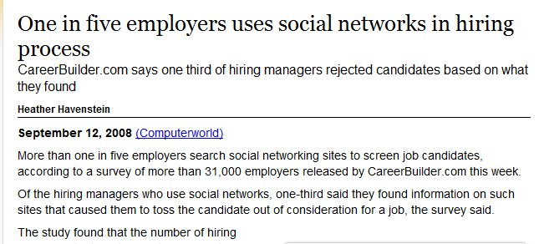

Slide 16
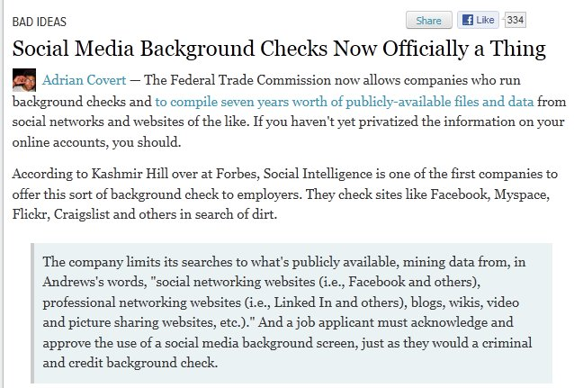
From: http://gizmodo.com/5813829/if-you-agree-to-a-social-media-background-check-your-public-info-could-sit-in-a-file-for-7-years

Slide 17
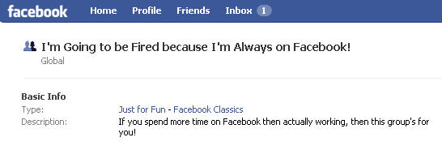
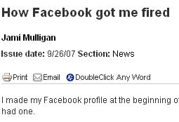
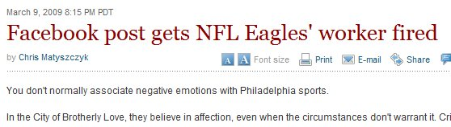
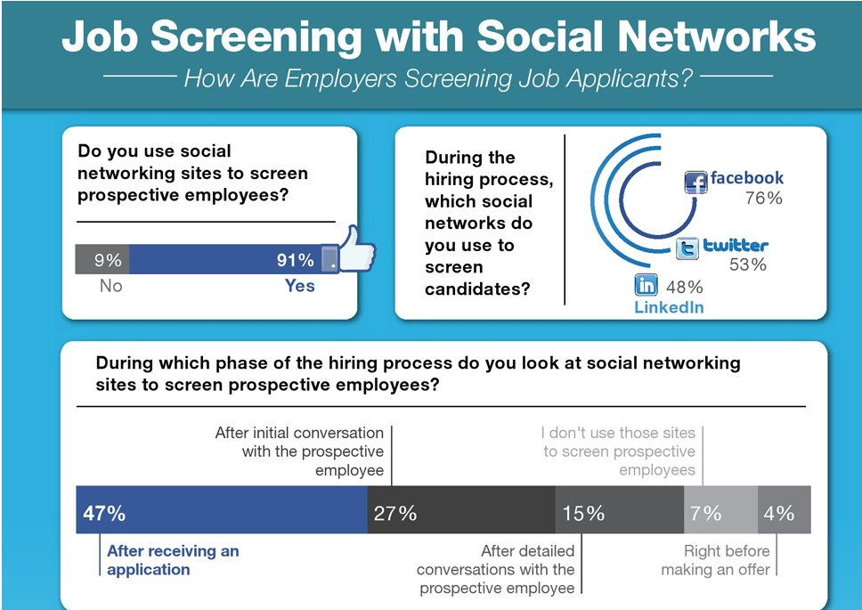
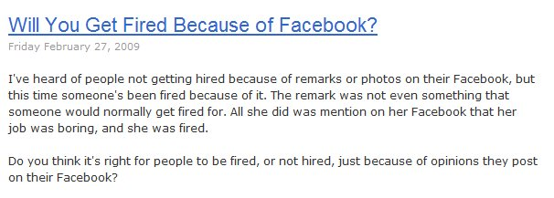

Slide 18
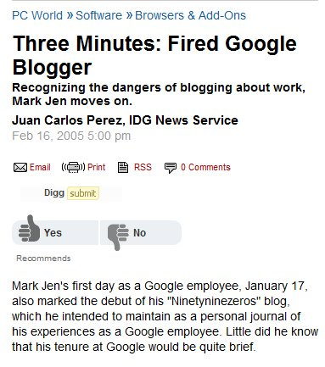


Slide 19
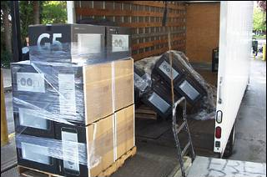

Slide 20
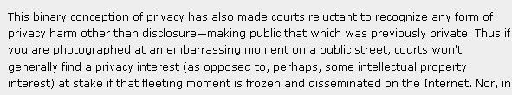
Courts won’t generally find a privacy interest

Slide 21

Image is Everything
Not Everything, but it does matter

Slide 22

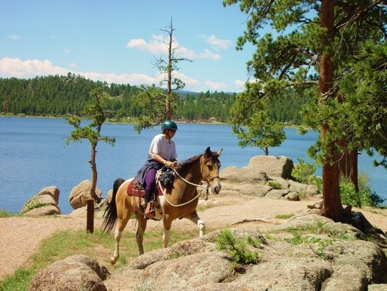

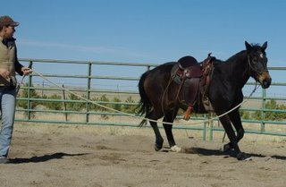
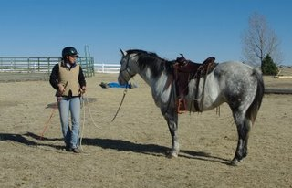

Slide 23
How to stand out?
Resume
Profiles
Networking
Volunteer
Research
Be a Leader
Blog
Publish
Speak
Can be Internal or External

Slide 24
Resumes
1-2 pages (resume)
  CV may be longer
Keywords at the end
Make the resume human readable
Include branding links
  To blog or promotional posts
  Online profile
Be professional
  Be relevant
  Don’t be funny
    Weird Things on Resumes
Include some Contact Information

Slide 25
Cover Letters
This is the first impression
  This is a pre-interview
Customize for each company
  How to write one?
    Google search
    Practice
  How not to write one?
    http://www.bradmcgehee.com/2010/03/how-not-to-write-a-resume-cover-letter/

Slide 26
Online Profiles
A digital representation of who you are
The details of your career
  A central repository of your work
  A portfolio for clients
  Tie together the various places where you have a presence.
Online Resume
  Can be a summary
  This can be your CV as well
  Include the information that has “rolled off” your resume.

Slide 27
Online Profiles
Give “them” one
  They’ll find one anyway
Be prepared to explain any you have created
  And maybe some you haven’t
Be professional
  You can have fun, but keep it separate
  ALL your actions reflect on you, remember that.
  Use “THE Test”

Slide 28
Online Profiles
Building an online profile
  Your Web site
  Facebook
  LinkedIn
  Plaxo
  MySpace
  Twitter
  Blogger/Wordpad/Typepress/other
Include Contact Information
  Avoid Identity Information
Keep this professional
  Use another profile for personal information

Slide 29
Online Profiles
Google Alerts
  Monitor what is being posted about you
Have this profile ready at all times
  This can be the first place you point people
Update this quarterly as your career advances
Summarize all your accomplishments in one place

Slide 30
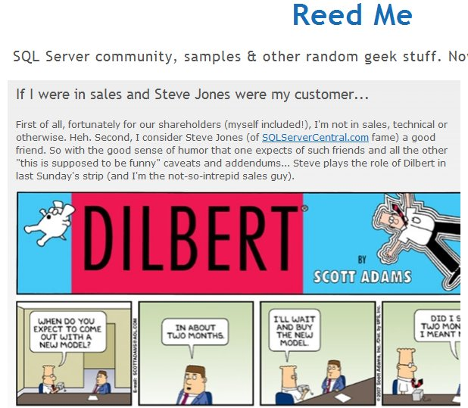

Slide 31





Social Networking
?

Slide 32
Social Networking
Web 2.0 / Social Networking
No different from the real world
  Chamber of commerce
  User groups
  BBB
In today’s world, the online world can take the place of these offline events.
You can still participate in offline events
  Use online tools to help reinforce your offline efforts.

Slide 33
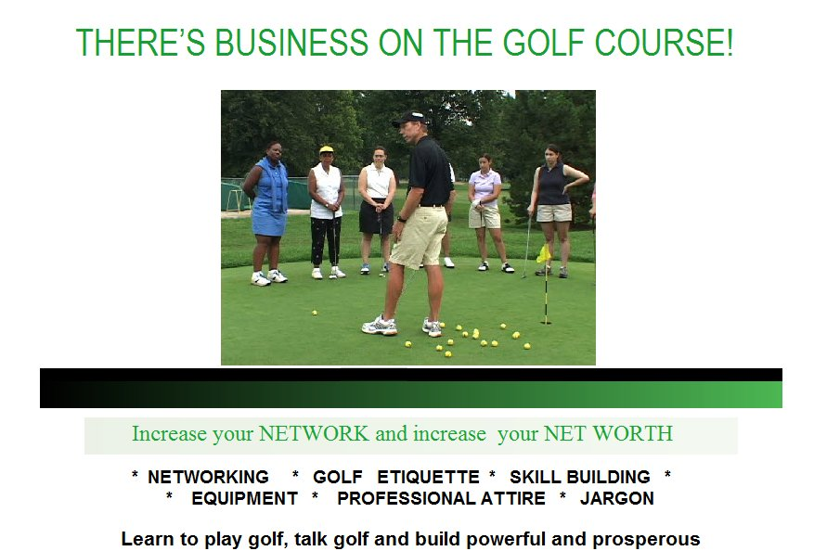

Slide 34
Networking
Online tools give you a way to network with other professionals
  Bonding
  Sharing
A way to let others know about you
  What you are engaged in
  Your current status
A way to hear about
  Opportunities

Slide 35
Networking
You’ve signed up, now what?
Interact with others
  Ask questions
  Post comments in your work, of your learning
  Survey others for their thoughts
  Get inspired

Slide 36
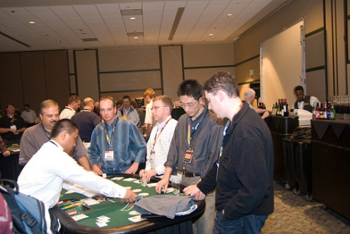

Slide 37
Social Networking
Avoid identity information
  Check with your family
Keep these interactions professional
  Use another account for personal information (usually)
Use an email that you can monitor.
Update this on a regular basis
  Use this to interact with others
  Every 2-4 weeks
Get email updates on a reasonable schedule

Slide 38
Volunteer
PASS/Local Group
  Be sincere
  Be sure your name is out there
  Document efforts
Work
  Tackle something that needs to be done
  Be sure this is noted somewhere, like the intranet, company newsletter, etc.
  Keep a record for your review.

Slide 39
Volunteer
Forums
  Help others by answering questions
  Pay it forward
  Force yourself to learn more/check yourself
  Note your username on your resume
Build a Project (Codeplex)
Non-Profit Organizations
  Could be technical or nontechnical
Don’t volunteer unless you want to

Slide 40
Research
Ask questions your online
  Can be added to your blog
  Show some back story, thought process, some effort being made
  Shows you are learning and unafraid to ask for help.
  Shows that you know how to find help
    This can be useful in an interview

Slide 41
Leadership
Everyone needs leaders
Leader != Manager
  But it helps
You can be
  Project leader
  Organization leader
  Thought leader
This does not have to be in technology!
  Document your efforts

Slide 42
Blog Survey
Who has a technical blog?
Who reads technical blogs regularly?

Slide 43
Blog Survey
Who has a technical blog?
Who reads technical blogs regularly?
10% have technical blogs
80% read blogs

Slide 44
Blogging
A chronicle
This is a your voice
Write about what you
  Learn
  Know
  Solve
  Do
  Think

Slide 45
Blogging
Don’t overthink it.
Tackle small, discrete items
Ignore similar posts
Remember this is about YOU!
  Building a publishing platform is a different type of blog. You can do this, but you do not have to.
A long term chronicle of your career.
Keep this blog professional
  Relate it to your career

Slide 46
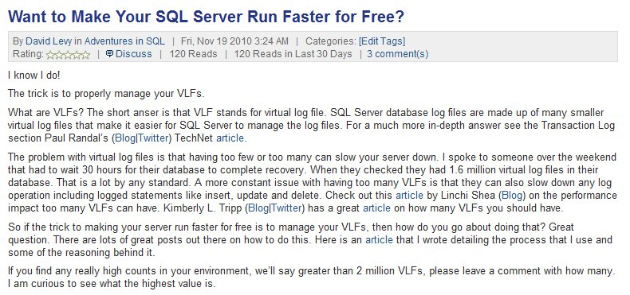
http://www.sqlservercentral.com/blogs/adventuresinsql/archive/2010/11/19/want-to-make-your-sql-server-run-faster-for-free_3F00_.aspx

Slide 47
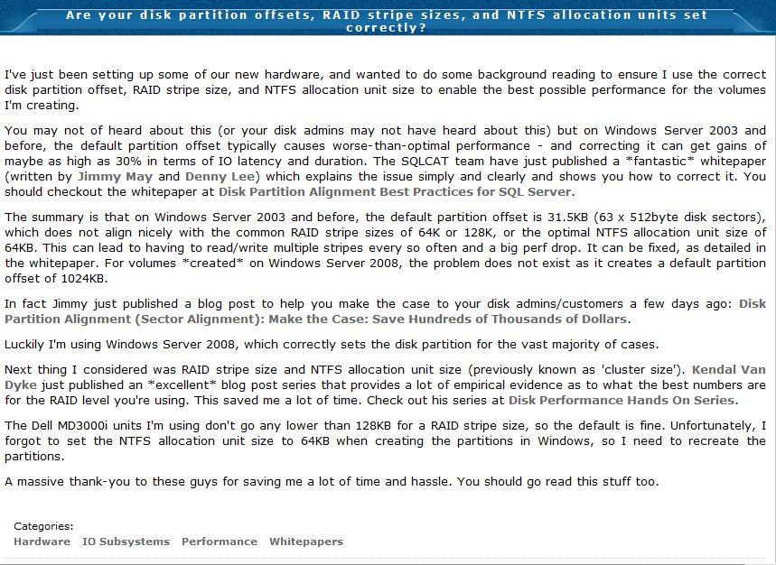
http://www.sqlskills.com/BLOGS/PAUL/post/Are-your-disk-partition-offsets-RAID-stripe-sizes-and-NTFS-allocation-units-set-correctly.aspx

Slide 48
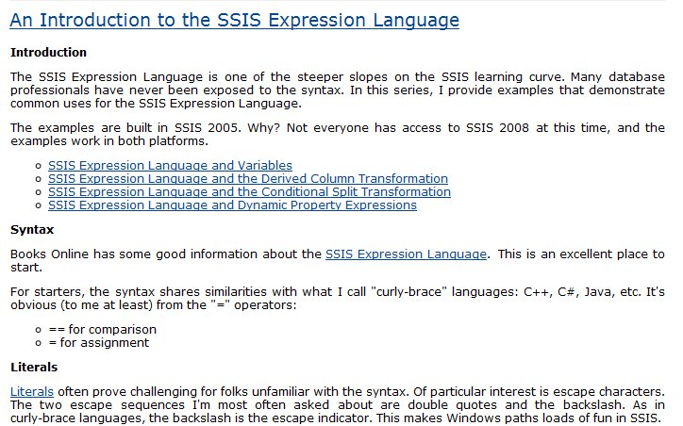
http://sqlblog.com/blogs/andy_leonard/archive/2009/01/30/an-introduction-to-the-ssis-expression-language.aspx

Slide 49
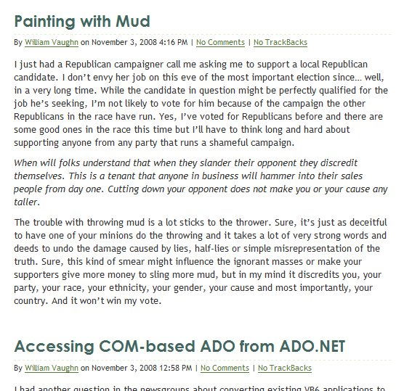
A Mistake
Politics
Development

Slide 50
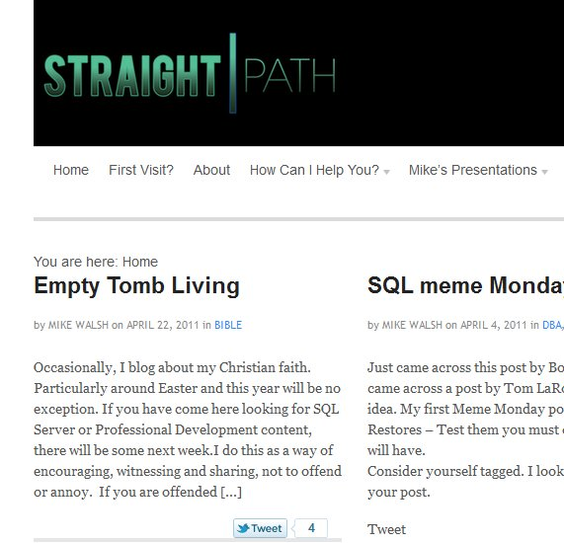

Slide 51
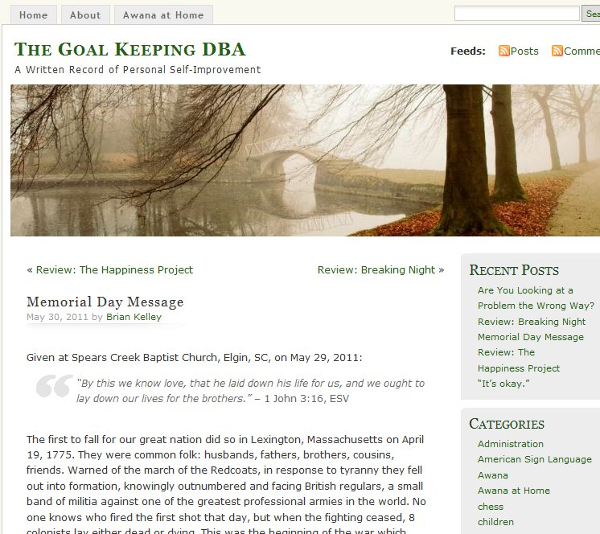

Slide 52
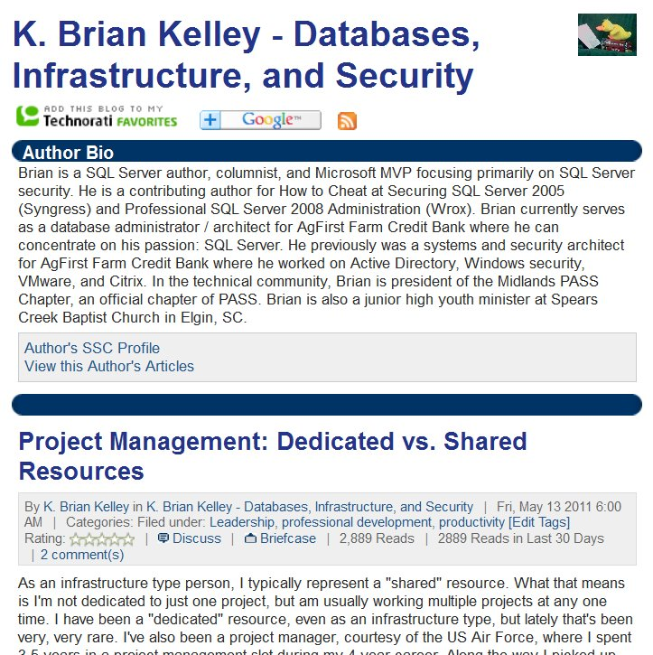

Slide 53
How to blog
Get Permission
Be smart
  Don’t disclose financial information
  Keep company secrets secret
Be consistent
  Pipeline and schedule
  Be clear
  A survey of hiring managers showed they tend to look at 5-10 posts.

Slide 54
How to blog
Don’t copy other posts
Don’t copy other posts
Don’t copy other posts
Do your own research
Link to others and give credit
Keep a record
  Use Blogger/Word Press/Typepad
  Use Word if you want more privacy
Live Writer is great

Slide 55
Authoring / Publishing
Become a teacher
Think “Essay”
  Focus, focus, focus
Don’t be intimidated
More formal writing and editing required.
  This is a step above blogging.

Slide 56
Authoring / Publishing
Different choices
  SQLServerCentral.com
  SQLTeam.com
  Simple-Talk.com
  SQL-Server-Performance.com
  SQL Server Magazine
.NET
  Simple Talk
  Visual Studio Magazine

Slide 57
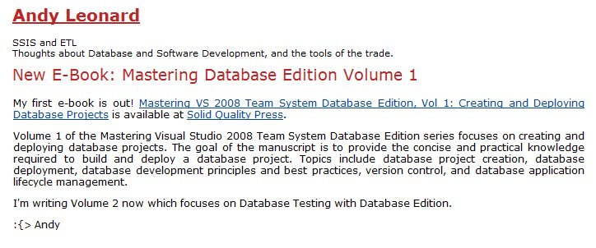
Books
Long projects
  Don’t start here. Get practice with articles or lots of blogs
Lots of authors subcontract out
  Social networking can help you find these
Promote it

Slide 58
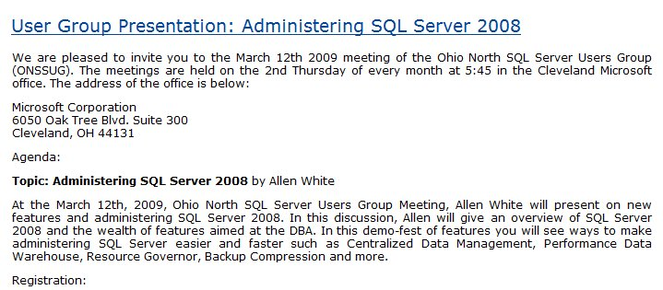
Speaking
Everyone can do this
Offline efforts
Promote it online
  Market on your blog (or others)
  Support with downloads
  Make sure there is a permanent URL

Slide 59

Documentation
Document everything.
  Never know when you’ll need something
Don’t clutter your resume
  But have links available
  Or have an online CV
Document mistakes
  Let them know you’re not that guy:

Slide 60
Recruiters
A great source for you job hunt
Many jobs go through recruiters
Non-Exclusive
Make sure they have you branding information in a profile

Slide 61

Balance
You can have a life and still do this
Work at a pace that fits your life. The key is to keep working.

Slide 62
Links
The Modern Resume blog – Weekly notes based on this presentation and new information.
Salary Negotiation: 32 Job Pay Tips - Focuses the job negotiation lens on the 32 salary negotiation tips for IT professionals. Includes exercises and questions to assist in preparation.
Examples of Interview Questions – Good general list of questions
The First Step is to Start – Motivational post.
Crazy Things People Put on Resumes – Don’t include these things
Recruiters screening candidates - http://mashable.com/2011/10/23/how-recruiters-use-social-networks-to-screen-candidates-infographic/

Slide 63


The End
Touch your resume every quarter
If you find something that works, send me a note
Set a reminder for 6 months from today and look back
Questions?
Career Forums at www.sqlservercentral.com/forums
www.themodernresume.com
# 66

Slide 64
References

