Slide 1

Preparation for Disaster
Steve Jones
Editor, SQLServerCentral
Red Gate Software

Slide 2
Be prepared
I will do my best

Slide 3


Slide 4
Why do we prepare for disasters?

Slide 5
Failure is inevitable

Slide 6
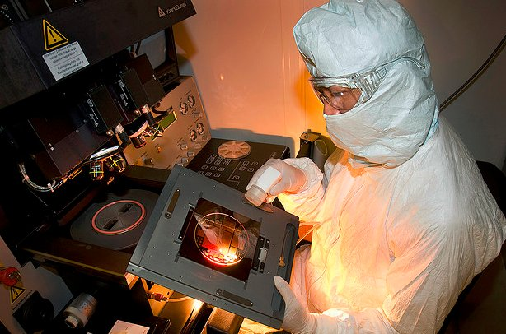

Slide 7
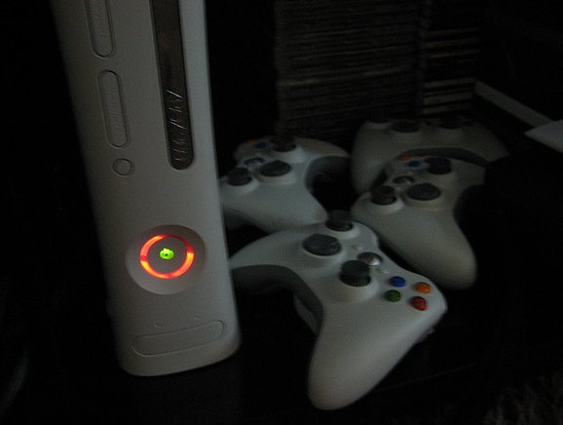

Slide 8
The “Whoops” Disaster

Slide 9


Slide 10


Slide 11
Who is a parent?

Slide 12
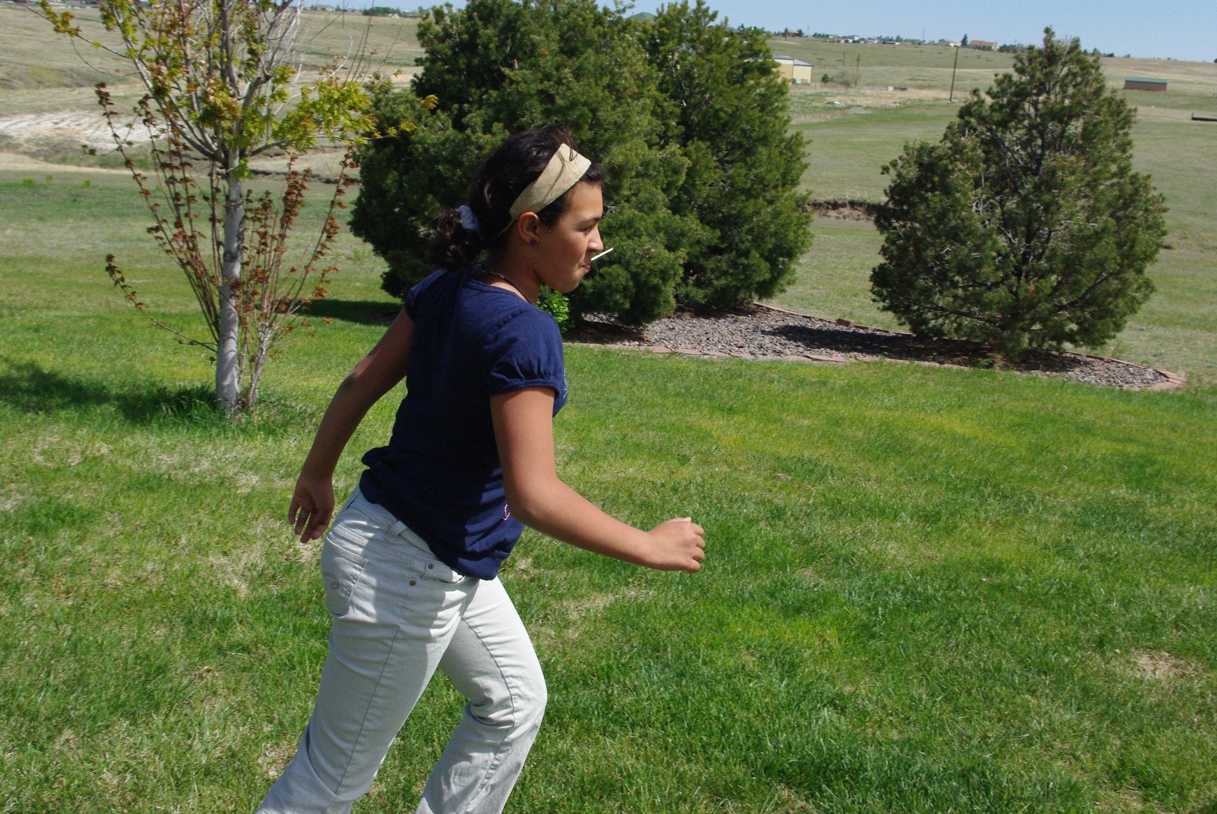

Slide 13
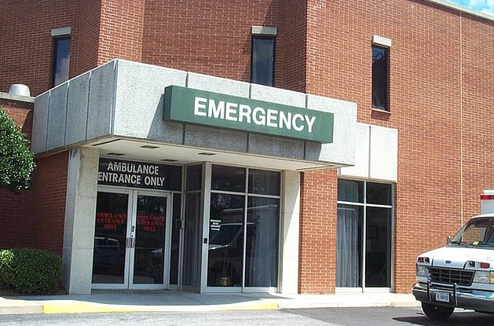

Slide 14


Slide 15


Slide 16
Be prepared
I will do my best

Slide 17
What’s a Disaster?
Earthquake that destroys your data center
Hard drive failure
Corruption in the database
Fire that closes your office (and server room)
Flooding in the city where your server is located
Bulldozer cuts the fiber cable to the office park
Water leak in the data center
Backup tape copied by competitor
Incorrect data load
Execute a DELETE without a WHERE
Deploy changes to production instead of dev server
Many, many more

Slide 18


Slide 19


Slide 20
insurance

Slide 21
backups are insurance

Slide 22
How often do you back up?

Slide 23
It depends

Slide 24
Recovery Time Objective (RTO)
Recovery Point Objective (RPO)

Slide 25
The Recovery Time Objective (RTO) is the duration of time and a service level within which a business process must be restored after a disaster (or disruption) in order to avoid unacceptable consequences associated with a break in business continuity.
- Wikipedia, http://en.wikipedia.org/wiki/Recovery_time_objective

Slide 26
The time it takes for you to get things running to the point where someone can use them after someone notices that they aren't.
RTO ~ Uptime*
* 100% uptime is not possible for all clients

Slide 27
RTO Examples
Time
Disaster Occurs
System Restored
Someone notices
Clients Connect

Slide 28
RTO Examples
Time
Disaster Occurs
System Restored
Someone notices
Clients Connect
RTO

Slide 29
RTO Examples
Time
Disaster Occurs
System Restored
Someone notices
Clients Connect
RTO

Slide 30
RTO Examples
Time
Disaster Occurs
System Restored
Someone notices
Clients Connect
RTO

Slide 31
RTO Examples
System | Response Hours | RTO
Web Order Entry (SQL012) | 24x7 | 5 minutes
Web Main (SQL014) | 24x7 | 40 minutes
CRM, internal | 8-5, must respond overnight | 120 minutes
Dynamics, internal | 8-5, weekdays | 300 minutes
Development, web | 8-5, 7 days a week | 2 days

Slide 32
Recovery Point Objective (RPO)

Slide 33
Recovery Point Objective (RPO) describes the acceptable amount of data loss measured in time.
- Wikipedia, http://en.wikipedia.org/wiki/Recovery_point_objective
0% data loss is possible

Slide 34
RPO Examples
Full Backup
Log Backup
Log Backup
Time
T1
Begin
T2
Begin
T3
Begin
Disaster Occurs
System
Restored
T1
Commit
T2
Commit
Someone notices
Clients Connect

Slide 35
RPO Examples
Full Backup
Log Backup
Log Backup
Time
T1
Begin
T2
Begin
T3
Begin
Disaster Occurs
System
Restored
T1
Commit
T2
Commit
Someone notices
Clients Connect
RPO?

Slide 36
RPO Examples
Full Backup
Log Backup
Log Backup
Time
T1
Begin
T2
Begin
T3
Begin
Disaster Occurs
System
Restored
T4
Begin
T1
Commit
T2
Commit
Someone notices
Clients Connect
RPO

Slide 37
RPO Examples
Full Backup
Log Backup
Log Backup
Time
T1
Begin
T2
Begin
T3
Begin
Disaster Occurs
System
Restored
T4
Begin
T1
Commit
T2
Commit
Someone notices
Clients Connect
c
RPO
With Tail Log

Slide 38
RPO Examples
Full Backup
Log Backup
Log Backup
Time
T1
Begin
T2
Begin
T3
Begin
Disaster Occurs
System
Restored
T4
Begin
T1
Commit
T2
Commit
Someone notices
Clients Connect
RPO
Without Tail Log, with Log Backup 2

Slide 39
RPO Examples
Full Backup
Log Backup
Log Backup
Time
T1
Begin
T2
Begin
T3
Begin
Disaster Occurs
System
Restored
T4
Begin
T1
Commit
T2
Commit
Someone notices
Clients Connect
RPO
Without Tail Log, without Log Backup 2, with log backup 1

Slide 40
RPO Examples
Full Backup
Log Backup
Log Backup
Time
T1
Begin
T2
Begin
T3
Begin
Disaster Occurs
System
Restored
T4
Begin
T1
Commit
T2
Commit
Someone notices
Clients Connect
?
RTO
Full Backup Corrupt

Slide 41
RPO Examples
System | Response Hours | RTO | RPO
Web Order Entry (SQL012) | 24x7 | 5 minutes | 0 data loss
Web Main (SQL014) | 24x7 | 40 minutes | 0 Price updates lost, < 10 minutes of inventory
CRM, internal | 8-5, must respond overnight | 120 minutes | < 5 minutes of updates
Dynamics, internal | 8-5, weekdays | 300 minutes | 0 data loss
Development, web | 8-5, 7 days a week | 2 days | < 1 day of changes

Slide 42
RPO - User Perspective
Full Backup
User starts T4
User starts T3
Log Backup
Log Backup
Time
T1
Begin
T2
Begin
T3
Begin
Disaster Occurs
System
Restored
T4
Begin
T1
Commit
T2
Commit
Someone notices
Clients Connect
?
RTO

Slide 43
A transaction is not committed until the user gets an acknowledgement in the application.

Slide 44
Building an RTO/RPO
SQLServerCentral
4 databases (3GB, 1.9GB, 260MB, 220MB)
Full backups nightly at midnight
Log backups every half hour
Servers clustered
Backups files are stored on separate physical drives from the data and log files.
RTO is 30 minutes
RPO is 10 min
Database | Full Backup Time | Full Restore Time | Log Backup Time (avg) | Log Restore Time (avg)
3GB | 7 min | 12 min | 2 min | 2 min
1.9GB | 4 min | 6 min | 1 min | 1 min
260MB | 2 min | 3 min | 1 min | 1 min
220MB | 2 min | 3 min | 1 min | 1 min

Slide 45
Building an RTO/RPO
SQLServerCentral
Can I meet my RTO? (30 min)
Full restore is 12 min
18 min allows for 9 logs, or a restore from midnight through 4:30am.
Any failures after this time requiring all logs will result in RTO being exceeded.
Database | Full Backup Time | Full Restore Time | Log Backup Time (avg) | Log Restore Time (avg)
3GB | 7 min | 12 min | 2 min | 2 min
1.9GB | 4 min | 6 min | 1 min | 1 min
260MB | 2 min | 3 min | 1 min | 1 min
220MB | 2 min | 3 min | 1 min | 1 min

Slide 46
Building an RTO/RPO
SQLServerCentral
Can I meet my RPO? (10 min)
Logs backed up every 30 minutes
If a failure is within 10 minutes of a log backup, I can meet the RPO
If the tail log backup is available, I can meet the RPO.
Database | Full Backup Time | Full Restore Time | Log Backup Time (avg) | Log Restore Time (avg)
3GB | 7 min | 8 min | 2 min | 1 min
1.9GB | 4 min | 5 min | 1 min | 1 min
260MB | 2 min | 3 min | 1 min | 1 min
220MB | 2 min | 3 min | 1 min | 1 min

Slide 47
Building an RTO/RPO
SQLServerCentral RPO Mitigations
Move log backups to every 5 minutes (or anything < 10 minutes)
SQLServerCentral RTO Mitigations
Differentials may help reduce the recovery time, but not likely enough to meet the RTO in all situations.
Most likely a standby server is needed to ensure the RTO can be met in all circumstances. Another server will be $5k + $400/mo
Without another server, RTO will likely be exceeded (max restore time is 284 min + response time. (8 min restore + 276 logs through 11:55pm).
Increase acceptable RTO to 300 min.

Slide 48
Meeting RTO/RPO
Remediation (zero cost)
RPO
  Log backups can be scheduled more often
  Mirror to a spare database
  Add auditing/logging of transactions
RTO
  utilize spare hardware for a warm database
  have scripts ready to eliminate restores (whoops! Disasters)
  Implement Backup Compression (if supported in your edition)

Slide 49
Meeting RTO/RPO
Remediation ( hard costs)
RPO
  Hot standby servers in a remote location
  Third party auditing tools
RTO
  Hot standby servers
  Third party tools for object level restores (SQL Virtual Restore, Data Compare, SQL Compare)
  Backup Compression (third party tools such as SQL Backup Pro)

Slide 50
talk to clients

Slide 51
use real terms

Slide 52
If we run log backups every 5 minutes then we can recover to within a 5 minute point in time, provided that we don’t lose the disks with the backups on them. We can script a copy to another server, but the copy will take 3 minutes. So we will have a period of time where we might have 7 or 8 minutes of log backups that we have not copied to a second server.
We can also run full backups once a week and then one differential backup each day. If we need to restore, then we can restore the full backup and find the last differential backup from midnight on the previous day. We can restore this and then we will have to restore up to 60 log files. If we can get another 120GB of space on the SAN, however, we can run two differential a day and then we would only need to restore 30 logs.

Slide 53
If we are down for 5 minutes, we lose, on average 5 orders. Each of those has a rough total of $46 and a profit of $18. That’s a daily average of $9888 in revenue and $5184. A clustered system will cost us around $48,000, or 8 days of downtime. We could also set up a mirrored system that would reduce our downtime for around $16,000, but it would not necessarily move all the scheduled tasks in a disaster. Without scheduled tasks the inventory update might be late or not run.
We averaged about 3 hours during unplanned downtime on servers last year.

Slide 54
Everyone wants 100% uptime and 0 data loss

Slide 55
but no one wants to pay for it.

Slide 56
Use a few more scenarios:
If we find corruption in our server on Saturday from our weekly checks, we could potentially have issues with some of the orders that were entered in the past week. Should we continue with weekly checks, or should we spend money to setup an alternative system to perform checks?
If the development server crashes today at 1pm, and the developers spend 3 hours recovering work, is it OK that we push the deadline back by two days?
If the data warehouse has an issue, we can rebuild it, but it will take 14 hours.
If we cut testing, we might have problems with the new calculations we are deploying. A rollback will take 2 hours.

Slide 57
RTO/RPO != SLA

Slide 58
SLA includes
Response time for a service
Uptime requirement for a long period
Specific performance benchmarks (i.e. report generation time or query completion time)
Hours which require responses
Priority is systems
May have maintenance outages specified

Slide 59
RTO/RPO
SLA
Budget
DR/BC Plan

Slide 60
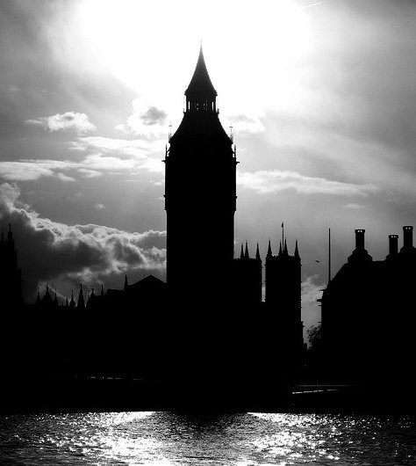
RTO/RPO
SLA
Budget
DR/BC Plan

Slide 61
Be prepared
I will do my best

Slide 62
B
C
P
S

Slide 63
Backups
Checks
Practice and preparation
Script and Schedule

Slide 64
Backups
Checks
Practice and preparation
Script and Schedule

Slide 65
Full Backups - Recommendations
Run as often as you can
Make at least two copies, one off the physical server
Make sure full backups files are physically separate from the data files.
  If you must, co-locate these with log files (.ldf)
  Be aware of your SAN/LUN structures
Monitor the backup file size growth over time
Restoring a full backup will often exceed your RTO, so be prepared to do this in advance on warm servers
Use COPY_ONLY for ad hoc backups
The mirrored backup option will fail both backups if one fails. DO NOT USE this. (SQL Backup does not fail the primary backup)
Compress Backups to save space/time
Do not append backups to one file. Use INIT and new files

Slide 66
Full Backups - Recommendations
Run as often as you can
Make at least two copies, one off the physical server
Make sure full backups files are physically separate from the data files.
  If you must, co-locate these with log files (.ldf)
  Be aware of your SAN/LUN structures
Monitor the backup file size growth over time
Restoring a full backup will often exceed your RTO, so be prepared to do this in advance on warm servers
Use COPY_ONLY for ad hoc backups
The mirrored backup option will fail both backups if one fails. DO NOT USE this. (SQL Backup does not fail the primary backup)
Compress Backups to save space/time
Do not append backups to one file. Use INIT and new files

Slide 67
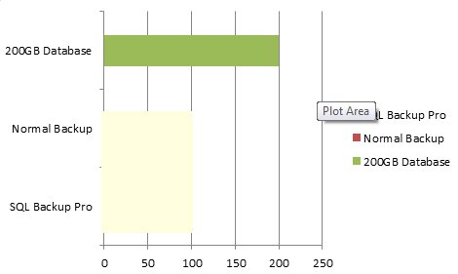
200GB File Size
Database Size

Slide 68
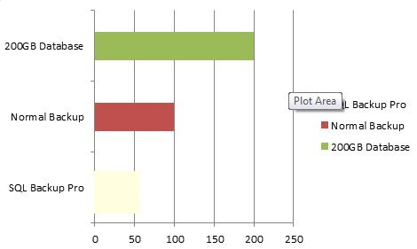
200GB File Size
100GB

Slide 69
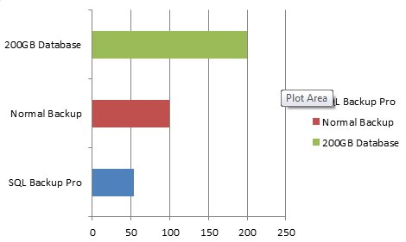
Database Size
Data Size
100GB
Compressed Data Size
54GB

Slide 70
Database Size
Data Size
54:13
Compressed Data Size
40:35

Slide 71
Use Compression
For more information, please visit the Red Gate stands in the lobby
Notes:
Show template, backup scheme set for fulls that I can use. Have two temples. Show the compression analyzer.

Slide 72
Use Compression
sp_estimate_data_compression_savings
Or ...
For more information, please visit the Red Gate stands in the lobby
Notes:
Show template, backup scheme set for fulls that I can use. Have two temples. Show the compression analyzer.

Slide 73
Log Backups - Recommendations
As often as possible to meet your RPO
Make at least two copies
Keep all log backups since the earliest full backup you have.
Make sure you monitor log size if you have database mirroring or replication running
Have a procedure for backing up the tail of the log
Keep log backups separate from the log

Slide 74
Differential Backups - Recommendations
Use these if you have a long interval between full backups
Use these if you have a lot of log backups between full backups
Do not delete log files between the last full backup and the last differential backup
Keep differential backups separate from data files (same as full backups)

Slide 75
File and Filegroup Backup Recommendations
Don’t mix filegroup backups with differential and full backups in an ad hoc manner. Use one or the other on an individual system.
Document that file backups are being performed.
Practice these restores as they are not a normal process for most DBAs.
Be careful of how you separate out tables and indexes. If you restore a partial data without indexes, will the system work?

Slide 76
Standby Servers
Extra servers that are available if the primary server goes down.
Used to help meet short RTO/RPO
Are kept in near up-to-date with data from the primary system
Can use any of these technologies
  clustering
  database mirroring
  log shipping
  replication
Hot (clustering, synchronous mirroring)
  Useful in complete system failure
  High bandwidth/connectivity requirements
Warm (asynchronous mirroring, log shipping, replication
  Useful for geographical separation
  Can help with load balancing in some situations (reporting or read-only data)
Cold (SQL Server installed, data in unknown condition)
  Useful if you have to consider recovering from one of many sites to a DR location.
  Useful if you have lots of primary servers and only need to recover a few of them.

Slide 77
The Backup Plan
Build system by system (or bucket by bucket)
Use RPO/RTO for each system to create the ideal plan
Balance the ideal with time constraints
Balance the ideal with resource (disk space) constraints
Keep as many backups as you can across time.
A hot/warm copy of the database can substitute for some backups, but not all.
Record and track backup sizes.
Continue to monitor over time as backup sizes will grow as data grows.
Buy storage in advance to meet your needs
Use third party tools to compress and/or encrypt backups

Slide 78
The Backup Plan
DO NOT USE the SSMS GUI to run backups. A manual process is doomed to fail.
Script and Schedule
  or script and run a job for add hoc backups
  SQL Backup Pro makes this easy across multiple instances
Document your plans
  Ensure all admins know about the backups
  Ensure at least one non-admin has the plan
Don’t forget server settings
  Version/patch levels
  Run book should have these
Don’t forget about backups of keys/certificates
  beware of TDE / SMK / DMK and copies of keys.

Slide 79
The Backup Plan
Get Backups offsite!
Make sure others know where the backups are, including at least one non-technical user
  They do not need to understand the details
  They do not need to know details (sealed envelopes)
Make sure others have access to offsite backups
  account names/numbers/passwords
Make sure that passwords/certificates are known/accessible to others
Encrypt / secure backups
Have a copy of your run book.

Slide 80
Backups
Checks
Practice and preparation
Script and Schedule

Slide 81
You cannot prevent corruption

Slide 82
Detect it as soon as possible

Slide 83
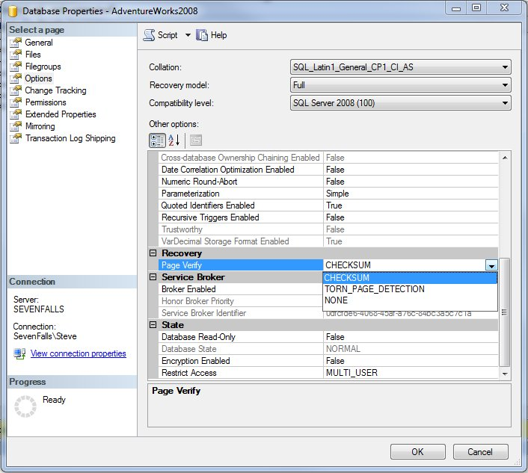
Detecting Corruption
ON EVERY DATABASE

Slide 84
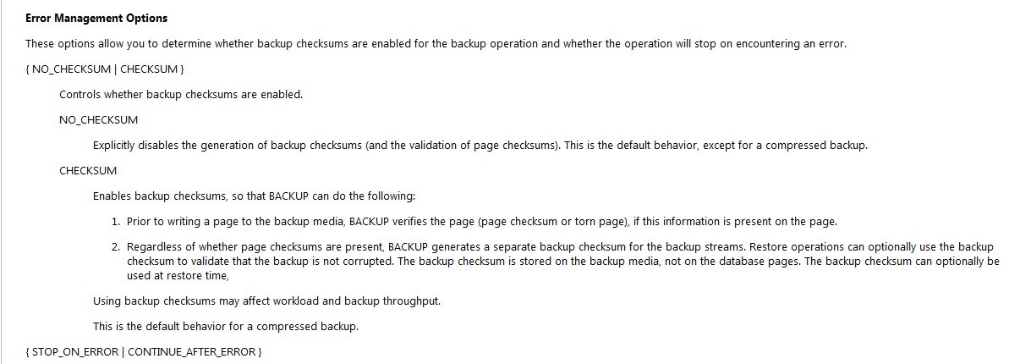
Detecting Corruption
ALWAYS use WITH CHECKSUM in backups
Stop/Continue after error according to your needs
ALERT someone ASAP on failures

Slide 85
DBCC CHECKDB

Slide 86
DBCC CHECKDB
DBCC is noted in the error log
Run as often as possible
Ideally run every day on every database
Very resource intensive, so…

Slide 87

DBCC CHECKDB using SQL Virtual Restore
For more information, please visit the Red Gate booths in the lobby

Slide 88
Backups
Checks
Practice and preparation
Script and Schedule

Slide 89
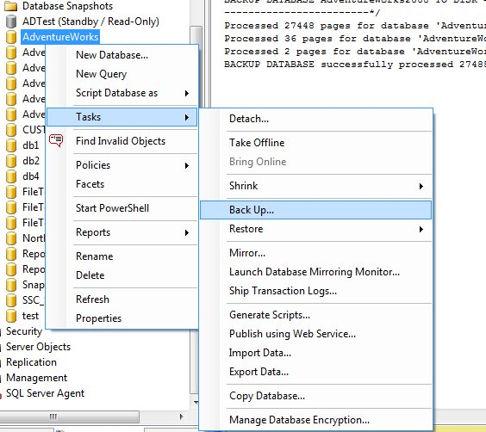
How many of you have seen this?

Slide 90
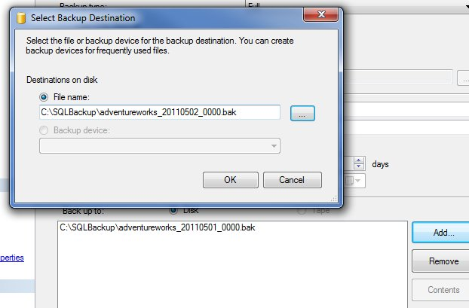

Slide 91
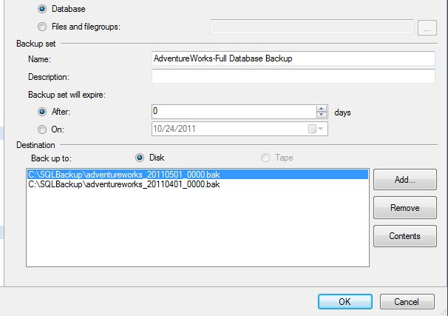

Slide 92
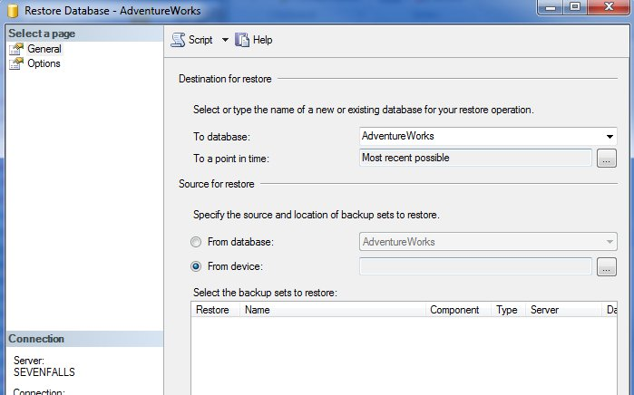
Or this during a restore?

Slide 93
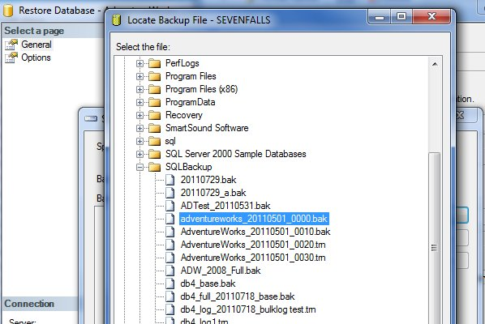

Slide 94
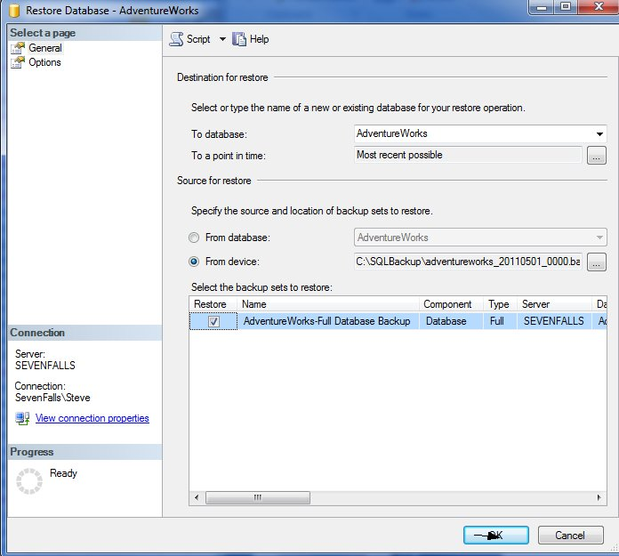

Slide 95
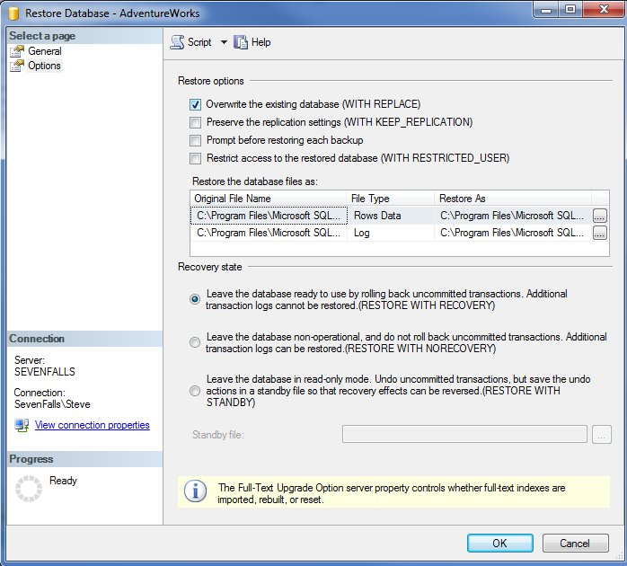

Slide 96
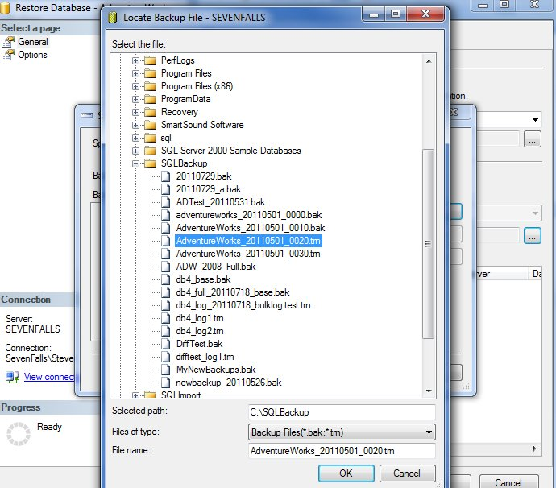

Slide 97
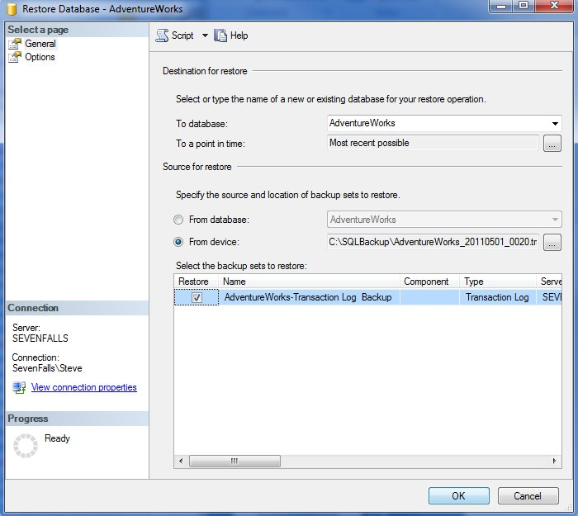

Slide 98
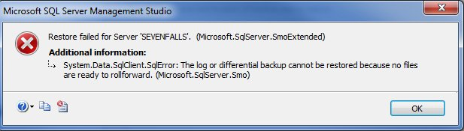

Slide 99
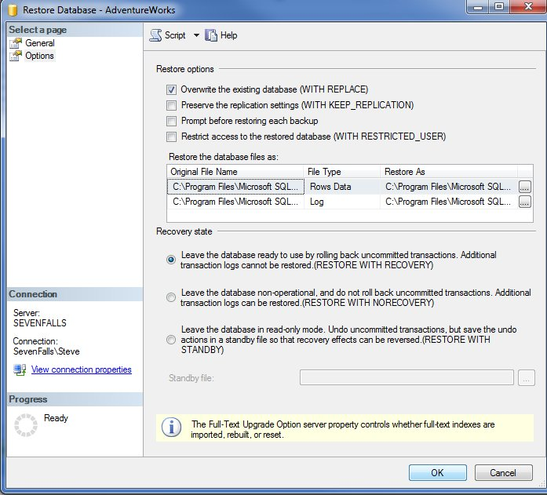

Slide 100
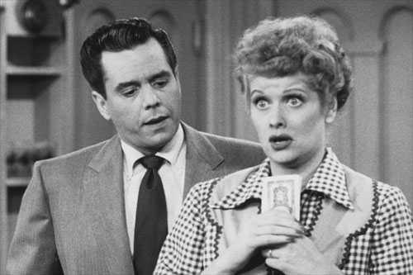

Slide 101
Run Book

Slide 102

Hopefully it isn’t like this

Slide 103
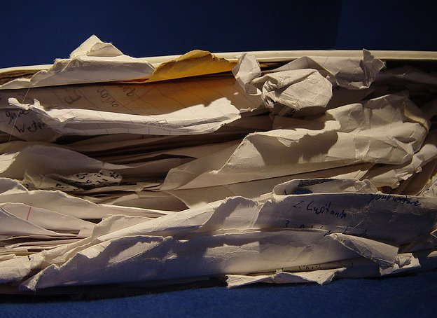

Slide 104
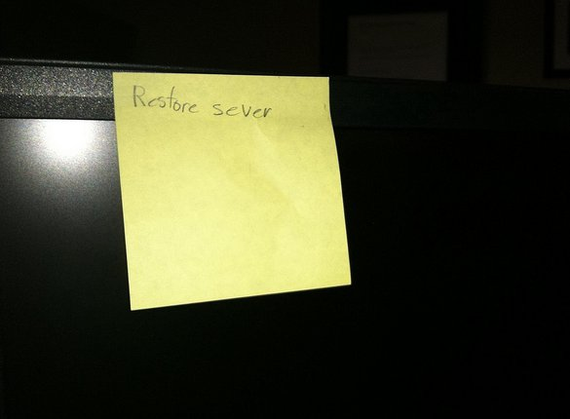

Slide 105
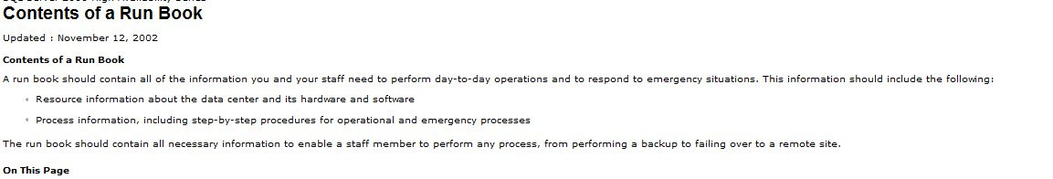
Run Book
The processes and procedures for day-to-day operations and emergency situation responses
Written by the most experienced person
Tested by the most junior person
Updated regularly
Offline (can be partially digital)
Secure
Image from http://technet.microsoft.com/en-us/library/cc917702.aspx

Slide 106
Run Book
Contains contact information
  For clients/customers/users
  vendors (software and services)
  warranty / support information
  Software keys / licenses
Priorities for systems
Up to date versions/settings
Processes for restoring service
Use checklists / outlines
  minimize details
  maximize information
Evolves over time, regularly.

Slide 107
Practice makes perfect

Slide 108
Practice Restoring Backups
Randomly perform restores regularly
More than once a year.
Make sure you test each media/device every month
Automate this if possible
On all servers, enable IFI
On warm servers, pre-allocate log files space (ldf)
Practice all types of restores you need
  Point in time
  Filegroup
  Marked transaction
ALWAYS RESTORE with NORECOVERY

Slide 109
Practice DR
Practice Object level recovery
Practice failovers to standby systems
Practice rolling back deployments
Practice configuring servers from scratch
Practice restoring encryption keys
Practice recovering media from storage
Practice installing SQL Server and applying patches

Slide 110
Backups
Checks
Practice and preparation
Script and Schedule

Slide 111
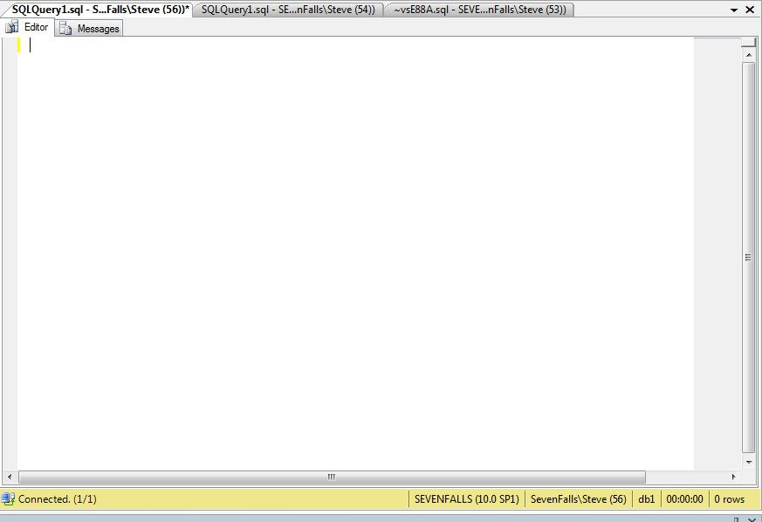
Restore database adventureworks from disk = ‘d:\dr\adventureworks_full_201104010001.bak’ with norecovery
Restore log adventureworks from disk = ‘d:\dr\adventureworks_log_201104010005.trn’ with norecovery
Restore log adventureworks from disk = ‘d:\dr\adventureworks_log_201104010010.trn’ with norecovery
Restore log adventureworks from disk = ‘d:\dr\adventureworks_log_201104010015.trn’ with norecovery
Restore log adventureworks from disk = ‘d:\dr\adventureworks_log_201104010020.trn’ with norecovery
Restore log adventureworks from disk = ‘d:\dr\adventureworks_log_201104010025.trn’ with norecovery
Restore log adventureworks from disk = ‘d:\dr\adventureworks_log_201104010030.trn’ with norecovery
Restore log adventureworks from disk = ‘d:\dr\adventureworks_log_201104010035.trn’ with norecovery
Restore log adventureworks from disk = ‘d:\dr\adventureworks_log_201104010040.trn’ with norecovery
Restore log adventureworks from disk = ‘d:\dr\adventureworks_log_201104010045.trn’ with norecovery
Restore log adventureworks from disk = ‘d:\dr\adventureworks_log_201104010050.trn’ with norecovery
Restore log adventureworks from disk = ‘d:\dr\adventureworks_log_201104010055.trn’ with norecovery
Restore log adventureworks from disk = ‘d:\dr\adventureworks_log_201104010100.trn’ with norecovery
Restore log adventureworks from disk = ‘d:\dr\adventureworks_log_201104010105.trn’ with norecovery
Restore log adventureworks from disk = ‘d:\dr\adventureworks_log_201104010110.trn’ with norecovery
Restore log adventureworks from disk = ‘d:\dr\adventureworks_log_201104010115.trn’ with norecovery
Restore log adventureworks from disk = ‘d:\dr\adventureworks_log_201104010120.trn’ with norecovery
Restore log adventureworks from disk = ‘d:\dr\adventureworks_log_201104010125.trn’ with norecovery
Restore log adventureworks from disk = ‘d:\dr\adventureworks_log_201104010130.trn’ with norecovery
Restore log adventureworks from disk = ‘d:\dr\adventureworks_log_201104010135.trn’ with norecovery
Restore log adventureworks from disk = ‘d:\dr\adventureworks_log_201104010140.trn’ with norecovery
Restore log adventureworks from disk = ‘d:\dr\adventureworks_log_201104010145.trn’ with norecovery
Restore log adventureworks from disk = ‘d:\dr\adventureworks_log_201104010150.trn’ with norecovery
Restore log adventureworks from disk = ‘d:\dr\adventureworks_log_201104010155.trn’ with norecovery

Slide 112
Automation

Slide 113
Script and Schedule
Use Scripts
Use SQL Agent or another scheduler
Use third party tools like SQL Backup Pro
Use monitoring to alert you to failures (like SQL Monitor)
Learn to use the Script button

Slide 114
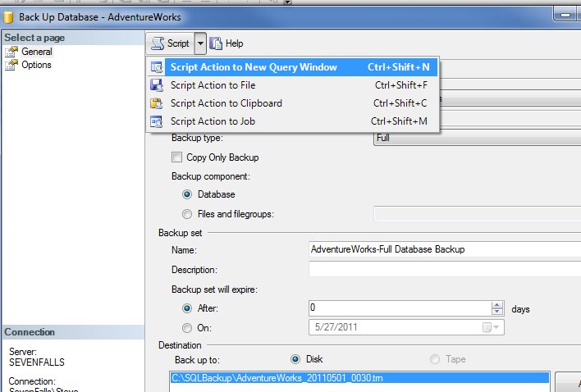

Slide 115
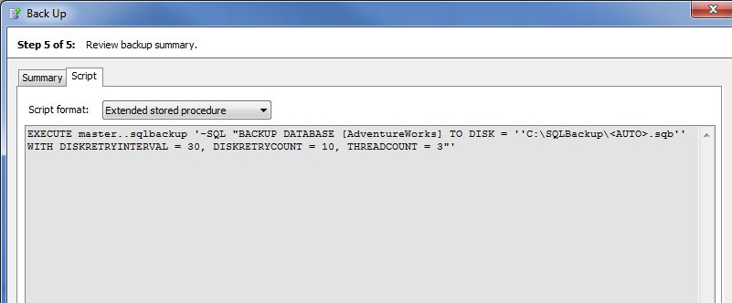
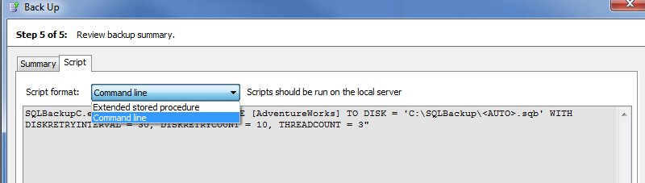
SQL Backup Pro

Slide 116
Script and Schedule
Script and schedule backups
Script and schedule configurations
  Preferably with the backups
Build a script library for yourself
  Restore a series of files
  Backup scripts
  Key backup and restore
  Configuration information
Keep your library available3
  USB Flash
  SQLServerCentral Briefcase
  Dropbox/Live Mesh/Box.net/etc

Slide 117
Whoops Disasters

Slide 118
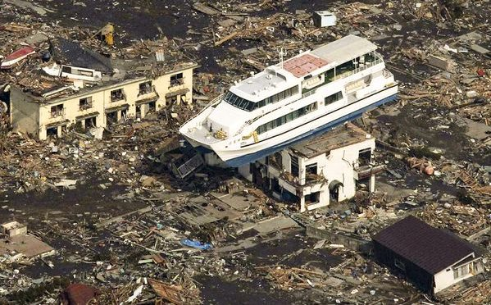

Slide 119
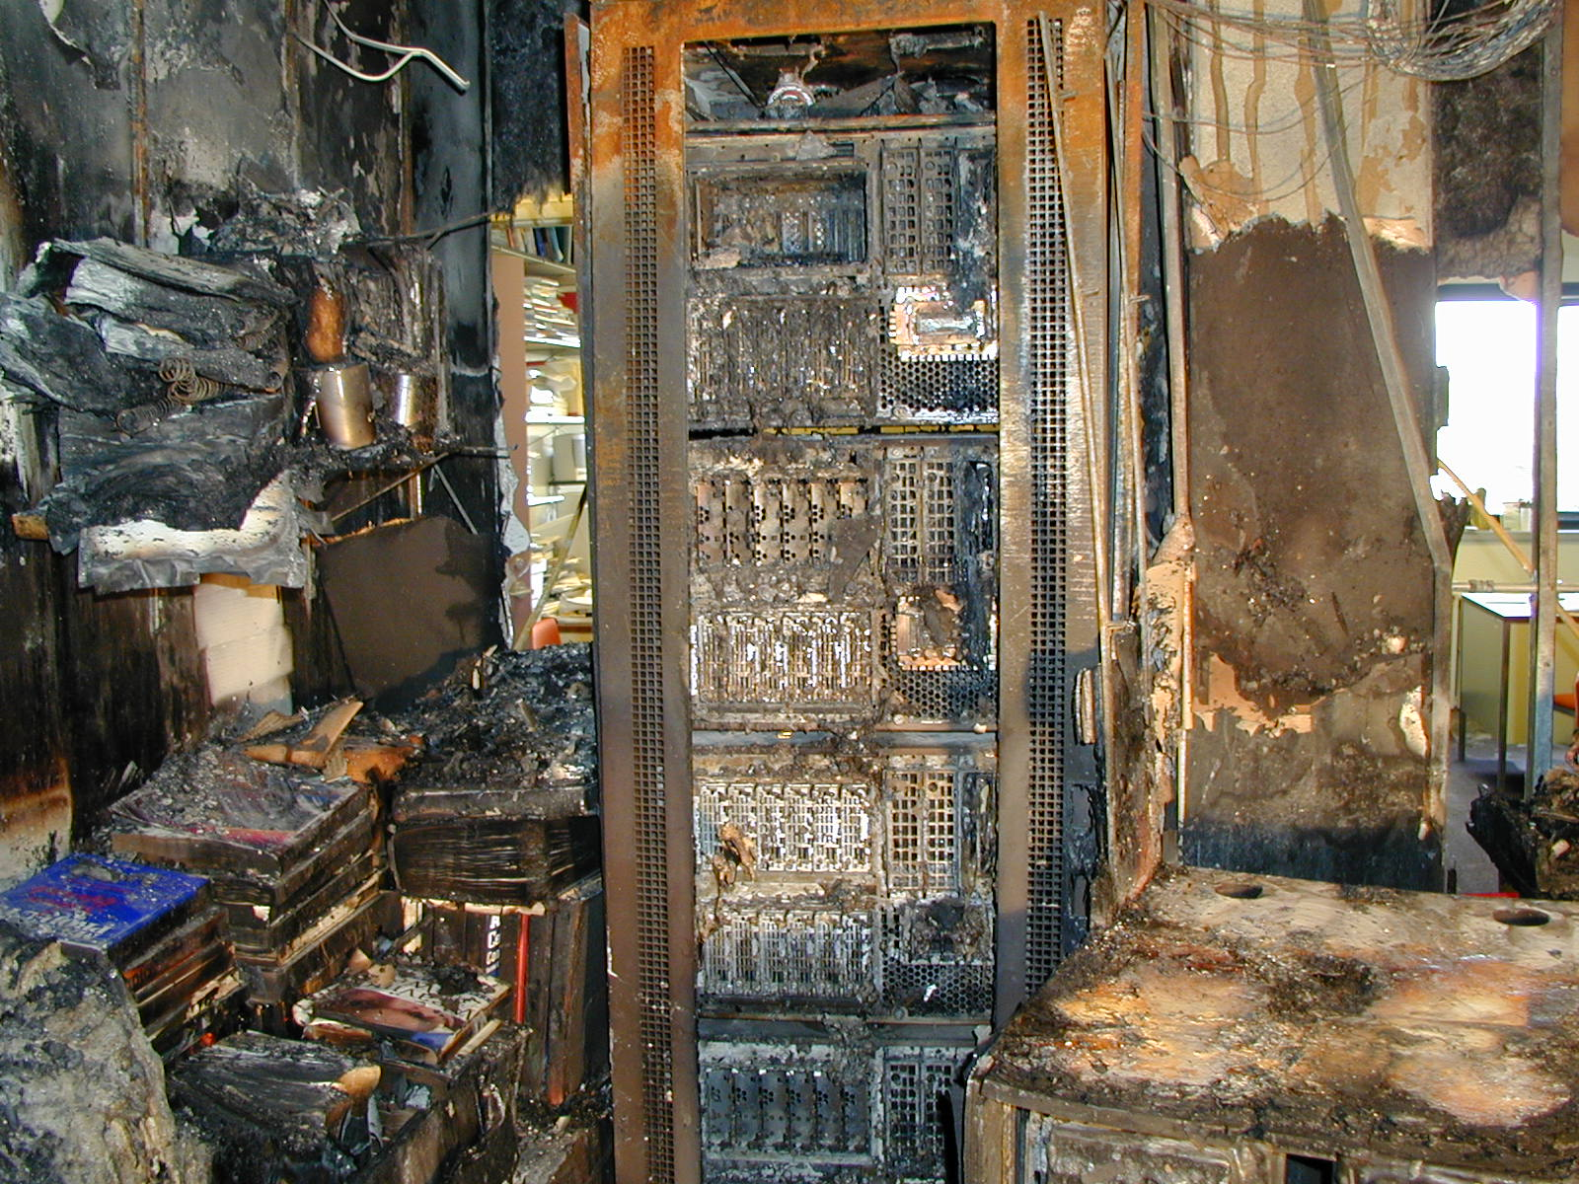

Slide 120
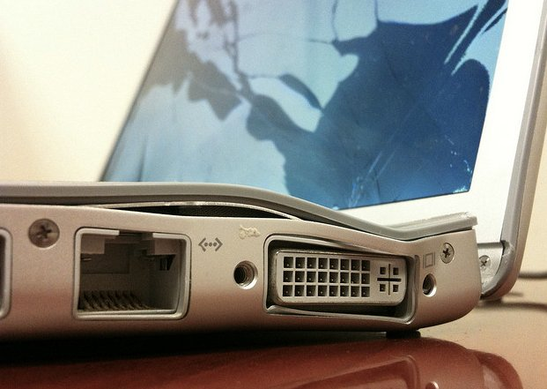
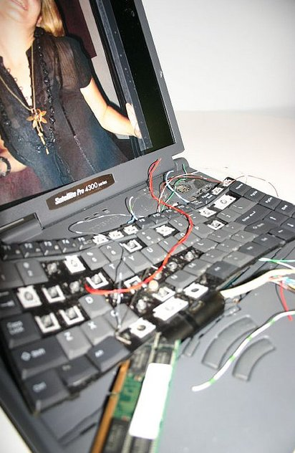

Slide 121
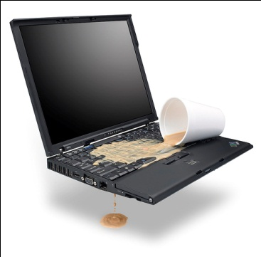

Slide 122
Whoops Disasters
Log Shipping on a delay
Database Snapshots (for scheduled changes)
Auditing/Tracking (bespoke/custom, CDC, Change Tracking)
Log Readers
Virtual Restore/Data Compare
Many third party backup tools can handle object level restore (Data Compare, SQL Virtual Restore, Red Gate Object Level Recovery)

Slide 123
Things To Do
Define RTO/RPO for all systems
Build an SLA that works with your budget
Have a backup plan that allows you to meet your SLA/RTO/RPO
Enable IFI
Pre-allocate transaction log on warm/standby servers
Keep backup files separate from data
Run DBCC as often as possible
Ensure all databases have Page Checksums set in the database options
Ensure that you use checksum with your backups
Practice, practice, practice, especially junior people
Document your run book offline
BCPS

Slide 124
Be prepared
I will do my best

Slide 125

The End
Questions?
Feel free to send notes/questions/comments to sjones@sqlservercentral.com

Slide 126
References
Ola Hallengren’s SQL Server 2005 & 2008 - Backup, Integrity Check & Index Optimization - http://www.sqlservercentral.com/scripts/Backup+%2f+Restore/62380/
Michelle Ufford’s Index Defrag - http://sqlfool.com/2010/04/index-defrag-script-v4-0/
Understanding SQL Server Backups - http://technet.microsoft.com/en-us/magazine/2009.07.sqlbackup.aspx
Full File Backups - http://msdn.microsoft.com/en-us/library/ms189860%28v=SQL.105%29.aspx
Paul Randal’s Corruption Posts - http://www.sqlskills.com/BLOGS/PAUL/category/Corruption.aspx
BACKUP - http://msdn.microsoft.com/en-us/library/ms186865.aspx
RESTORE - http://msdn.microsoft.com/en-us/library/ms186858.aspx
RTO - http://en.wikipedia.org/wiki/Recovery_time_objective
RPO - http://en.wikipedia.org/wiki/Recovery_point_objective
Run Book - http://en.wikipedia.org/wiki/Runbook
What is a Runbook? - http://bwunder.com/SQLRunbook.aspx

Slide 127
References
Backing Up and Restoring Databases in SQL Server (BOL) - http://msdn.microsoft.com/en-us/library/ms187048%28v=SQL.100%29.aspx
Proven SQL Server Architectures for High Availability and Disaster Recovery
Partial Database Availability & Online Piecemeal Restore (video)
Designing an Availablity Strategy (video)
SQL Backup Pro - http://www.red-gate.com/products/dba/sql-backup/
SQL Data Compare - http://www.red-gate.com/products/sql-development/sql-data-compare/
SQL Virtual Restore - http://www.red-gate.com/products/dba/sql-virtual-restore/
Mirrored Backup Fails (Item 30-12) - http://www.sqlskills.com/BLOGS/PAUL/category/Database-Mirroring.aspx
Backup SMK - http://technet.microsoft.com/en-us/library/aa337561.aspx
Restore SMK - http://technet.microsoft.com/en-us/library/aa337510.aspx
Backup DMK - http://technet.microsoft.com/en-us/library/aa337546.aspx
Restore DMK - http://technet.microsoft.com/en-us/library/aa337511.aspx
TDE and Keys - http://www.bradmcgehee.com/2008/09/sql-server-2008-transparent-data-encryption/

Slide 128
Image credits
Boy Scout Emblem: http://www.scouting.org/
XBOX Red Ring of Death: http://www.flickr.com/photos/esasse/1527535844/
Clean Room: http://www.flickr.com/photos/brookhavenlab/3119988763/
Emergency Room: http://www.flickr.com/photos/andrewbain/521869846/
Floppy disks : http://www.flickr.com/photos/fdecomite/4963106794/
Prince 1999: http://www.prince.org
You’re Fired: http://www.flickr.com/photos/liam-manic/3428068335/
Car accident: http://www.flickr.com/photos/27248028@N02/2574613540/
Big Ben: http://www.flickr.com/photos/mrgiles/179848691/
Run Book: http://www.flickr.com/photos/acaben/11518666
Run Book 2: http://www.flickr.com/photos/wysz/50915075/

