Slide 1
The Top Ten SQL Server Skills You Need
Steve Jones
Editor
SQLServerCentral / Red Gate Software

Slide 2
Agenda
Intro
Perform a Backup
Restore a Database
Setup Security
Join Tables Together
Create an Index
Run Database Maintenance
Schedule a Job
Send an Email from SQL Server
Import Data
Search BOL

Slide 3
Intro
The 80/20 rule
Most of your job will take very basic skills.
  Polish those skills
Don’t ignore the 20%
  Improve your skills
Keys to most of your job:
  Know Defaults
  Use Defaults
  Modify as Needed

Slide 4
Intro
The 80/20 rule
Most of your job will take very basic skills.
  Polish those skills
Don’t ignore the 20%
  Improve your skills
Keys to most of your job:
  Know Defaults
  Use Defaults
  Modify as Needed

Slide 5
Agenda
Intro
1. Perform a Backup
2. Restore a Database
3. Setup Security
4. Join Tables Together
5. Create an Index
6. Run Database Maintenance
7. Schedule a Job
8. Send an Email from SQL Server
9. Import Data
10. Search BOL
Questions

Slide 6
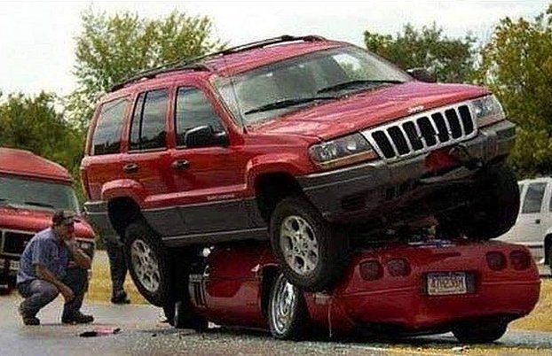
1. Backups
Backups are insurance
Most backups are never used
This is the first thing you should do for any new database

Slide 7
1. Backups
Know Recovery Models
  Simple/Bulk-Logged/Full
  If you don’t know, use the Full Recovery Model
  Full requires log backups

Slide 8
Full Backup
  All data in the database, and enough log to ensure a consistent database
  Backup is at the point in time of the completion of the data reading portion of the database.
    Backup starts at T1
    Data read (and write) is complete at T2
    All log records from T1 to T2 are then written to the backup file. Perhaps some records from pre-T1
    Backup completes at T3
    Backup is consistent at T2
Read all data in the database
Read log records from T1 to T2
Time
T1
T2
T3

Slide 9
1. Backups
Log Backups
  Needed in Full and bulk-logged recovery models
  Include all log records since the last log backup
    NOT the last full backup
  Log backups allow log space to be reused
  Simple command
    BACKUP LOG

Slide 10
1. Backups
There are other backup types
  Differential
    NOT incremental.
    All changes since the last full backup
  File and Filegroup backups
  Tail Log backup
Learn how these work if you need to.

Slide 11
1. Backups
The 80/20 Rule
  Schedule Full backups (once/day)
  Schedule Log backups (once/hour)
Keep as many backups as you can (given space)
Keep ALL log backups since your earliest full backup
Make sure you backup keys and certificates
  Backup Service Master Key
  Backup Database Master Key
  Backup Certificates

Slide 12
1. Backups
Backup before AND after changes.
  Backup before updates
  Backup before patches
  Backup before application changes
  Backup after restores (especially in DR)
  Backup after large data loads
Backup when you can

Slide 13
Agenda
Intro
1. Perform a Backup
2. Restore a Database
3. Setup Security
4. Join Tables Together
5. Create an Index
6. Run Database Maintenance
7. Schedule a Job
8. Send an Email from SQL Server
9. Import Data
10. Search BOL
Questions

Slide 14
2. Restores
Needed to recover data
Restores return data from a backup file to a usable database
You may never need to do this for primary databases in full.
Be Prepared

Slide 15
2. Restores
Restore a full database
  Recovers to a point in time during the full backup.
Restore log backups
  Restores to any point in time between full backups.
Restore Differentials
  Allow less log restores to be required
  DOES NOT allow for log backups to be deleted

Slide 16
2. Restores
Always use NORECOVERY
  RESTORE DATABASE MyDB WITH RECOVERY
Always use scripts/T-SQL
  GUI allows for more mistakes
Build a script library to manage restores
  Automated T-Log Restore (from www.sqlservercentral.com

Slide 17
2. Restores
Demo
  Restore full backup
  Restore log backup

Slide 18
2. Restores
Restores are stressful
Restores impact availability
You really want these to be smooth
Practice, practice, practice
  Restore full backup
  Restore log backup
  Restore differential backup
  Restore system databases
  Restore objects (native or third party tools)
  Restore Keys/certificates
  Restore to a new server
  Restore users/logins (and fix orphans)
  Restore backup headers
  Restore to new files/paths

Slide 19
Agenda
Intro
1. Perform a Backup
2. Restore a Database
3. Setup Security
4. Join Tables Together
5. Create an Index
6. Run Database Maintenance
7. Schedule a Job
8. Send an Email from SQL Server
9. Import Data
10. Search BOL
Questions

Slide 20
3. Setup Security
Security is important for today’s data
  By default, users have no access
Two aspects to security setup
  Add principals for server/database access
  Grant rights for object access
SQL Server
Instance
Database
Principal
Role
Client Account
Object (Table, view, stored procedure, etc)
Permissions

Slide 21
3. Setup Security
Add logins to the server
  Optionally grant server roles (rarely)
Map logins to users in a database
  A login does not have rights to a database automatically
  Set a default database to one the login has a user mapping
Group users into roles
  Database pre-defined
  User-defined
  Always use roles

Slide 22
3. Setup Security
Grant rights to objects
  Always grant rights to roles
    Or schemas, if you are advanced
  Use GRANT to add permissions
  Use REVOKE to remove permissions
    Not DENY
  Use DENY if you have conflicting permissions
  Users/Roles have no rights by default to any objects

Slide 23
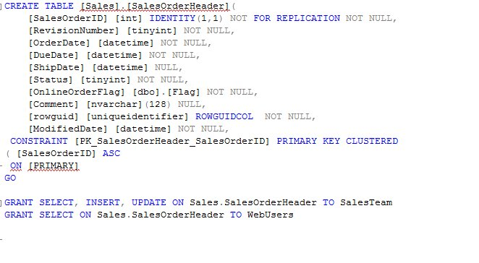
3. Setup Security
Principle of Least Privilege
  DO NOT just grant sysadmin, db_owner, or other privileged roles
Store permissions with object scripts

Slide 24
3. Setup Security
Demo
  Add login
  Add user
  Add role
  Grant permissions

Slide 25
Agenda
Intro
1. Perform a Backup
2. Restore a Database
3. Setup Security
4. Join Tables Together
5. Create an Index
6. Run Database Maintenance
7. Schedule a Job
8. Send an Email from SQL Server
9. Import Data
10. Search BOL
Questions

Slide 26
4. Join Tables Together
People seem to want their data out of the database
Needed for quick checks of client applications
Often get ad hoc requests for data
Learn basic T-SQL
  SELECT
  INNER JOIN
  OUTER JOIN
  WHERE
  ORDER BY
  GROUP BY

Slide 27
4. Join Tables Together
JOINs are essentially the intersection of data from basic schooling.
A
B
C D
E
F G
H
I
A
B
C D
E
F G
H
I

Slide 28
4. Join Tables Together
Common data
A
B
C D
E
F G
H
I
Z
G
Y D
J
F M
B
V
B, D, F, G

Slide 29
4. Join Tables Together
G K S
Z
G
Y D
J
F M
B
V
A
B
C D
E
F G
H
I
G

Slide 30
4. Join Tables Together

Slide 31
4. Join Tables Together
SELECT
  list of columns or fields you need returned
FROM
  Tables (or views/functions) containing the data
INNER JOIN
  Matching rows from both tables
WHERE (or ON clause)
  Limitations on which data is returned
  This is where SQL Server does the work of removing unwanted information
ORDER BY
  SQL Server has no ordering of rows. Ever.
  Specify an order if you need one.

Slide 32
4. Join Tables Together
Outer JOIN
  All rows from one table, only data in matching rows from both tables.
  NULLs in non-matching rows
GROUP BY
  User with Aggregates (SUM, MIN, MAX, etc)
  Uses a HAVING clause to restrict data (similar to WHERE)
Practice, practice, practice

Slide 33
4. Join Tables Together
Demo

Slide 34
Agenda
Intro
1. Perform a Backup
2. Restore a Database
3. Setup Security
4. Join Tables Together
5. Create an Index
6. Run Database Maintenance
7. Schedule a Job
8. Send an Email from SQL Server
9. Import Data
10. Search BOL
Questions

Slide 35
5. Create an Index
Indexes allow you to find data. Fast.
Not created by default
  Except for PKs
Can be
  Ascending
  Descending
  clustered (1 per table)
  Nonclustered (many per table)
  Multiple columns
  Unique (or non-unique)
  Different granularities (spatial)

Slide 36
5. Create an Index
One place you can use SSMS
Defaults not always good
Multiple column indexes are good
Create one, test performance, create another if needed
Stick to 3-6 indexes for most tables

Slide 37
5. Create an Index
DEMO
  Create an index
  Alter an index
  Set Primary Key

Slide 38
Agenda
Intro
1. Perform a Backup
2. Restore a Database
3. Setup Security
4. Join Tables Together
5. Create an Index
6. Run Database Maintenance
7. Schedule a Job
8. Send an Email from SQL Server
9. Import Data
10. Search BOL
Questions

Slide 39
6. Database Maintenance
Index management
Corruption Detection
Space management

Slide 40
6. Database Maintenance
Index management
  ALTER INDEX WITH REBUILD (replaces DBCC DBREINDEX)
  ALTER INDEX WITH REORGANIZE (replaces DBCC INDEXDEFRAG)
Rebuild requires more resources, quicker.
Reorganize uses minimal resources (online), takes longer.
Statistics are updated with index rebuilds
  Large data changes may require you to UPDATE STATISTICS manually or with a job
  Use AUTO UPDATE STATISTICS/AUTO CREATE STATISTICS

Slide 41
6. Database Maintenance
Corruption Detection
  DBCC CHECKDB
  Page Checksums
  Backup with Checksum
You cannot prevent corruption
  Detect as soon as possible
Ideally run every day
If resources are in issue, run on a copy of your database
  Tests restores as well

Slide 42
6. Database Maintenance
Space Management
  Proactively add space to databases
  Demo
DO NOT SHRINK (regularly)
  Rare operation
  If you need more space, get more space.

Slide 43
Agenda
Intro
1. Perform a Backup
2. Restore a Database
3. Setup Security
4. Join Tables Together
5. Create an Index
6. Run Database Maintenance
7. Schedule a Job
8. Send an Email from SQL Server
9. Import Data
10. Search BOL
Questions

Slide 44
7. Schedule a Job
SQL Server Agent is your friend
Scheduler that can handle many tasks for the DBA
  T-SQL commands
  ActiveX commands
  PowerShell scripts
  OS commands (command prompt)
  Replication jobs
  SSIS/SSAS tasks
  more

Slide 45
7. Schedule a Job
Flexible Scheduling
  Multiple schedules possible for a job
  Recurring / ending
  Granularity is 1 sec
  Can include retries
Flexible Ordering of steps
Jobs are not reentrant
  If previous execution is still running, the next scheduled iteration will not run.
Notification of Failure/Success
  Don’t notify on success

Slide 46
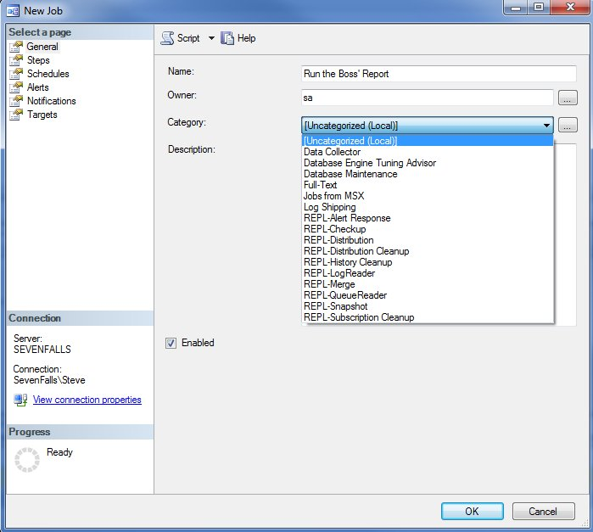
7. Schedule a Job

Slide 47
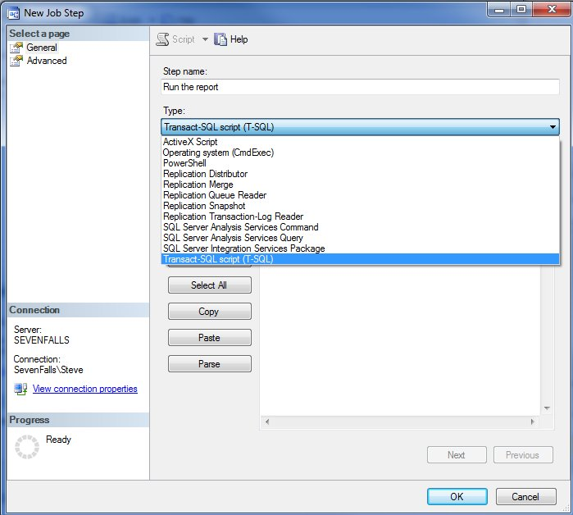
7. Schedule a Job

Slide 48
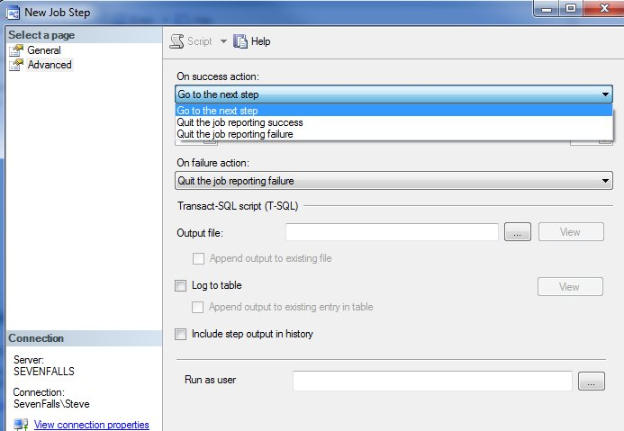
7. Schedule a Job

Slide 49
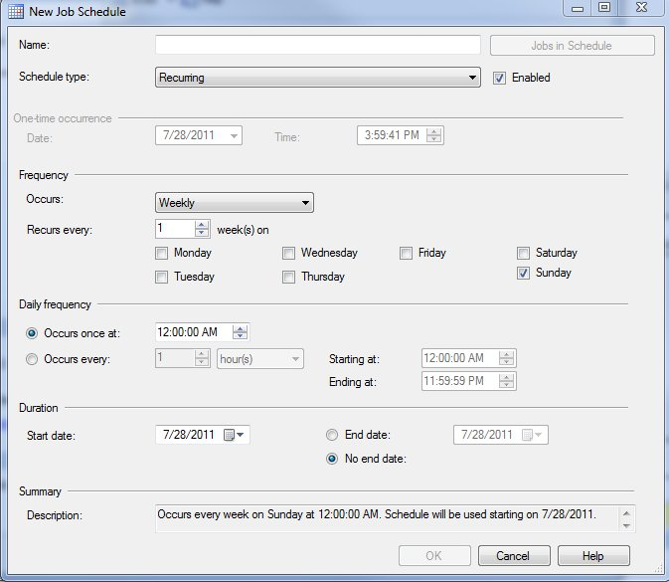
7. Schedule a Job

Slide 50
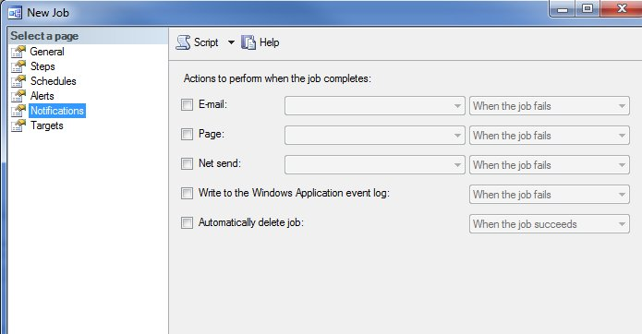
7. Schedule a Job

Slide 51
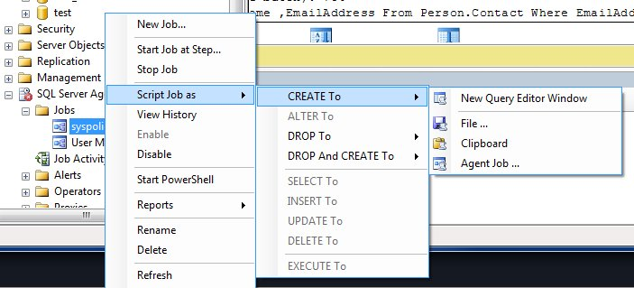
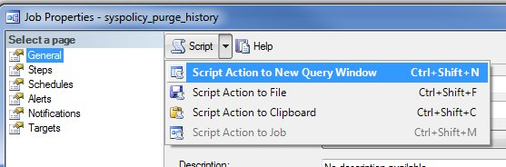
7. Schedule a Job
Backup/Restore
  Learn to script jobs
  Backup/restore jobs from MSDB

Slide 52
Agenda
Intro
1. Perform a Backup
2. Restore a Database
3. Setup Security
4. Join Tables Together
5. Create an Index
6. Run Database Maintenance
7. Schedule a Job
8. Send an Email from SQL Server
9. Import Data
10. Search BOL
Questions

Slide 53
8. Send an Email from SQL Server
Database Mail
  Enterprise class mail subsystem
  SMTP mail compliant
  Multiple profiles possible

Slide 54
8. Send an Email from SQL Server
Always Enable Database Mail
ALWAYS use a separate account for each server (use the instance name)
If possible, use an Exchange group for notifications
  Handles vacations
  multiple notifications
  Changing jobs
There is a configuration wizard
  Need email account information from postmaster

Slide 55
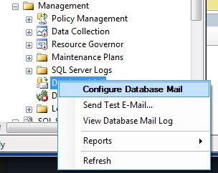
8. Send an Email from SQL Server

Slide 56
8. Send an Email from SQL Server
Enable failure alerts for jobs
  Avoid success alerts
Enable error log alerts
Enable performance alerts
  Disk space at a minimum
  Log % full at a minimum
Send email from applications
  Sp_send_dbmail

Slide 57
Agenda
Intro
1. Perform a Backup
2. Restore a Database
3. Setup Security
4. Join Tables Together
5. Create an Index
6. Run Database Maintenance
7. Schedule a Job
8. Send an Email from SQL Server
9. Import Data
10. Search BOL
Questions

Slide 58
9. Import Data
Import (and export) wizards use SSIS
Allow data to/from various providers:
  ODBC (.NET)
  Oracle (.NET)
  SQL Server (.NET)
  Flat File
  Access
  Excel
  Office 12 Access
  SSAS v9/10 (OLEDB)
  Data Mining Services (OLEDB)
  OLAP Services 1.0 (OLEDB)
  Oracle (OLEDB)
  Search (OLEDB)
  SQL Server (OLEDB)
  SQL Server Native Client 1.0

Slide 59
9. Import Data
You will be asked to ad hoc import data
  Usually from Excel
You will be asked to export data on an ad hoc basis
  Usually to Excel
Exports usually need some T-SQL
  If an application produces this data, think about using Trace/Profiler to capture the T-SQL.
Save as an SSIS package
  If you will repeat this
  If you want to learn more about SSIS

Slide 60
9. Import Data
Wizard Demo

Slide 61
Agenda
Intro
1. Perform a Backup
2. Restore a Database
3. Setup Security
4. Join Tables Together
5. Create an Index
6. Run Database Maintenance
7. Schedule a Job
8. Send an Email from SQL Server
9. Import Data
10. Search BOL
Questions

Slide 62
10. Search Books Online
Know what this is.
  Should be installed on all workstations
  Know online links
Know how to search for information
This includes more than just searching BOL
  The idea is that you can find information (relatively) quickly
  Can include Google/Bing/Yahoo, however you must know how to separate good information from bad
  Can include other sites like SQLServerCentral

Slide 63
10. Search Books Online
Don’t forget about Forums (MSDN, SQLServerCentral, etc)
  Posting a question and getting an answer is a valid way to solve problems
  Know how to check/research information.
Have a series of bookmarks /briefcase links.
  This is your library of information.
  Common problems solved/scripts used
  Think about a flash drive/cloud drive/IE or FF common links saved.

Slide 64
Review
Perform a Backup
Restore a Database
Setup Security
Join Tables Together
Create an Index
Run Database Maintenance
Schedule a Job
Send an Email from SQL Server
Import Data
Search BOL

Slide 65
Review
The 80/20 Rule
  Learn these skills at medium level
  Be able to handle 80% of your job from knowledge or memory
  Research and continue to learn in order to handle the 20% that is unusual or hard.

Slide 66
Questions
www.sqlservercentral.com/forums
@Way0utwest (twitter)
Linked In Discussions (SQLServerCentral group)
Google Plus

Slide 67

Complete the Evaluation Form to Win!
Win a Dell Mini Netbook – every day – just for handing in your completed form. Each session evaluation form represents a chance to win.
Pick up your evaluation form:
  In each presentation room
  Online on the PASS Summit website
Drop off your completed form:
  Near the exit of each presentation room
  At the Registration desk
  Online on the PASS Summit website
Sponsored by Dell

Slide 68
Thank you
for attending this session and the
2011 PASS Summit in Seattle

Slide 69
References
1. Backups
  Backup (T-SQL)
  Recovery Model Overview
  Choosing a Recovery Model
  Working with Transaction Log Backups
  Create a Full Backup (HOW TO)
  Create a Log Backup (HOW TO)
  Security Considerations for Backup and Restore
  Tail-Log Backups
  Backup Service Master Key
  Backup Database Master Key
  Backup Certificates
  When Do You Take a Full Backup? (blog)
  Two Types of Tail Log Backups (blog)
  #1 Skill Needed – Backups (blog)

Slide 70
References
2. Restore a Database
  RESTORE (T-SQL)
  Restore a full backup (How to)
  Restore a log backup (How to)
  Restore a Differential backup (How to)
  Restore file backups (How to)
  Working with Transaction Log Backups
  RESTORE MASTER KEY
  RESTORE SERVICE MASTER KEY
  CREATE CERTIFICATE
  Considerations for Restoring the master Database
  #2 Skill – Performing a Restore (blog)

Slide 71
References
3. Setup Security
  Principals (Database Engine)
  Database-Level Roles
  Permissions of Fixed Database Roles (Database Engine)
  Password Policy
  Permissions (Database Engine)
  CREATE LOGIN (Transact-SQL)
  CREATE ROLE (Transact-SQL)
  GRANT (Transact-SQL)
  REVOKE (Transact-SQL)
  DENY (Transact-SQL)
  SQL Server Encryption
  sys.fn_my_permissions (Transact-SQL)

Slide 72
References
4. Join Tables Together
  SELECT (T-SQL)
  WHERE (Transact-SQL)
  ORDER BY Clause (Transact-SQL)
  GROUP BY Clause (Transact-SQL)
  Search Condition (Transact-SQL)
  INNER JOIN
  OUTER JOIN
5. Create an Index
  Creating Indexes (Database Engine)
  Index Basics
  Create Index
  Alter Index
  Creating Unique Indexes

Slide 73
References
6. Database Maintenance
  ALTER INDEX WITH REBUILD (replaces DBCC DBREINDEX)
  ALTER INDEX WITH REORGANIZE (replaces DBCC INDEXDEFRAG)
  UPDATE STATISTICS (Transact-SQL)
  Using Statistics to Improve Query Performance
  DBCC CHECKDB
  A SQL Server DBA myth a day: (9/30) data file shrink does not affect performance
  Why you should not shrink your data files
  Importance of data file size management
  Managing the Size of the Transaction Log File
  How to: Shrink a File (SQL Server Management Studio)
7. Schedule a Job
  Create a SQL Server Agent Job (How to)
  Configuring SQL Server Agent
  Using the SQL Server Agent Error Log
  Scheduling SQL Server Agent Jobs

Slide 74
References
7. Schedule a Job
  Using Performance Objects
  Creating and Attaching Schedules to Jobs
  Specifying Job Responses
  Scripting Jobs Using Transact-SQL
8. Send an email from SQL Server
  Stairway to SQL Server Agent - Level 4: Configuring Database Mail
  Setting Up Database Mail - SQL School Video
  Customizable Error Log Scanning
  Automate Monitoring SQL Server Error Logs with Email Alerts
  SQL Server Alerts: Soup to Nuts
  How to: Notify an Operator of Job Status
  Sp_send_dbmail

Slide 75
References
9. Import Data
  Using the SQL Server Import and Export Wizard to Move Data
  Exporting SQL Server Data to Excel (SQL Server Video)
  How to: Run the SQL Server Import and Export Wizard
  Creating Packages Using the SQL Server Import and Export Wizard
  Choose a Data Source (SQL Server Import and Export Wizard)
  Choose a Destination (SQL Server Import and Export Wizard)
10. Search Books Online
  Start Page on MSDN
  Getting Started with SQL Server Books Online
  SQLServerCentral Search
  SQLServerCentral Forums

