Slide 1
Adopting a DevOps Process for Your Database
Steve Jones
Advocate/Editor
Redgate Software/SQL Server Central

Slide 4
Three Takeaways
The database can be built*
The database can be tested*
The database can be released*
* like other software
Notes:
This should be at the beginning and end of your presentation: What are the three talking points your audience should be able to answer after this presentation?

Slide 5
Agenda
Who am I?
Principles of DevOps
The DevOps Software Development Pipeline
Evolving Database Development

Slide 6
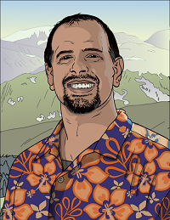



30 years SQL Server data experience
DBA, developer, manager, writer, speaker in a variety of companies and industries
Founder, SQLServerCentral
And current editor, with the goal of helping you learn to be a better data professional every day
Steve Jones
Advocate, Redgate Software
Editor, SQLServerCentral
14 year Microsoft Data Platform MVP
I am honored to be recognized by Microsoft for the last decade as an MVP
/in/way0utwest
@way0utwest
www.voiceofthedba.com
Notes:
steve

Slide 7
What is DevOps?
Grew out of the Agile movement
Velocity ‘09 – 10+ Deploys Per Day: Dev and Ops Cooperation at Flickr
Is not Agile (or Scrum or Lean or Kanban)
Is an amalgamation of various ideas and principles that describe how to better build software.

Slide 8
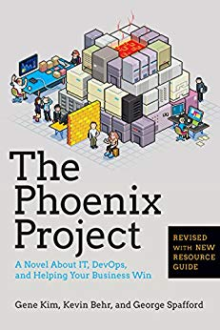

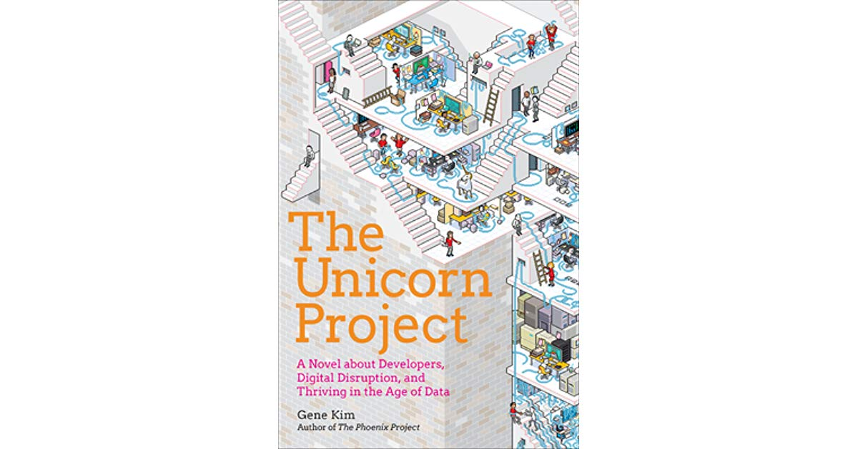
The Three Ways
Principles underlying DevOps from Gene Kim
  Systems Thinking (Flow)
  Amplify Feedback Loops
  Culture of Experimentation and Learning

Slide 9
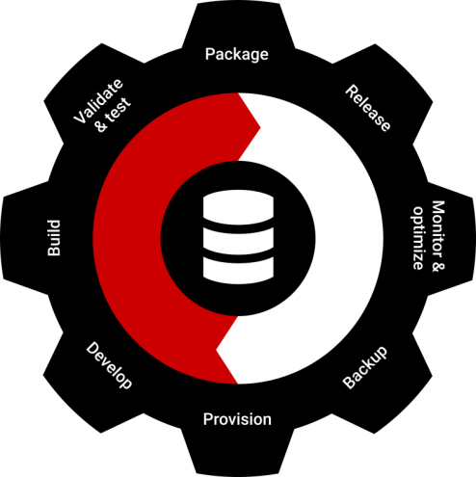
What is DevOps?
“DevOps is the union of people, process, and products to enable continuous delivery of value to our end users.”
- Donovan Brown

Slide 10
DevOps in Practice
Culture
  DBAs and developers and others working together
Automation
  Introduce tools to the database
Lean
  make db changes simpler, evolve the db
Measurement
  consider impact of db change
Sharing
  understand how a db change impacts development and operations
  Culture - DBAs and developers (and others) working together
  Automation - Introduce tools to the database
  Lean - make db changes simpler, evolve the db
  Measurement - consider impact of db change
  Sharing - understand how a db change impacts development and operations

Slide 11



The Application Development Pipeline
Development
Operations
Continuous integration
QA
Build
Production
Trigger
Test
Staging
Report
Sync
Beta
Publish
Artifact repository

Slide 12

The Database Development Pipeline
Development
Operations
Continuous integration
QA
Build
Production
Trigger
Test
Shared
Staging
Report
Sync
UAT
Publish
Artifact repository

Slide 13
Evolving Database Development
We need consistent environments in Development
Easily onboard developers
Have a consistent data set(s)
  For all devs, build envs, test envs, etc.
  Start testing here by ensuring your use cases are represented
  Shift security and compliance left
Compliance
  Ensure sensitive data is protected
  Classify data in production
  Mask/anonymize/pseudomize sensitive information

Slide 14
Evolving Database Development
The foundation is Version Control (VCS)
As much as we can, treat the db code like app code
VCS Organization
  Can be same repo or separate repo (I prefer separate)
  Use a sub folder for the DDL
Use the same VCS as app developers
  Distributed
  Centralized
Be careful with branching flows (short lived)

Slide 15
SQL and Version Control
Capture our DDL (and DML) into a VCS
Use Pull Requests for code review
The code process is
  Write code
  Get changed DDL/DML to a text file
  Commit to the VCS
  Comments are why changes were made, not what.
Options for database DDL and DML
  Scripting – SMO in SQL Server
  Third Party Tools
  File | Save

Slide 16
Demo: Store database code in a VCS

Slide 17
Database Continuous Integration
App code uses CI to build, test, package code
Start code evaluation here (tests)
Database Build Process
  Pull code from VCS
  Order code according to rules of SQL
  Execute code on a database
  Run tests
  Package code for downstream release
Use a Build Server just like application code
  TFS Build, Bamboo, Team City, Cruise Control, Jenkins, etc.

Slide 18
Database Testing
Tests must be automated
  Known starting state
  Transaction support
For SQL Server
  tSQLt
  Microsoft Unit Testing Projects
  DBUnit
  Custom scripted tests
For best results, use a curated test data
  Additive or subtractive from production
  Include some randomness
  Ensure no sensitive data is used

Slide 19
Demo: Implement Continuous Integration

Slide 20
Generate the Update Script
For code (stored procedures, functions, views, modules, etc.)
  Take latest version from VCS
For tables
  Use Comparison or migration scripts to make changes.
Tools
  Comparison tools (SQL Compare, etc)
  Migration Tools (SQL Change Automation, FlywayDB, EF migrations, etc.)

Slide 21


Model/State/Compare based process
Dev
Prod
Tables
Cust
Views
CustomerSales
Procedures
CheckLogin
GetCustList
Functions
CalcDiscount
Tables
Cust*
Sales
Views
CustomerSales
Monthly Sales
Procedures
CheckLogin*
GetCustList
Functions
CalcDiscount*
Create table Sales
Tables
Cust*
Sales
Views
CustomerSales
Monthly Sales
Procedures
CheckLogin*
GetCustList
Functions
CalcDiscount*
SQL Compare
Tables
Cust
Views
CustomerSales
Procedures
CheckLogin
GetCustList
Functions
CalcDiscount
Alter table Cust
Create View MonthlySales
Create Sales
Alter Cust
Create MonthlySales
Alter CheckLogin
Alter Calcdiscount
Alter proc CheckLogin
Alter function CalcDiscount

Slide 22
Migrations based process
Dev
Prod
Tables
Cust*
Sales
Views
CustomerSales
Monthly Sales
Procedures
CheckLogin*
GetCustList
Functions
CalcDiscount*
Tables
Cust
Views
CustomerSales
Procedures
CheckLogin
GetCustList
Functions
CalcDiscount
Create table Sales
001Create table Sales
Tables
Cust*
Sales
Views
CustomerSales
Monthly Sales
Procedures
CheckLogin*
GetCustList
Functions
CalcDiscount*
Tables
Cust
Views
CustomerSales
Procedures
CheckLogin
GetCustList
Functions
CalcDiscount
Alter table Cust
002Alter table Cust
Create View MonthlySales
003Create View MonthlySales
Alter proc CheckLogin
004Alter proc CheckLogin
Alter function CalcDiscount
005Alter function CalcDiscount

Slide 23
Pros/Cons
State/Model/Compare
Pros
  Simpler for developers
  Merges are easier
  Tooling generates script
  Visibility of History
Cons
  Domain of problems not solved
  Tool ordering of changes can be problematic
  Tool choices for changes could be an issue
Migrations
Pros
  All changes work since they worked in dev/test
  Control over method and order of changes
  All domain problems handled
Cons
  Harder for developers
  History hard to assemble
  Merges are hard (chronology matters)
  All changes in Dev occur in Prod

Slide 25
Deploy the Code
Use a consistent process
Use automation where you can, use manual steps (documented) where you cannot/fear issues
Slowly and continuously improve the process
Use a Release Management Server
  Octopus Deploy
  TFS
  Bamboo

Slide 26
Demo
Release to Downstream Environments

Slide 27
Release Issues - Rollback
For code – Deploy the previous version
  Views
  Procs
  Functions
For tables
  Need custom code
  I pre-write and test for risky tables (deploy to QA, run rollback in QA)
  I like a separate DBA pipeline for this
  In general, I am a fan of dark deploys and roll forward
  I DO NOT trust tools for table/data rollback

Slide 28
Release Issues – Environmental Data
Data that varies by environment (queue names, security, etc)
Script and deploy with deploy once scripts (maybe separate pipeline)
Use tokens where possible and store config data in the environment

Slide 29
Refreshing Development
  Use safe data in development environments
  Ensure developers can deploy or refresh databases *easily*
  Use Masking
    Use scripts or tools to de-identify/pseudonymize/anonymize
    Inject data to create known values for testing
    Add Randomness
    Include new rows for edge cases
  Maintain this a part of the development process

Slide 30
Summary
Understand and apply the DevOps principles to the db
  Systems Thinking
  Feedback Loops
  Experimentation and Learning
Treat the database like application code
  Build the exceptions into your process
Adapt to your environment
  Do more of what works
  Do less of what doesn’t

Slide 31


The End
www.voiceofthedba.com
sjones@sqlservercentral.com
@way0utwest
/in/way0utwest

Slide 32
www.voiceofthedba.com
sjones@sqlservercentral.com
/in/way0utwest
@way0utwest

