Slide 1
A Version Control Primer for Databases
Steve Jones (he/him)
Editor, SQL Server Central
Advocate, Redgate Software

Slide 2
Agenda
Who am I?
Why use Version Control
The basics of a versioning software
Git introduction
Push/Pull
Branches
Merges
Pull Requests

Slide 3





31 years SQL Server data experience
DBA, developer, manager, writer, speaker in a variety of companies and industries
Founder, SQLServerCentral
Currently the editor in chief, with the goal of helping you learn to be a better data professional every day
Steve Jones
Advocate, Redgate Software
Editor, SQLServerCentral
he/him
14 year Microsoft Data Platform MVP
I have been honored to be recognized by Microsoft for the as a Data Platform MVP working with SQL Server
/in/way0utwest
@way0utwest
sjones@sqlservercentral.com
www.voiceofthedba.com
Notes:
steve

Slide 4
Keeping track of code is hard

Slide 5
Not really, but it can be….

Slide 6
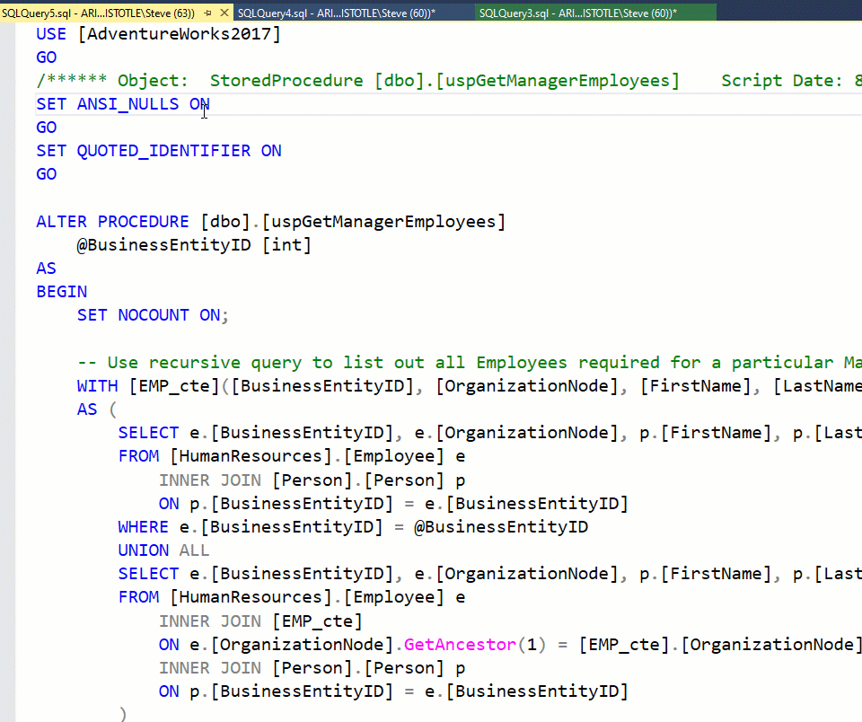
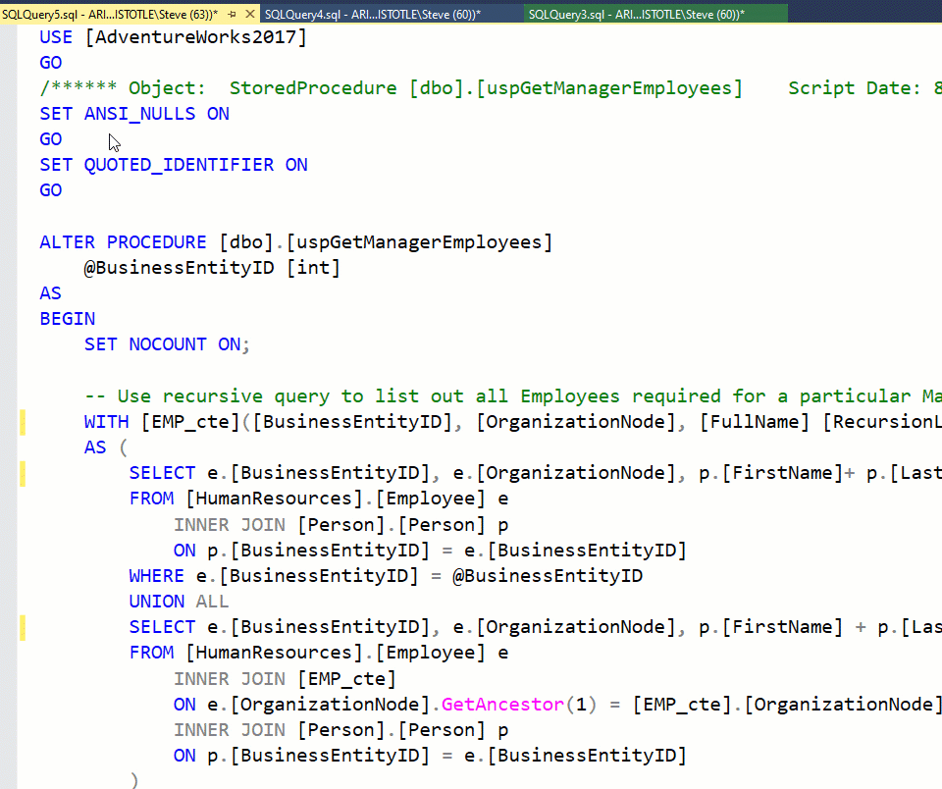
Versions get confusing
Notes:
What’s the difference? Not easy to tell.

Slide 7
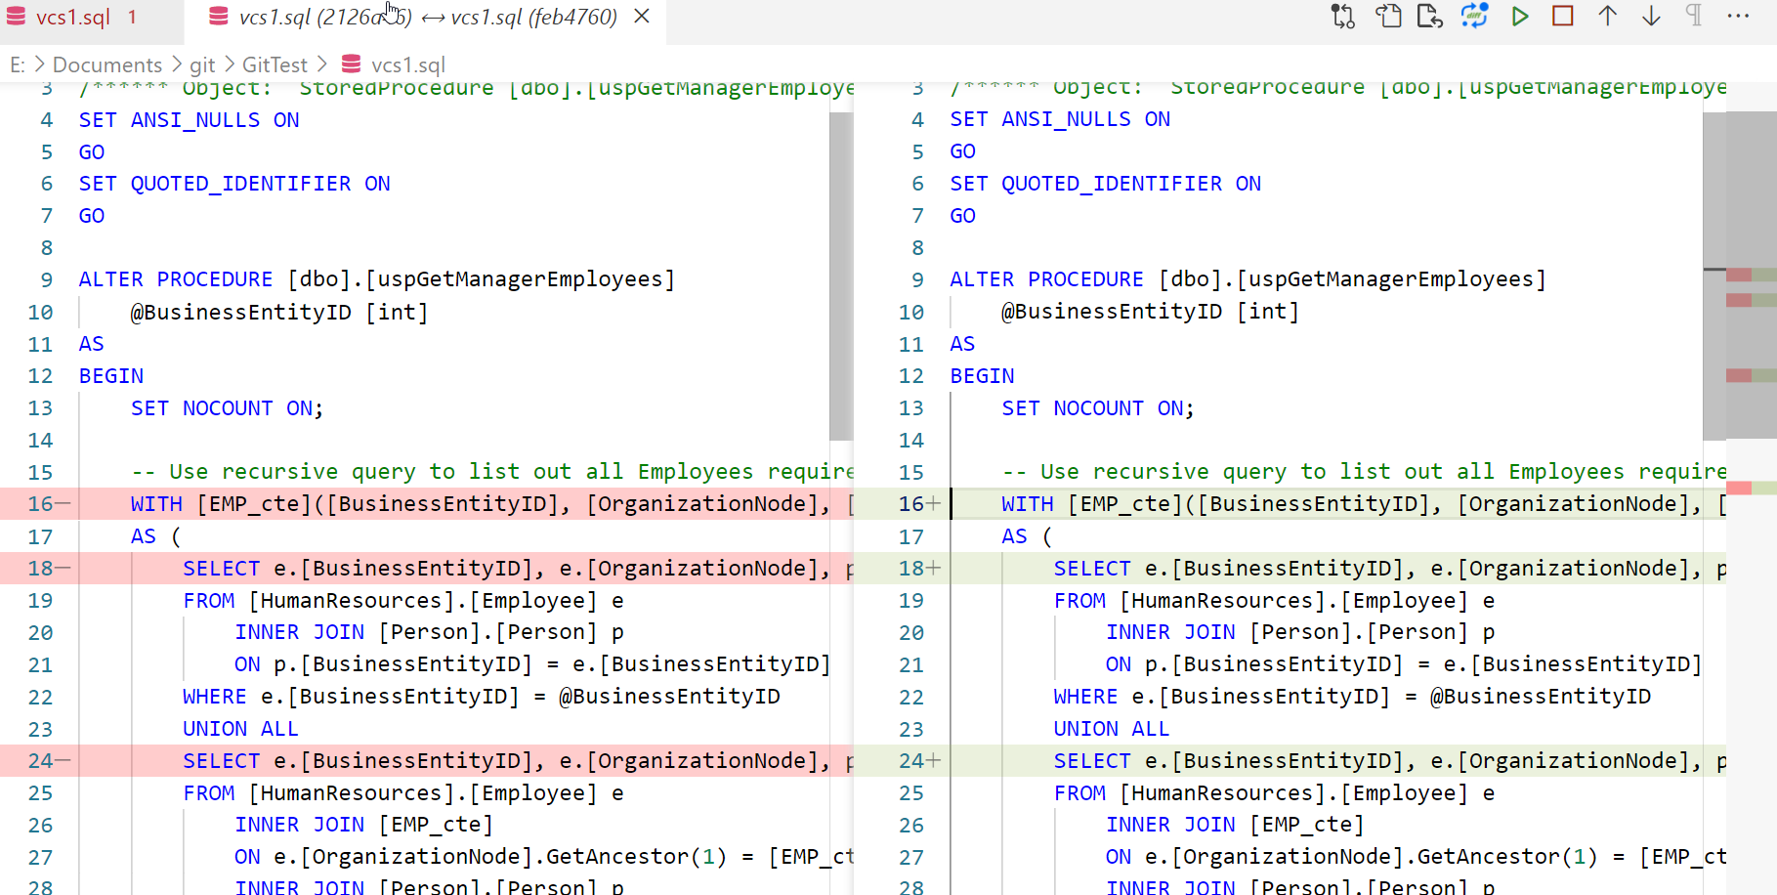
Is this easier?

Slide 8
Is this easier?

Slide 9
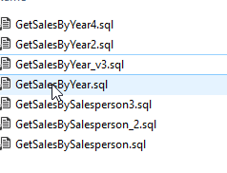
How many of you do this?

Slide 10
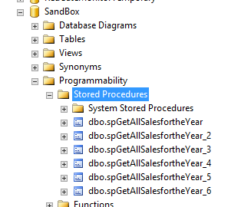
Or this?

Slide 11
If you do this, you are using Version Control
It’s not good version control
Tracking changes is hard for yourself
It’s worse in a team environment
Plus, version control is important for your career.

Slide 12
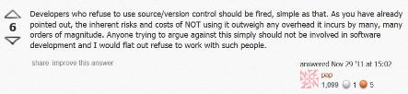
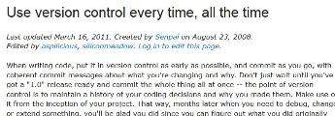


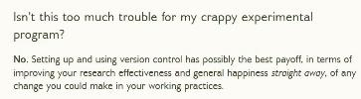
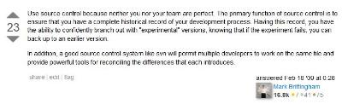



Developers who refuse to use source/version control should be fired, simple as that.
Notes:
Developers who refuse to use source/version control should be fired, simple as that. – top stack exchange
Isn’t this too much trouble for my crappy experimental program. - Drupal
Use source control because neither you nor your developers are perfect. – bottom stack exchange
There are no excuses where you should not use it. - makeuseof
If it’s not in source control, it doesn’t exist. - TroyHunt
http://programmers.stackexchange.com/questions/122150/how-can-i-convince-cowboy-programmers-to-use-source-control
http://www.makeuseof.com/tag/git-version-control-youre-developer/
http://www.mactech.com/articles/mactech/Vol.14/14.06/VersionControlAndTheDeveloper/index.html
http://drupal.org/node/299067

Slide 13
Use source control because neither you nor your developers are perfect.
Notes:
Developers who refuse to use source/version control should be fired, simple as that. – top stack exchange
Isn’t this too much trouble for my crappy experimental program. - Drupal
Use source control because neither you nor your developers are perfect. – bottom stack exchange
There are no excuses where you should not use it. - makeuseof
If it’s not in source control, it doesn’t exist. - TroyHunt
http://programmers.stackexchange.com/questions/122150/how-can-i-convince-cowboy-programmers-to-use-source-control
http://www.makeuseof.com/tag/git-version-control-youre-developer/
http://www.mactech.com/articles/mactech/Vol.14/14.06/VersionControlAndTheDeveloper/index.html
http://drupal.org/node/299067

Slide 14
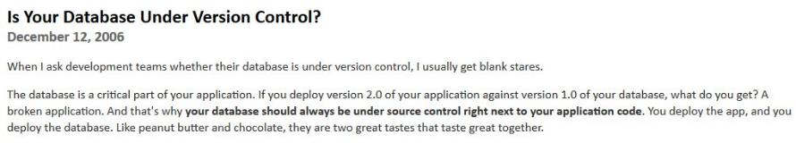

“…your database should always be under source control right next to your application code.”
Notes:
Many of the better developers out there, whether working with application code or database code, believe in this process. In terms of databases, the code should be a peer with your application code.

Slide 15
DevOps Requires a Foundation
For many companies, the foundation of building better software is version control
Knowing version control is important for your career prospects
While some employers will train you, think about who you hire?
  I’m great at writing fast queries, but I don’t know anything about git
  I’m great at writing fast queries and sharing code with others through git

Slide 16
It’s not just code
Documentation
  https://github.com/MicrosoftDocs/sql-docs
  https://github.com/dbafromthecold/SqlServerAndContainersGuide/wiki/Building-a-custom-image
Books
  https://github.com/EbookFoundation/free-programming-books
  https://github.com/aosabook/aosabook
Blogging
  https://developmentseed.org/blog
Sites
  https://sqlsaturday.com/
  https://datasaturdays.com/

Slide 17
The Basics of Version Control
A primer for DBAs

Slide 18
All code is text
For almost all software systems, we use code to tell the computer what to do
We author, experiment, and finally save code for our team to see
A “version” is simply a text file that we’ve decided is working (ish)
We use a common system to save these versions of text files
This is called a:
  Version control system (VCS)
  Source control system (SC)
  Revision control system (RCS)

Slide 19
Two Major Types of VCS
Centralized (TFS, Subversion, Vault)
  Uses a “server” to store all code (client/server)
  Users all connect to the server to store and retrieve code
  Always online
  Allow file locking
  Contains a canonical copy
  Needs backup
Distributed (Git, Mercurial)
  Each node is essentially its own server (peer to peer)
  Often one node is chosen as a server (i.e. GitHub)
  Each copy of code is a working copy, no canonical copies
  Every copy is a backup (albeit, potentially at different points of time)

Slide 20
Common Concepts
Repository (database) – where files are stored
Branch (copy) – A set of files that were all copied at the same time. This is also a verb to make a copy
Checkout (file|open) – Retrieve a file(s)
Commit (file|save) – Make a save in the repository
Merge – move changes from one branch into another
Tag – A label at a point in time for a set of files
Trunk/main/master – Often the main copy of development code that isn’t a branch (ish)

Slide 21
VCS Brands
CVS/PVCS
Vault
Perforce
Rational ClearCare
Visual SourceSafe
Team Foundation Version Control
Subversion
Mercurial
Git

Slide 22
An Introduction to Git
The VCS winner

Slide 23
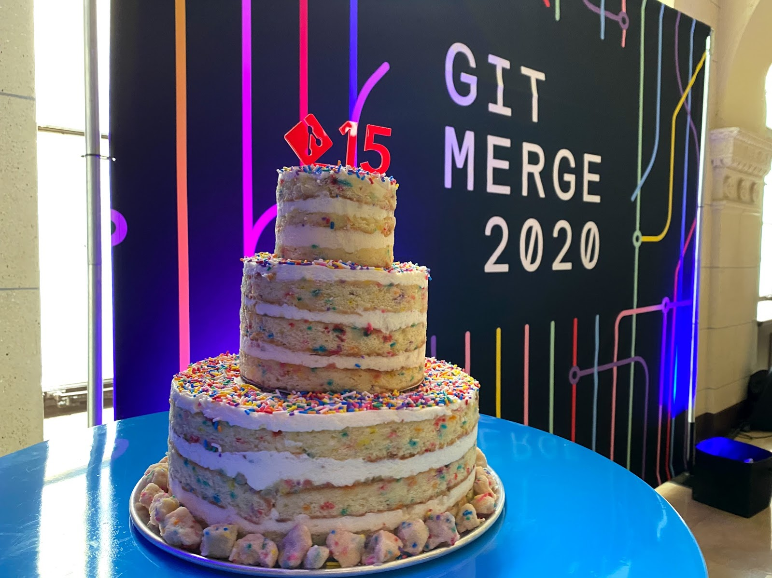
Git has won

Slide 24
Git Features
Is distributed
Scales (Windows is 3.5mm files, 300GB)
Easy to get and share code
Lots of online support for code:
  GitHub
  Azure DevOps
  BitBucket
  GitLab
Allows offline work
Many clients

Slide 25
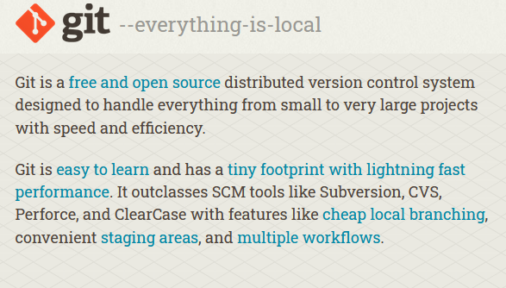
Getting Git
Git is free/open source
https://git-scm.com/
Download for your platform
Quick, simple install
The default is a command line

Slide 26
Git Basics
Init – create a repository
Tracked – A file(s) that git versions
Ignore – A file(s) that git doesn’t track or version
Add – add a file to be tracked
Commit – save a version
Clone – get a copy from another peer/server
Config – change your setup
Status – the state of your repository
Log – a history of changes

Slide 27
Demo
Getting Started with Git
Notes:
New folder
Save a file
Git init
Git add
Git commit
Git log

Slide 28
Making Git Fit You
You need to personalize your install for others
There are global and repo specific settings
Lots of setup tutorials
  https://git-scm.com/book/en/v2/Getting-Started-First-Time-Git-Setup
  https://docs.github.com/en/get-started/getting-started-with-git/setting-your-username-in-git
  https://careerkarma.com/blog/git-config/
Notes:
Git config –global –list
Change user name
Edit file, commit, show log
Change local repo name
Edit file, commit, show log
List local and global settings

Slide 29
Demo
Configuring Git
Notes:
New folder
Save a file
Git init
Git add
Git commit
Git log

Slide 30
Git Clients
Lots of options
  CLI
  Visual Studio
  VS Code / ADS
  GitKrakken
  SourceTree
  Github Desktop
  More
I’ll show a few

Slide 31
Working with real code
Let’s download a repo and write code
I’ll write code in
  SSMS
  ADS (Azure Data Studio)

Slide 32
Demo
Let’s write code
https://github.com/way0utwest/VCS_Primer
Notes:
https://github.com/way0utwest/VCS_Primer
Clone repo
Open files in ADS and SSMS, edit and commit

Slide 33
Push and Pull
Sharing Code

Slide 34
Remotes
A remote is a copy of the git repository that is not on your machine
Each remote is a peer
In practice, most often we have one main remote acting as a server
Push is a way of sending your changes to the remote
Pull is a way of getting changes from the remote
Usually you want to pull first, just in case there are collisions

Slide 35
Commands
Push – Send code to a remote repo (usually a central one)
Pull – Get code from a remote repo
Fetch – pulls branches and tags from a repo

Slide 36
Demo
Sharing code
Notes:
Show online repo
Push
Make change online
Pull

Slide 37
Branches
Copies of Code

Slide 38
Git Branches
A branch is a copy of code, started at a point in time.
Each copy is independent, and git manages tracking this
Only one branch in a repository is active
Changing branches changes the file system
Create a branch with:
  Git branch <branch name>
  Git checkout –b <branch name>
Delete with the –d option

Slide 39
Demo
Creating a branch
Notes:
Add a new branch, then add a file
Switch branches, show the file system changes
List branches

Slide 40
Merges
Getting branches in sync

Slide 41
Merge
Merging is where we combine changes from two copies
This could be across branches or remotes
If the same file is changed in two places, then there is often a merge conflict
Merging application code is often simpler than merging database code
There are tools to help with resolving conflicts (Beyond Compare, kdiff3)

Slide 42
Demo
Merging Branches
Notes:
Add a new branch, then add a file
Switch branches, show the file system changes
List branches

Slide 43
Pull Requests
A second set of eyes

Slide 44
Pull Request
A pull request is a request for someone to review your code
  And potentially merge it into their branch
The idea is that you are requesting someone else to “pull” your changes
Usually this is done in a GUI fashion with a server repository

Slide 45
Demo
Asking for Review
Notes:
Add a new branch, then add a file
Switch branches, show the file system changes
List branches

Slide 46
Summary
Version Control is the basis by which we keep track of all our code
This is useful for teams to be able to share, review, and collaborate on code.
Git has won and almost everyone is moving to git for new work
There isn’t great tooling for DBAs
Git isn’t too hard, but does require some practice
There are lots of resources available

Slide 47

The End
www.voiceofthedba.com
sjones@sqlservercentral.com
@way0utwest
/in/way0utwest

Slide 48
Git Resources
Atlassian Tutorials
https://learngitbranching.js.org/
Git series at SQLServerCentral
Git Anatomy
Git source site
How to Set up Git Using Git Config
Where to find system, global and local Git config files on Windows and Ubuntu Linux

Slide 49
References
http://programmers.stackexchange.com/questions/122150/how-can-i-convince-cowboy-programmers-to-use-source-control
http://www.makeuseof.com/tag/git-version-control-youre-developer/
http://www.mactech.com/articles/mactech/Vol.14/14.06/VersionControlAndTheDeveloper/index.html
http://drupal.org/node/299067

