Slide 1
Don’t forget the database
Steve Jones (he/him)
Editor, SQLServerCentral
Advocate, Redgate Software
@way0utwest
Notes:
Complex enterprise applications are rapidly growing and evolving as DevOps sweeps through software development. However, many teams struggle to meet the demands placed upon them if they do not have a solution to speed up database development. Learn how prioritizing database development can accelerate the adoption of DevOps just like any other application.
Start Zero Downtime app
Open command line, Zerodowntime repo, flyway folder
Run ZeroDowntime1.cmd

Slide 2
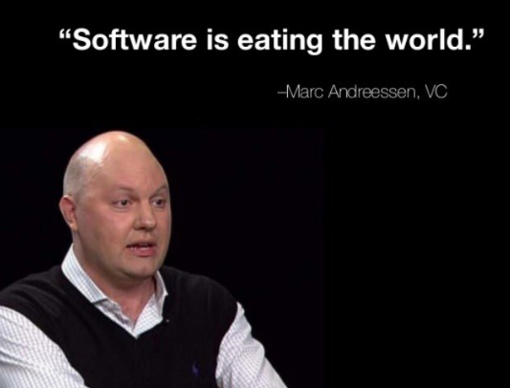
In 2011 …
In the future every company will become a software company
Notes:
In 2011 we had this famous quote and essay from Marc Andresssen. He postulated that every company will need to be a software company.
I don’t know about that, but it certainly is true for a lot of us. Even if we don’t build software, we use it.

Slide 3

Today …
Notes:
We continue with the digital transformation

Slide 4

Everyone is using software
Notes:
The simplest businesses have adopted tech, especially after the pandemic, which has loweded costs and opened markets.

Slide 5

In many industries
Notes:
Mechanics now use computers, which are indispensable in today’s vehicles.

Slide 6

No matter how remote
Notes:
All over the world, even if very analog parts of the world, where farmers, fisherman, and ranchers work, software is in use. Here a farmer gets weather, pricing, and other information through SMS, but software on the other side of this phone is providing the data.
https://www.theguardian.com/global-development-professionals-network/2012/nov/27/farmers-mobile-phones-sms-agriculture

Slide 7
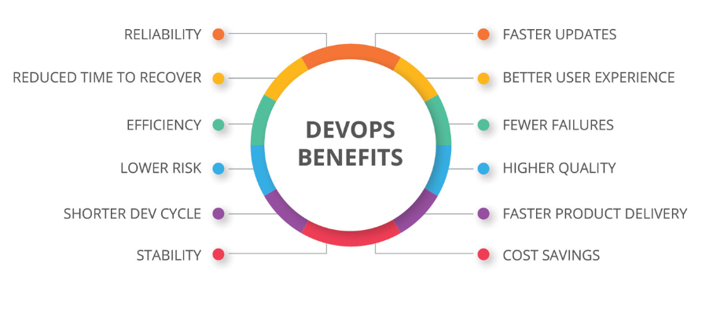
The key to better software is DevOps
Notes:
We’ve learned across the last decade that DevOps is key. It is a better set of principles that drive better outcomes when building, deploying, and operating software.
https://devops.com/different-organizations-different-devops-outcomes/

Slide 8

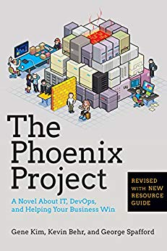
However, it’s not easy
Notes:
These books have shown that transforming an organization is hard, both for dev and ops.
https://amzn.to/3NtHD67
https://amzn.to/44lBHlm

Slide 9
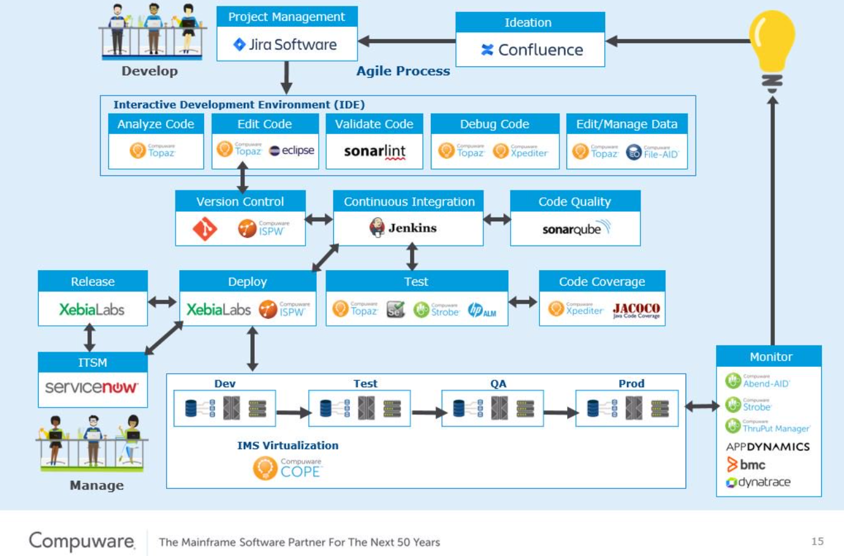
DevOps is complex
Notes:
DevOps is complex, because of the complexity of all the systems we need.

Slide 10
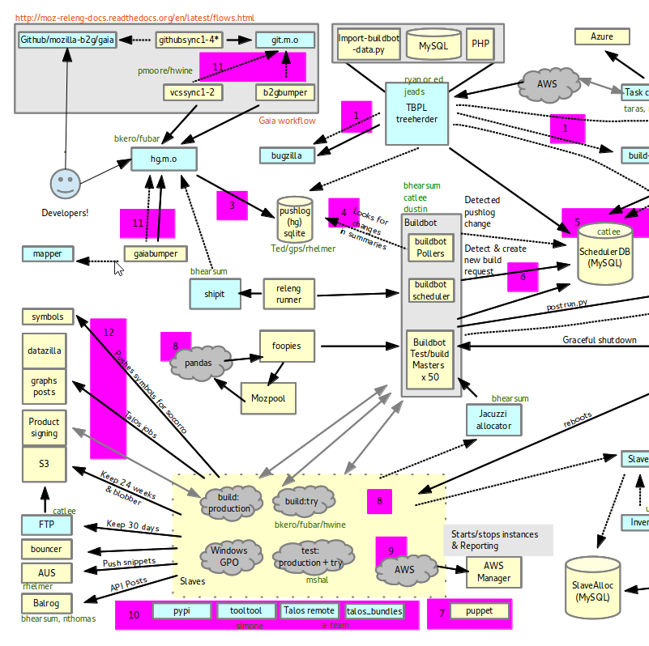
Applications have lots of moving parts
Notes:
Our applications are also very complex

Slide 11
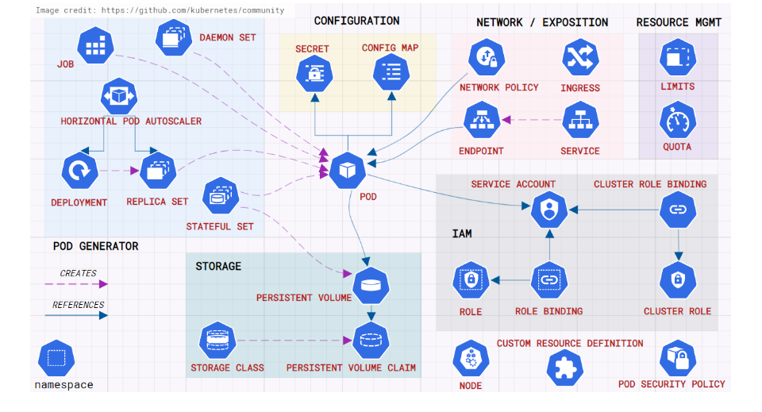
Even reference architectures are busy
Notes:
Even when we try to model something that is designed to be easy to learn, it gets hard.
K8s - https://docs.cloudskew.com/free-kubernetes-architecture-diagram-tool.html

Slide 12
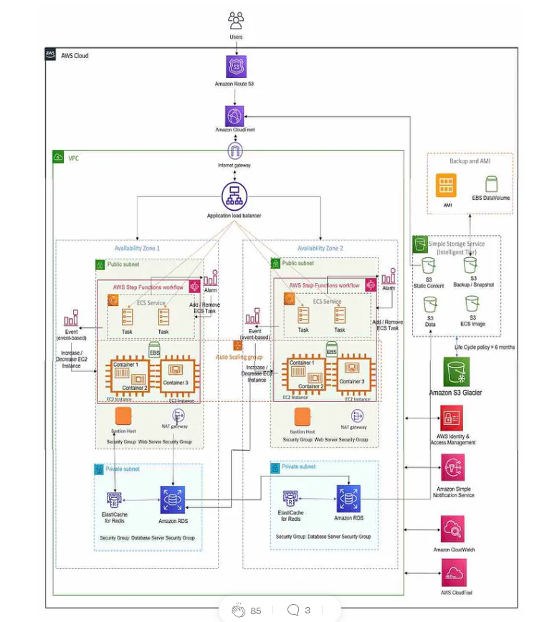
Web apps have a lot of pieces in 2023
Notes:
AWS - https://medium.com/nerd-for-tech/aws-series-reference-architecture-1-web-application-type-1-2817c8dc09b

Slide 13
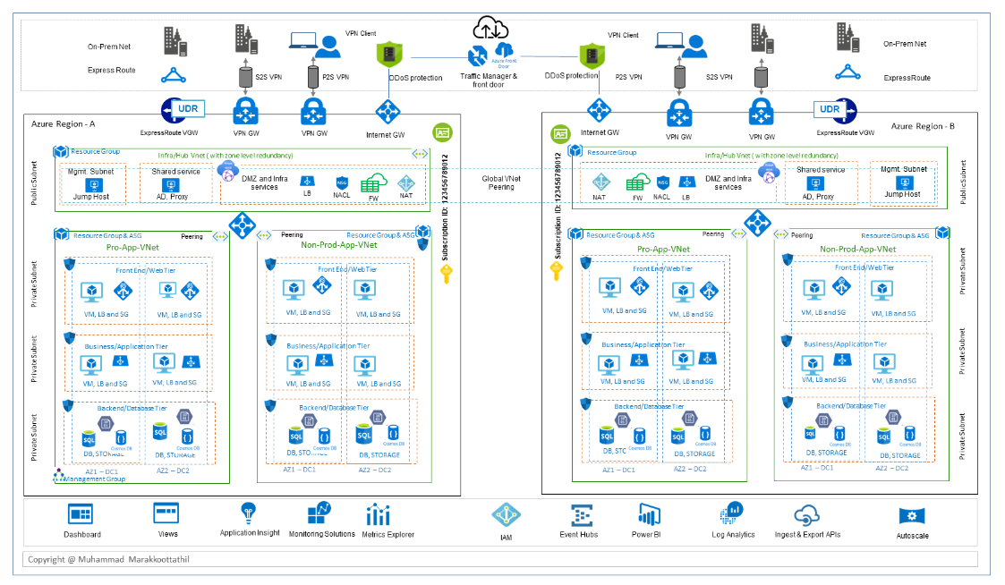
The Cloud is really busy (and pricey)
Notes:
Designs quickly grow and grow, often as we see new technology and new possibilities. In the cloud, we are bombarded with new options that were designed to solve a specific issue. That’s great, but this also leads to complexity. Even more important, this can lead to high costs, especially to provision and maintain development environments.

Slide 14
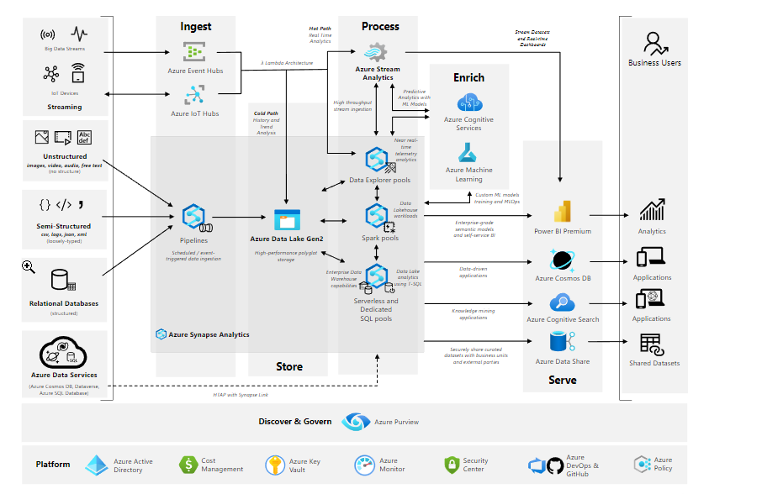
The data warehouse is often needed
Notes:
We usually need to add in systems that allow decision making. Often, this is a data warehouse, especially when we’ve chosen a non-traditional data store instead of an RDBMS.
In all these areas, the database is fundamental

Slide 15

There’s a lot to learn
Notes:
On top of all the complexity, we have to upskill staff. Even if you have a person or team that understands everything, the next person might not. And onboarding is hard.
We all need to learn and learn how to learn, and do this regularly. Not obsessively, but often. And we need to experiment and be skeptical.
https://devopslaunchpad.com/blog/how-to-get-started-with-salesforce-devops/

Slide 16
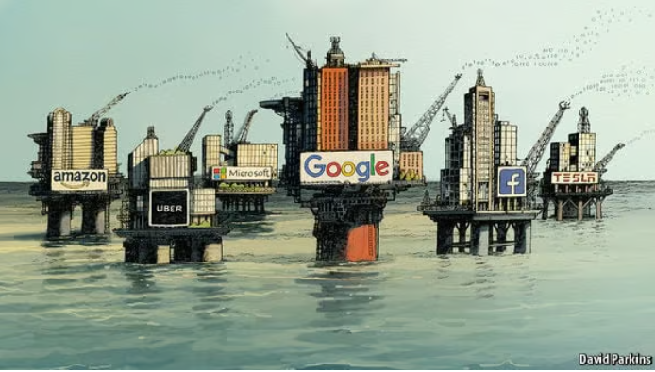
Data is the new oil
“… an immensely, untapped valuable asset.”
– Wired 2014
Notes:
We know that data what powers these applications. It’s the new oil.
Whether you think data is the new oil, the new gold, part of web 4.0 of whatever. We know data is one of the most valuable assets in a company. It is often untapped, but more and more companies are trying to ensure that they capture more data and they find ways to analyze and use it.
https://www.economist.com/leaders/2017/05/06/the-worlds-most-valuable-resource-is-no-longer-oil-but-data

Slide 17
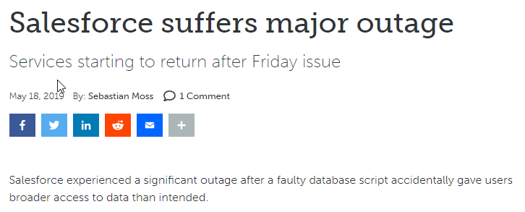
Database Downtime is expensive
Down for 15 hours
Notes:
Database downtime can be expensive. Does anyone remember this? A script deployed at SF gave too many rights, and they shut down access for 15 hours. That’s a lot of outages for customers, and probably significant costs for them in credits.
This wasn’t a disaster, a weather event, a hack, or a equipment failure. This was a script run by someone in the IT group. I would guess that salesforce embraces devops, but did they include the database?

Slide 18
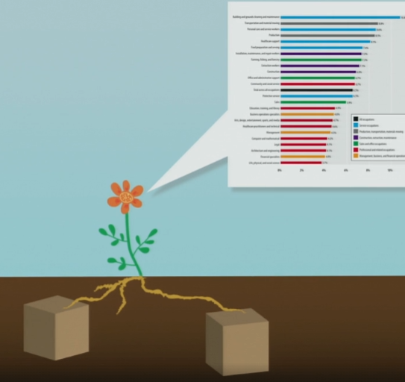
Don’t forget the database
Notes:
From Tim Berners-Lee, the data is brown and underground, and maybe uninteresting, but someone takes it and uses software and produces something beautiful, something useful, informative.
No matter what we do with software, we need to bring the data along. We have to ensure that the database is part of our software delivery pipeline.
https://www.ted.com/talks/tim_berners_lee_the_next_web/transcript

Slide 19
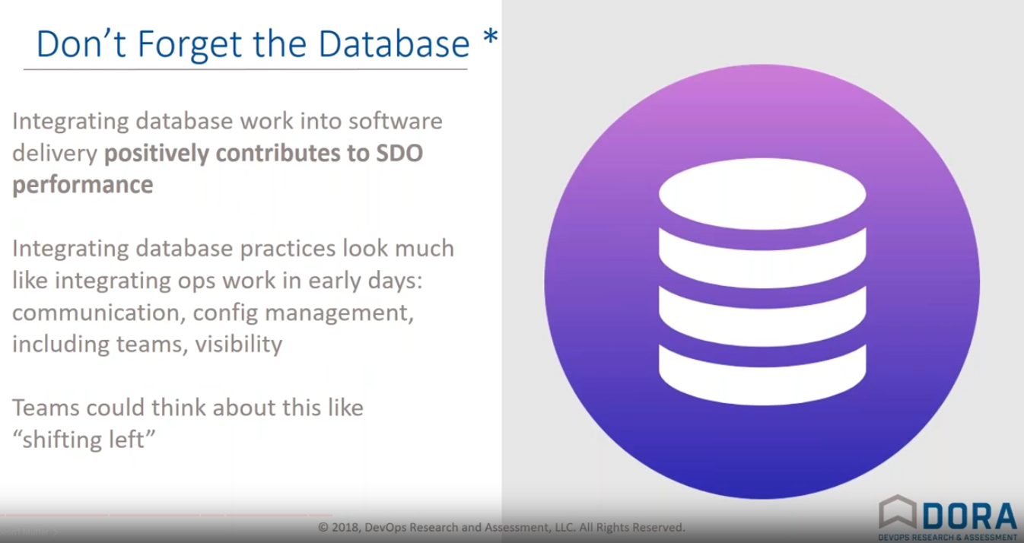
…treating DBAs like every other part of the value stream does increase performance …
“Databases were always very scary to change” – Gene Kim
From the 2018 State of DevOps report
Notes:
Keeping the database up with other software is important. The 2018 State of devops tackled this for the first time. In an interview with Gene Kim, he noted that treating the DBAs as part of the value stream improved performance of software teams. This was the first year (starting from 2013) that the database was included. A lot of companies found that changing app software without the database is a problem.
https://www.youtube.com/watch?v=is43drdJSXo

Slide 20
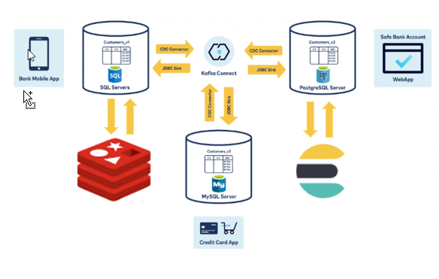
More complexity with multiple datastores
Notes:
More and more applications are using different data stores. Even if not in the same app, they’re in the same company.
https://www.confluent.io/blog/sync-databases-and-remove-silos-with-kafka-cdc/
https://www.elastic.co/
https://www.redis.io

Slide 21
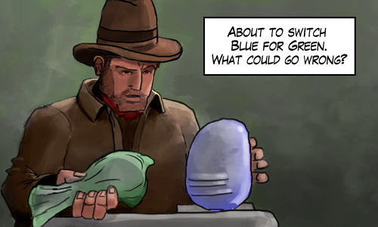
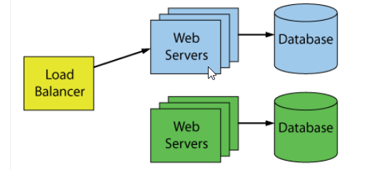
Database deployments are complex
Notes:
From Michael Swart
Database deployments are more complex than web servers. We can have blue-green, but for most datastores, the data lives somewhere. We can’t switch to a new version. Keeping the state of our data and evolving it is a challenge. Even in NoSQL systems, we are creating technical debt to manage disparate schemas.
https://michaeljswart.com/2018/01/100-percent-online-deployments-blue-green-deployment/

Slide 22
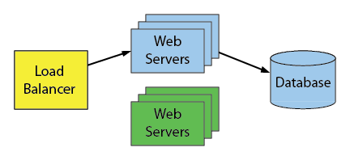
Database deployments are complex
Notes:
From Michael Swart
Database deployments are more complex than web servers. We can have blue-green, but for most datastores, the data lives somewhere. We can’t switch to a new version. Keeping the state of our data and evolving it is a challenge. Even in NoSQL systems, we are creating technical debt to manage disparate schemas.
https://michaeljswart.com/2018/01/100-percent-online-deployments-blue-green-deployment/

Slide 23

“Any sufficiently advanced technology is indistinguishable from magic”
Notes:
Arthur Clarke write that advanced technology is magic.
People sometimes think zero downtime deployments are magic.
Let’s keep one going
https://amzn.to/3AGJsou

Slide 24
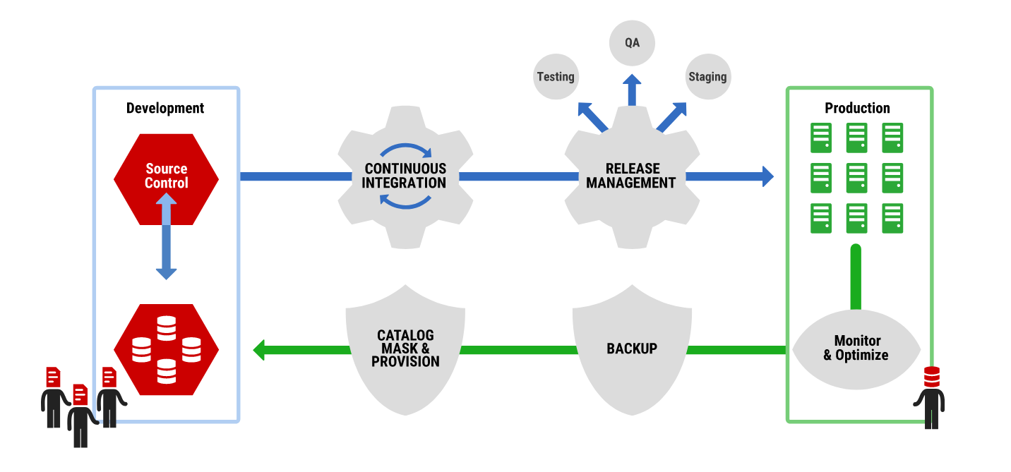
Let’s make an online deployment
Notes:
Let’s see that’s not the case. I’ll add some columns to a running system.
Switch to app, running
Run zerodowntime1.cmd

Slide 25
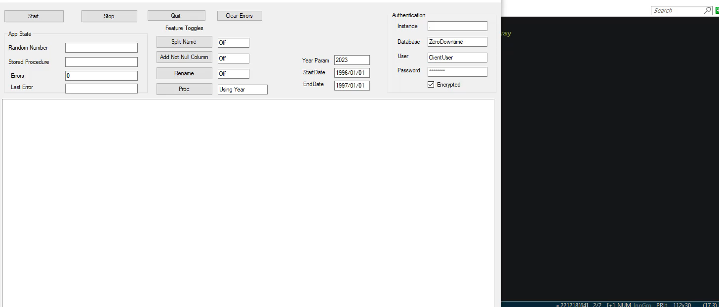
Splitting a Name

Slide 26
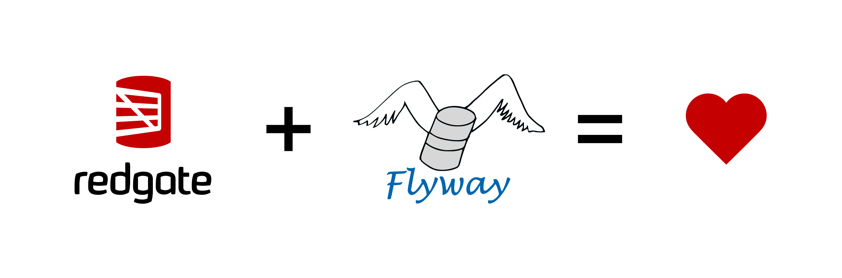
Like Magic
Notes:
Switch to app, running
Run
zerodowntime2.cmd
zerodowntime3.cmd
zerodowntime4.cmd

Slide 27
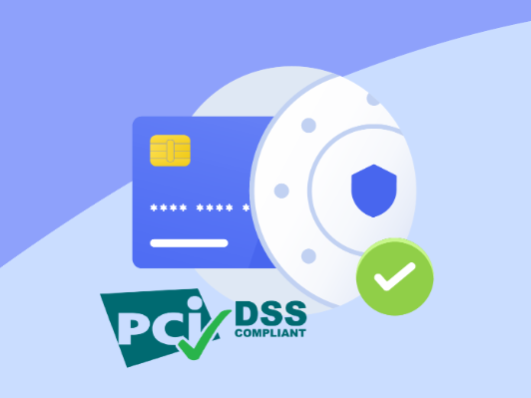
We can respond to auditors
Notes:
Check app
Run zerodowntime5.cmd
Run zerodowntime6.cmd
https://ebizcharge.com/blog/is-pci-compliance-mandatory/

Slide 28
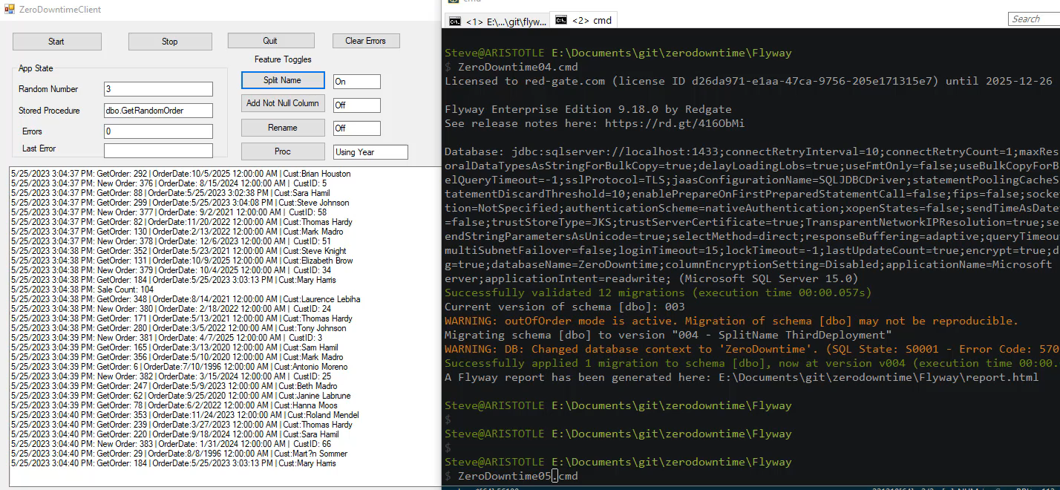
Adding Not NULL Auditing Columns

Slide 29
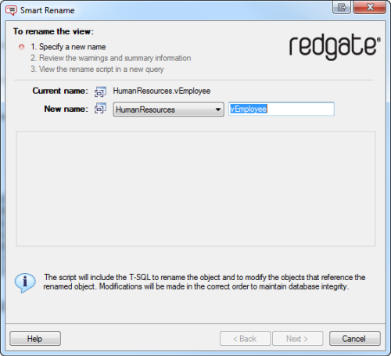
We can rename objects
Don’t do this, but if you must…
Notes:
I never rename things. It’s a firing offense to me, but in case that’s not the case….
Check app
Run zerodowntime7.cmd
Run zerodowntime8.cmd
https://ebizcharge.com/blog/is-pci-compliance-mandatory/

Slide 30
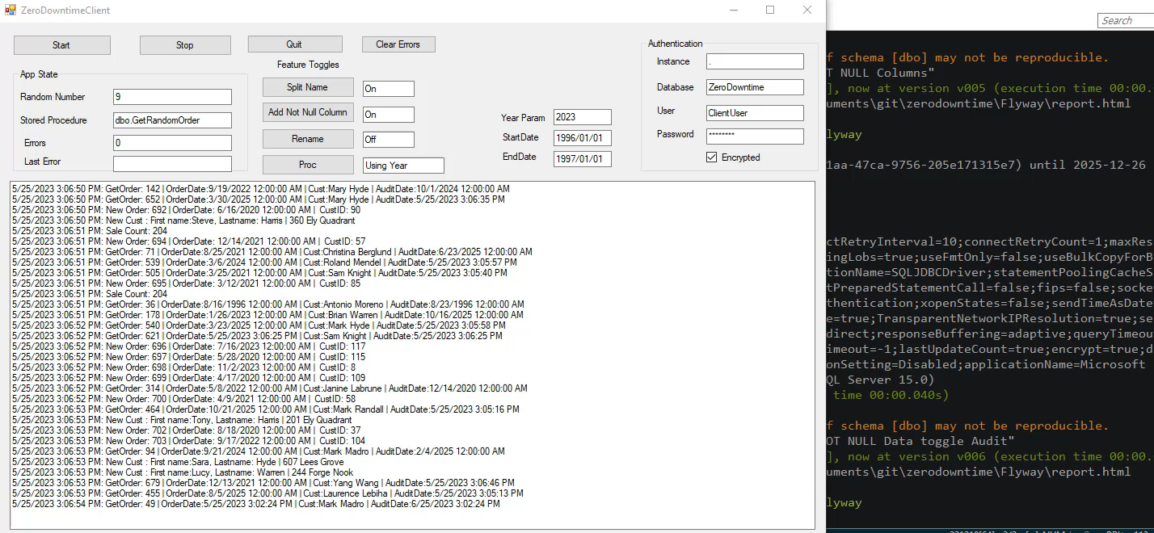
Renaming a Column

Slide 31
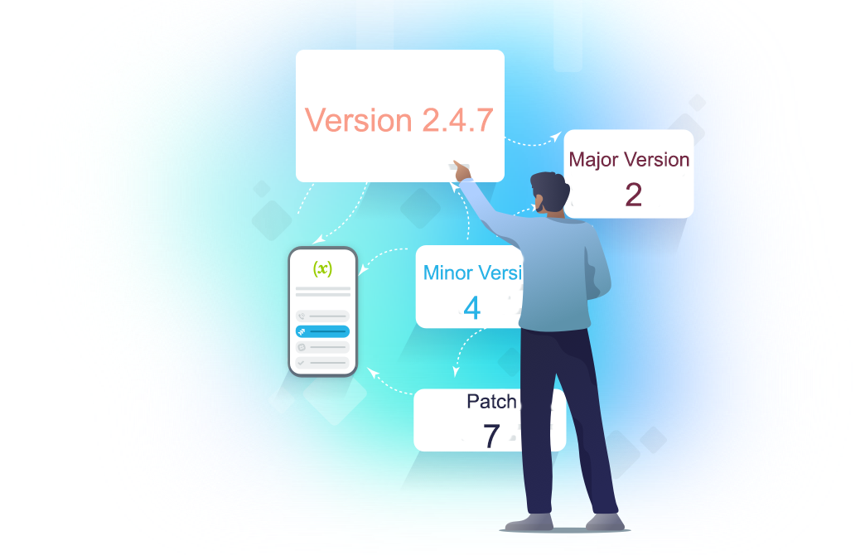
We can even rev our API
Altering stored procedure parameters
Notes:
We can even change our API, in this case a stored procedure.
Check app
Run zerodowntime8.cmd
Run zerodowntime10.cmd
Run zerodowntime11.cmd
https://www.xmatters.com/blog/blog-four-rest-api-versioning-strategies/

Slide 32
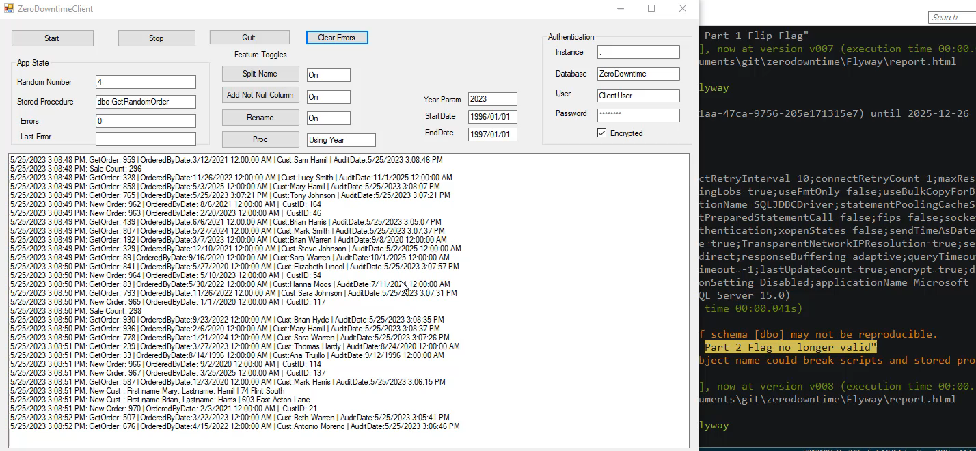
Changing our API

Slide 33
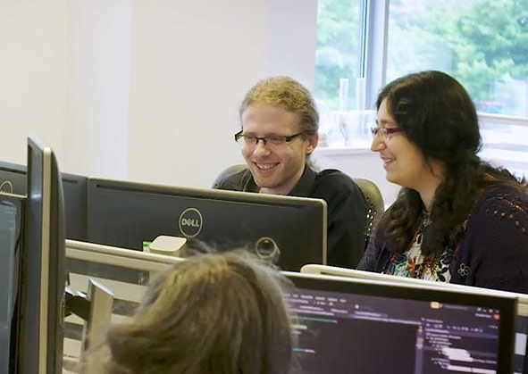
We need Dev and Ops to work together
After aligning development practices…
“Not only is our development team more productive, we are also seeing substantially faster delivery times and, most importantly, more accuracy.”
Rynhardt van Rensburg, Systems Analyst, ABSA Bank

Slide 34
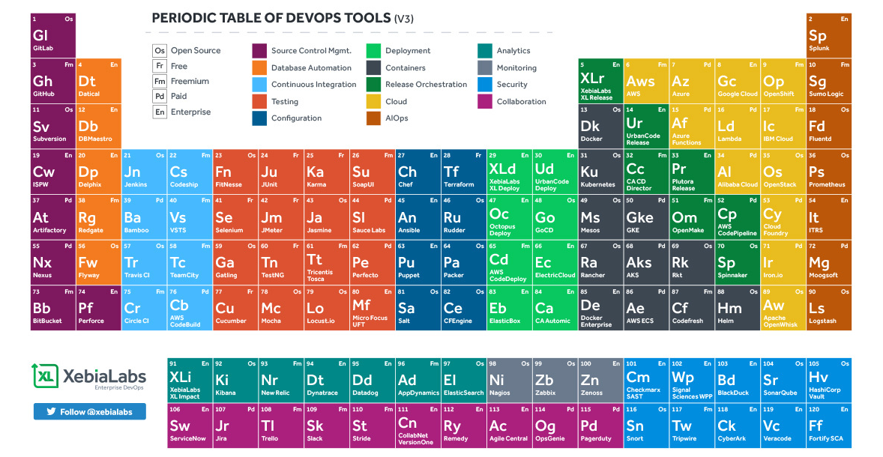
There are lots of tools to help
Notes:
There are lots of tools, including database tools. This is a very small sampling, though both Redgate and Flyway are listed here.

Slide 35
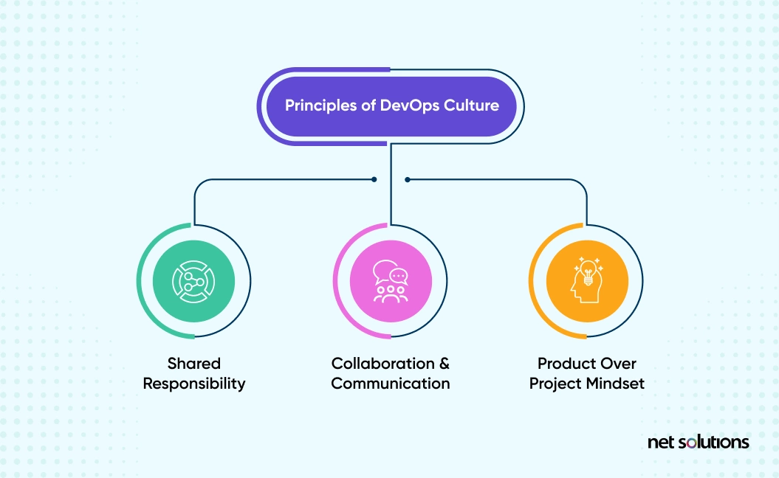
Culture is key
Notes:
Culture is important to managing

Slide 36

With support from management
Notes:
Management must support change
https://www.teamly.com/blog/how-can-managers-support-employees/

Slide 37
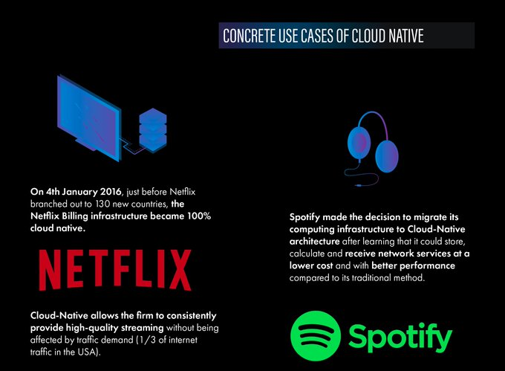
You can become a world-class software team
Notes:
https://twitter.com/SopraBanking/status/966988547336101888

Slide 38
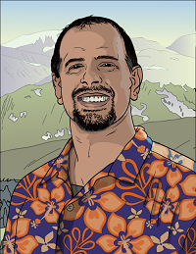




32 years SQL Server data experience
DBA, developer, manager, writer, speaker in a variety of companies and industries
Founder, SQL Server Central
Currently the editor in chief, with the goal of helping you learn to be a better data professional every day
Steve Jones
Advocate, Redgate Software
Editor, SQLServerCentral
President, SQL Saturday
he/him
15-year Microsoft Data Platform MVP
I have been honored to be recognized by Microsoft for the as a Data Platform MVP working with SQL Server
/in/way0utwest
@way0utwest
Steve.Jones@red-gate.com
www.voiceofthedba.com
Notes:
steve

Slide 39


The End
www.voiceofthedba.com
Steve.Jones@red-gate.com
@way0utwest
/in/way0utwest

Slide 40
Agenda
Who am I?

Slide 42
References
Software is eating the world - https://a16z.com/2011/08/20/why-software-is-eating-the-world/
Farmers using SMS - https://www.theguardian.com/global-development-professionals-network/2012/nov/27/farmers-mobile-phones-sms-agriculture

Slide 43
Images
Digital Transform - https://www.cio.com/article/191171/january-2021-the-race-to-digital.html
Mozilla Architecuture - https://www.chesnok.com/daily/2014/05/02/release-engineering-a-draft-of-an-architecture-diagram/
Azure IaaS Reference - https://www.networkbachelor.com/azure-iaas-reference-architecture-a-quick-overview/
AWS - https://medium.com/nerd-for-tech/aws-series-reference-architecture-1-web-application-type-1-2817c8dc09b
Synapse Data Warehouse - https://learn.microsoft.com/en-us/azure/architecture/example-scenario/dataplate2e/data-platform-end-to-end?tabs=portal
Profiles of the Future - https://amzn.to/3AGJsou
https://www.mlive.com/business/mid-michigan/2011/01/coffee_shop_owner_utilizes_new.html
https://blog.torque360.co/5-problems-with-the-current-auto-repair-shop-software/
https://www.theguardian.com/global-development-professionals-network/2012/nov/27/farmers-mobile-phones-sms-agriculture
https://devops.com/different-organizations-different-devops-outcomes/
https://twitter.com/BMCCompuware/status/994600280342913024/photo/1
https://www.confluent.io/blog/sync-databases-and-remove-silos-with-kafka-cdc/
https://redis.io/
https://www.elastic.co/
https://michaeljswart.com/2018/01/100-percent-online-deployments-blue-green-deployment/
https://ebizcharge.com/blog/is-pci-compliance-mandatory/
https://www.netsolutions.com/insights/how-to-build-devops-culture/

