Slide 1
Blogging for the Tech Professional
Building a brand for yourself
Steve Jones
Advocate, Redgate Software
Founder/Editor, SQLServerCentral
Notes:
Regular browser
- Voice of the dba blog schedule
Private browser open
wordpress.com
Wordpress.org
Portal.azure.com (way0utwest for t-sqltuesday rg)
Ghost
Voiceofthedba.com
Blogspot.com (sjones@dkranch.net)
tsqltuesday
Open Live Writer
Have draft post

Slide 2
Agenda
Why Blog
Setting up a Blog
Picking Topics
Writing Skills
Scheduling and Promotion

Slide 4





33 years SQL Server data experience
DBA, developer, manager, writer, speaker in a variety of companies and industries
Founder, SQL Server Central
Currently the editor in chief, with the goal of helping you learn to be a better data professional every day
Steve Jones
Advocate/Architect, Redgate Software
Founder/Editor, SQLServerCentral
he/him
16-year Microsoft Data Platform MVP
I have been honored to be recognized by Microsoft for the as a Data Platform MVP working with SQL Server
/in/way0utwest
@way0utwest
sjones@sqlservercentral.com
www.voiceofthedba.com
Notes:
steve

Slide 5
Why bother blogging?
A few reasons to spend more time on another task

Slide 6

Self-Improvement
Explaining things forces you to learn*
Writing improves communication skills*
Searching for topics broadens knowledge
Digging into topics deepens knowledge
* If you get/take feedback
Notes:
Grow your T shaped knowledge with blogging

Slide 7
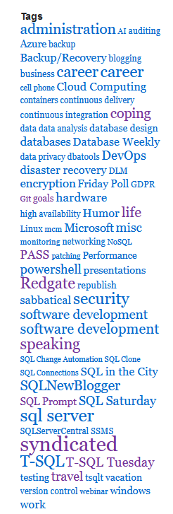
Document My Career
I use a tag cloud
Over time, I can see what I’ve worked on
I also see what I’ve learned
Notes:
My tag cloud helps me to learn about myself and what I like. I do a lot of Redgate and T-SQL. I also have done a lot of coping tips and life blogging lately. Not much SSRS or SSIS

Slide 8
Blog Survey
Who has a technical blog?
Who reads technical blogs regularly?

Slide 9
Blog Survey
Who has a technical blog?
10% of people
Who reads technical blogs regularly?
80% of people
You stand out from a resume with your blog
Notes:
Stand out from the crowd, everyone else interviewing alongside you

Slide 10
Career Benefits
Interviewers perform due diligence
  80+% of employees look you up
  They want to evaluate you before contact
You (slightly) control the interview
  People are lazy
  They click on your links
Proof of knowledge/skill
  Over time
You learn about yourself

Slide 11
Reasons for blogging
I went to the office for the first time. I f**king hated it. (reddit)
There is going to be a shakeup in how companies work.
Offices, WFH, hybrid, no one knows.
The Surprising Effects of Remote Work
Working From Home Is the Trend of the Year—And Next Year Too
How to Hire Remote Workers, Remotely
  “…look for candidates with initiative”
  “…employees should also be inclined to troubleshoot issues on their own”
  “… look for candidates who can speak clearly, write unambiguously and listen attentively”

Slide 12
My #1 Reason for blogging

Slide 13
Choice
My #1 Reason for blogging

Slide 14
Choice
My #1 Reason for blogging
Choose your job, your employer, your location
Notes:
You want to be able to pick the place you work, what you do, who you work for or with

Slide 15

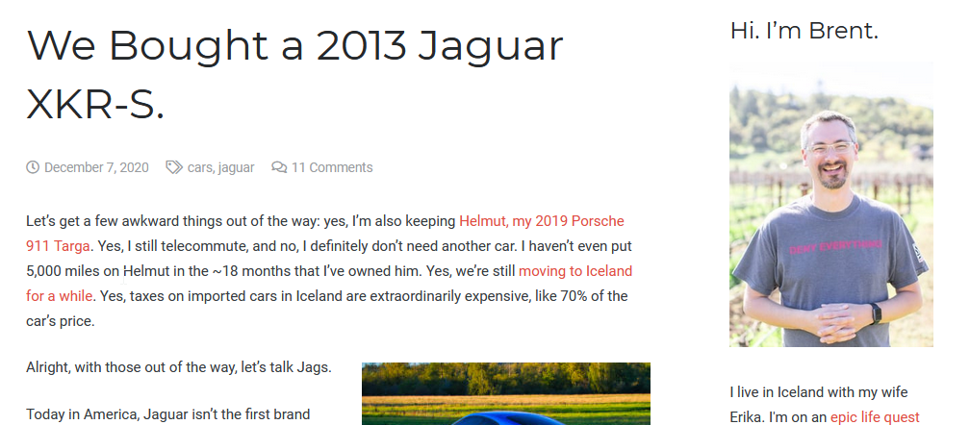
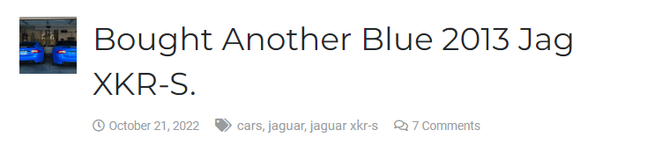
Brent Ozar

Slide 16
Setting up a blog
Where and how do I get started

Slide 17
Lots of Blogging Platforms
Wordpress
Blogger/Blogspot
Tumblr
LinkedIn
Medium/Substack
Ghost
Drupal
Jekyll
MoveableType

Slide 18
Wordpress
Seems to be the most popular platform for now
Lots of plugins/add-ons
Easy to export/import
Wordpress.com is where I host
You can pick any place that provides hosting (the software is free)
  Requires MySQL by default
  Project Nami uses SQL Server
Notes:
I recommend Wordpress. Custom domain not required.

Slide 19
Picking Topics
“I can’t think of what to write about.”
Really?

Slide 20
I write about what I …
Learn
Know
Solve
Do
Think
Notes:
Basically anything I do at work or related to my career is something I can write about.

Slide 21
Whenever you solve something
Make a note
Sketch why/how/what you did with a few details
Think about teaching yourself a day ago
Write a short set of steps
Capture code/screenshots
Notes:
Outline what you’ve done, save for later.

Slide 22
Let’s do this
Demo: How do I pick what to write on?
Notes:
Have people suggest topics.
Ask what they did last week at work

Slide 23
Writing Skills
Communication is very important

Slide 24
Think essay
Use the 5-paragraph style
  Tell me what you will teach me
  Tell me the details (3 paragraphs)
  Tell me what you taught me
Can be shorter or longer

Slide 25
Focus
Aim for 1-2 pages
Write a topic sentence and refer to this
Longer topics, break up into separate posts
Link posts together
Notes:
Try to stop at 1-2 pages and separate longer items into multiple posts or part 1/2/3.

Slide 26
Build Good Language Skills
Work on your Spelling/grammar
Use resources from past schooling
Get feedback from friends/family
Even non-technical people can recognize good writing

Slide 27
Keep it simple and consistent
Use headings
  Don’t put two headings together
  Always have a description after a heading
Format
  Format code
  Limit bold/italics/block quotes/etc.
Paragraphs
  Don’t be choppy
  Change when the main thought changes
Images/Code
  Don’t rely on comments
  Refer to the image in text

Slide 28
Little Things
Define acronyms
  RPO (Recovery Point Objective)
  Availability Group (AG)
Pick Boring Headlines
  Don’t be too cute or funny, this doesn’t always translate
  SEO prefers specific headlines
Give credit (don’t plagiarize)
  Link to resources you use
  Don’t copy more than a para and always cite the source
  This includes MS docs
Use tags/categories

Slide 29
Scheduling and Promotion
Helping others find you

Slide 30
Be consistent
Schedule posts in advance, this isn’t news
Stopping/starting/gaps look funny to recruiters
  I leave travel/vacation notes on my blog.
1 post/month or more is good. Less looks funny
Better to start slow and then increase as you have time
Don’t worry if you aren’t perfect here
Keep showing improvement

Slide 31
Getting Started
Write offline on a consistent basis
Pick a good time(s) every week to keep working
  Once a week, twice, whatever
  Set a meeting for yourself
Hold the posts until you have 10
That gives you a pace
Schedule those 10, and keep writing

Slide 32
Promoting Yourself
Link your social media accounts
  Twitter
  Facebook
  LinkedIn
  Etc.
Add your blog URL to your CV
Hashtags can be used in the title
Link posts in a series if appropriate
If you write about specific projects/topics, maybe link to posts/categories

Slide 33
Summary

Slide 34
Building a Brand
A blog is a good way to document your career
  For yourself
  For your review
You can showcase your skills and abilities
This gives some weight to your CV
Over time, this chronicles who you are
Writing builds better communication skills

Slide 35

The End
www.voiceofthedba.com
sjones@sqlservercentral.com
@way0utwest
/in/way0utwest

