Slide 1
Balance In Life With a Career
Steve Jones (he/him)
Editor, SQLServerCentral
Advocate, Redgate Software
President, SQL Saturday 501.c.3 charity
@way0utwest
Notes:
Keeping up with the demands of work and life can be tough, especially with a family. Come learn some tips and techniques for coping with the demands you face while also finding ways to grow your career as a technologist.

Slide 2
Agenda
Introductions
My Journey
Challenges
Goals
Optional things to grow your career
Tips for finding balance
Notes:
Outline
The challenges of a busy life
Finding direction with goals
Tips for getting better
Set aside time
Revisit your goals periodically, not too often
Consciously Measure progress
Find balance

Slide 3
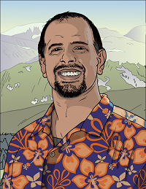




35 years database experience
DBA, developer, manager, writer, speaker in a variety of companies and industries using SQL Server, Oracle, and other database platforms.
Founder, SQL Server Central
Currently the editor in chief, with the goal of helping you learn to be a better data professional every day
Steve Jones
Advocate, Redgate Software
Editor, SQL Server Central
President, SQL Saturday 501.c.3 charity
he/him
19-year Microsoft Data Platform MVP
I have been honored to be recognized by Microsoft for the as a Data Platform MVP working with SQL Server
/in/way0utwest
@way0utwest
sjones@sqlservercentral.com
www.voiceofthedba.com
Notes:
Steve Bio

Slide 4
My Schedules
Life in the early years

Slide 5
Virginia Power – Young and Single
Often out of balance
Not enough hobbies
No family
500a – Alarm, hit snooze
505a – Alarm, hit snooze
…
530 – Get up, shower, shave eat
700a – Start work
530p – Finish work
531 – Read articles, practice skills
Work schedule
Lots of after hours work
Quarterly releases Sat night-Sun am
Crisis work over 100hrs/week
Regularly working 60+ hrs/wk
Career Investment
Reading lots of sources about tech
Experimenting with programming, administration, etc.
Life
Rowing 2x/week
Worked 2nd job weekends
Notes:
An internship and then a full time gig. Large utility
Long commute
Trying to grow my career and learn as much as I could

Slide 6
The Penrod Company – Married
Slightly out of balance
Not enough career effort
Enjoyed life for 3 years
630a – Alarm, get up
730a – Start work
430p – Finish work
Weekends off
Work schedule
Rarely working past 5p
Deploying changes on weekends
Usually 45hrs/week
Rarely over 60hrs/week
Career Investment
Reading tech occasionally
Rarely practicing anything
Always looking to improve our IT dept, not my career
Life
Raising kids
Trying to exercise regularly
Notes:
Short commute, small company
Managing 2 staff

Slide 7
IAN – Young Kids
Way out of balance
Missed family
Tired often
Health worse
430a-500a – Woken up by a toddler
800a – start work
630-730p –Finish work
Work Schedule
Quarterly, worked through the weekend to support report generation (20+hrs/weekend)
Often we had dev debugging or vendor support at night
I kept a blanket/pillow in my office
Easily worked 60-65hrs/week
Career Investment
No time for anything formal
Learned new things at work from troubleshooting
Life
Raising kids
House maintenance
Inconsistent exercise
Notes:
Startup in Denver, trying to create success
Inherited a poor setup

Slide 8
SQL Server Central – Working partner, busy kids
Lightly out of balance
Few days off
Too little vacation
Work Schedule
Often working for an hour at night, or random hours on weekends
Working on vacations
Took lots of time off to visit kids at school during the day (lunches, events)
Easily worked 60-65hrs/week
Light consulting (random jobs for a few days)
Career Investment
No time for anything formal
Constant experimenation
Blogging/documenting more
Troubleshooting issues for clients
Life
Enjoying family and flexibility
Taking more vacation time
Regular exercise
700a – Wake up
730a – walk to another room, work
800a – get kids up, drive to school
900a – back at work
330p – pick up kids
430p – back to work
530p – stop working

Slide 9
Growing my career
Pre-Colorado
  Ambitious, always wanting a better job (more $$)
  Always looking to learn because I felt I was behind others
Colorado/early SSC
  Still consulting
  Learning to produce content, needed topics
  Worried about finding new jobs
Redgate
  Need to learn to help customers
  More settled and comfortable in life

Slide 10
The Challenges We Face
Imposter Syndrome is Common

Slide 11
Our career challenges
You need to fix <system I wasn’t aware existed>
Someone asked me about/to install/to support <new tech>
I don’t know enough about <technology we use>
I’m personally interested in <new tech we don’t use>
I see jobs that request <some tech I don’t know>
I hear that <my tech skill> isn’t being used anymore or being replaced in other places
The cloud/AI worries me
Notes:
These are things I’ve heard in my career
From myself or others
We are constantly challenged to do more
This can explicit or implicit. Be careful of the latter

Slide 12
Technology challenges
Technology is complex, and getting more complex
  Most companies keep increasing the breadth of their tech stack
  They regret this and keep doing it
Pace of change is fast, new versions too often
  DevOps is here, with many companies releasing tech <= 1 year
We are expected to know our subject area
  Across all versions
  As well as any tangentially-related tech
We can work from anyone
  We are expected to work from anywhere
  At any time
We like to solve problems
  We want to be heroes
  We feel pressure to be heroes
Notes:
The world keeps growing and changing around us
DevOps can be great, but it creates a lot of challenges for us
Our jobs are often ill-defined (we’re technologists) and are expected to know computers
It’s easy for us to get things done from anywhere
Many of us like being heroes

Slide 13

We worry we’re easily replaceable
Notes:
How many of you worry about being replaced?
Management might think all technologists can be shuffled
Do they really value our knowledge?

Slide 14
Even more challenges
There are only 24 hours in a day (and 7 days in a week)
Management often takes advantage of salaried workers
  On-call load
  Expect extra hours to meet milestones from others
  We have things fail and we must work long hours to solve problems
Spouse/partners want us to break away from tech
Mobile/laptop/tablets make it hard to get away from tech
Lots of people use tech in leisure

Slide 15

After hours work is common
Notes:
Who’s on call?
Who deploys at night/weekends?

Slide 16
Goals
Where do you want to go?

Slide 17
Planning your career
Thinking time is important
What do you do now?
  List what you are paid to do
  List what other things make you valuable at your company
What do you want to do?
  Most of the same, with more money?
  More time away from work?
  Change to a new area
Makes lists and examine them across time
  With partner/spouse
  With friends/colleagues
  Debate your goals
Notes:
Thinking time is when you consider an idea/option/etc. You’re not doing work.
Feels like brainstorming. Important when looking for direction
Make lists of what you like, what you don’t.
Think of possibilities here.
Debate this over time. Multiple sessions are invaluable for me.
At home and at work

Slide 18
Things you are paid to do
Things you are interested in
Better Opportunities
Notes:
Perhaps you should consider things here, where you can get paid and you are interested.
Ideally you find something in the center
Next might be things you like and get paid to do
However, you need to get paid (right?) so maybe you choose things that pay you and offer better opportunities.
In this case, make sure you have hobbies

Slide 19
If you know what you want
Make a plan
  May be a multi-year plan
  Consider not only career, but life outside of work
  Budget for time and $$ investments
Add details to help achieve the plan
  Semi-specific steps of things to do
Start working towards the goals
Periodically re-examine your plan
  1-3 times a year

Slide 20
If you know don’t know
Or aren’t sure
Start investigating some areas
  Timebox these efforts (1 week-1 month)
  Commit to learning during this time
Talk to people in different areas, ask questions
  What is their daily work?
  What did they need to learn?
  What opportunities are there?
  How much time does this take?
  How much compensation?

Slide 21
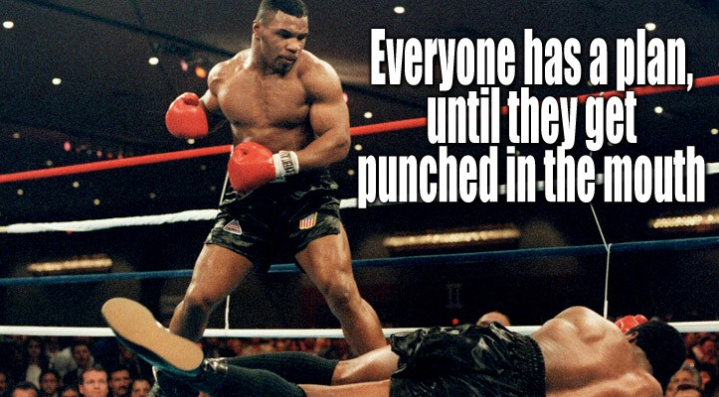
Keep in mind

Slide 22
The Optional Things
What did I do to grow my career?

Slide 23
Ways to become better
Read
Practice
Question
Write
Speak

Slide 24
Read, read, read
Reading is one of the quickest ways to consume information
  Video works, but is slower
The more you read, the faster you read
Save/mark/highlight interesting things and go back to them
Subscribe to sources of relevant information
This isn’t a queue, don’t be afraid to re-order things

Slide 25
Practice skills
To get better at something, practice
  Guitar – play guitar
  Volleyball – play volleyball
  SQL – write queries
Duplicate what others have done
  Re-type their code (best)
  Copy/paste and alter (better)
  Copy/paste – less helpful
Start a project
  Useful, useless, anything

Slide 26
Practice solving the people’s problems
Other people’s problems are interesting
These are often things you might not
  Think of
  Encounter in your work
  Or think are problems
Use forums
  SQL Server Central (preferred 😉 )
  dba.stackchange.com
Builds skills in
  Problem setup/spec clarification
  Algorithm development
  Testing
  Communication

Slide 27
We don’t know it all
Learn to ask questions when you don’t know/understand
Learn to communicate well
Accept advice
Test advice
Extend the result to do more

Slide 28
Write, write, write
Communication is important for your career
Learn to be better
  Clear (say what you mean and what they need to hear)
  Professional (spelling, grammar, etc.)
  Succinct (short and to the point)
Blog for your career – adds weight to a resume
Articles/Books – impress hiring managers
  and Mom

Slide 29
Speak
We have to speak to others at work
We might have to present to management
We might need to speak to our team
Public speaking is really no different
Valuable way to force yourself to learn, pace, and communicate

Slide 30
Finding Balance
The key to success

Slide 31
Work to Live
The goal is to enjoy your life
Make time for yourself, partner, family, hobbies, faith
Work gives us purpose, which is good
However, we need more than work
Aim for balance

Slide 32
Set aside time
Every career field has people who regularly work on their craft
Inertia in incredibly powerful
Set aside regular time to improve
  At least weekly
  Be wary of daily
  Maybe spend a weekend or a vacation day dedicated to career
Be kind to yourself
  This is a second job
  The chaos of life will get in the way
This can be 30 minutes a week
  More than 4 hours can be arduous

Slide 33

Use lunchtime
Steal some lunches
I’ve dedicated these to learning
I also use these for health
Team training sessions
  Prep time
  Teaching time
Make sure you still eat

Slide 34
Measure progress
Set vague goals
  Semi-concrete, but not overly precise
  i.e. I want to set up a cluster in Azure
  i.e. I want a Databricks notebook to read files and process them to a table
Set milestones to check, not dates
  You are the worst person to estimate effort
  Check that you are making progress
  If you’re not moving quickly, make sure you ask for help

Slide 35
Live your life
Watch your diet
Get exercise of some sort
Enjoy hobbies
Make sure family/friends/faith are in your life
Visit nature
Have fun

Slide 36
Learn to make choices
You have responsibilities to yourself to enjoy life
You have responsibilities to others (partner/family/etc.)
You want to grow your career
Find balance between these
How?

Slide 37
Balancing your life
Reduce some fun time
  Less nights out/sports/concerts/etc.
  Less consumption for fun (reading/TV/movies)
  Skip some events (make choices)
  DO NOT NEGLECT partners
Reduce some career growth opportunities
  Maybe skip a session once a week (if you do more than one)
  Reduce your learning time lightly

Slide 38
Finding balance
Take advantage of dead time at work
  Use breaks to learn/practice something new
  Give up a lunch a week
Ask for time at work
  Investigate new technology if it (lightly) relates to something else
  Spend time improving skills when doing work (try new things)
  Look for opportunities to invest in new skills
  Timebox investigations if they might help your employer

Slide 39
Re-evaluate
Re-evaluate your investment periodically
  6mos – 1 year
Don’t be afraid to adjust your time up or down
Account for life changes (marriage, kids, etc.)
Discuss with your partner for support

Slide 40
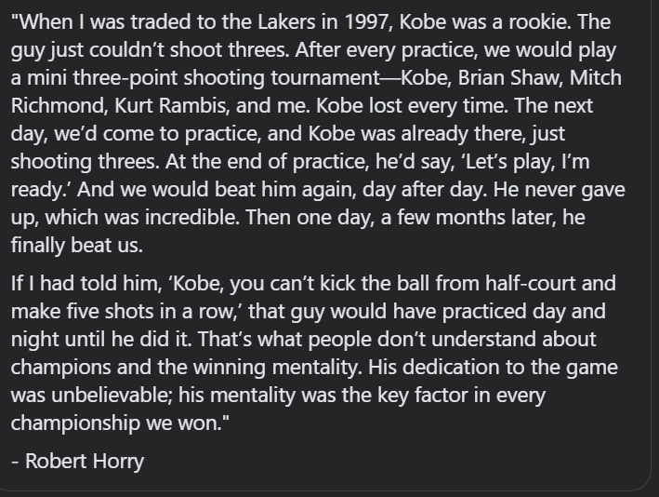
Keep plugging away

Slide 41
Summary
Set goals to manage your career deliberately
Make adult decisions
Be patient, stick to the plan (but don’t be afraid to change a bit)
Find balance
Keep moving forward

Slide 42
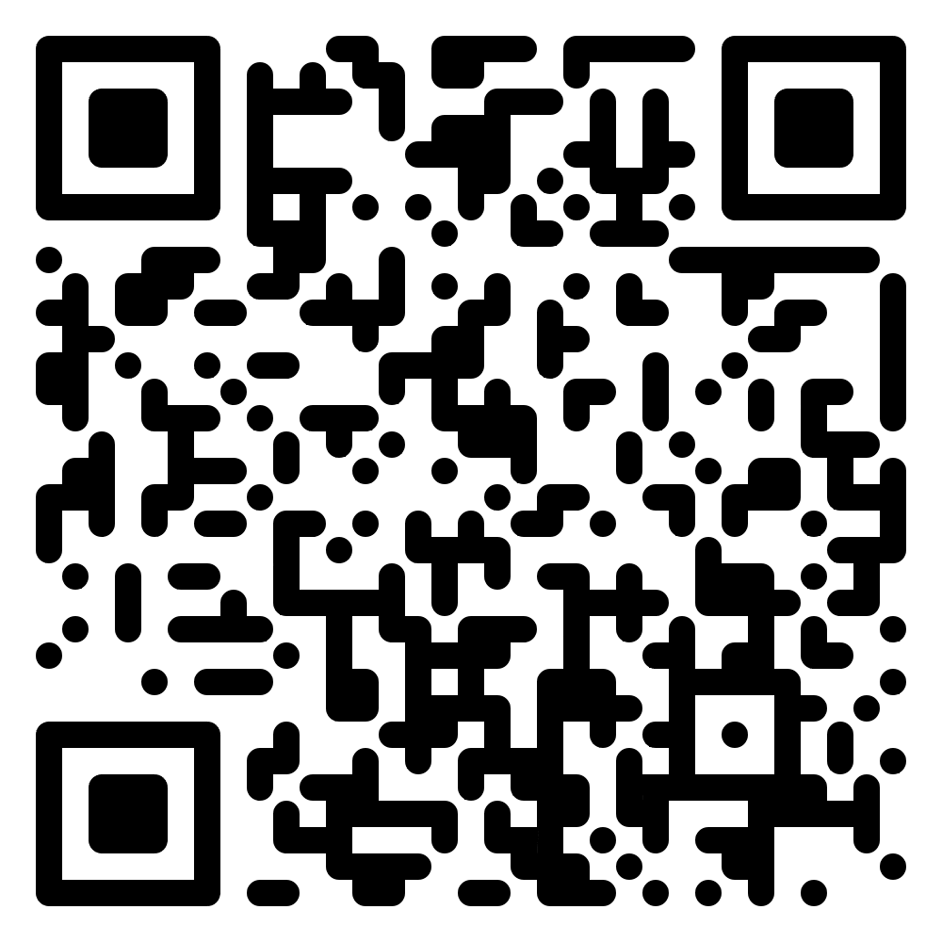

Thank you for coming
www.voiceofthedba.com
sjones@sqlservercentral.com
@way0utwest
/in/way0utwest

