Slide 1
Running a Local GenAI Model on your Laptop
Steve Jones (he/him)
Editor, SQLServerCentral
Advocate, Redgate Software
President, SQL Saturday 501.c.3 charity
@way0utwest
Notes:
Learn how you can easily set up a local model to run on your machine, protecting your data and prompts from being used by anyone else for training.

Slide 2
Agenda
Introduction
A Quick Demo
Overview of GenAI and LLMs
Using Containers to run an LLM
Using Python to train an LLM
A Local RAG Setup with SQL Server

Slide 3


Slide 4
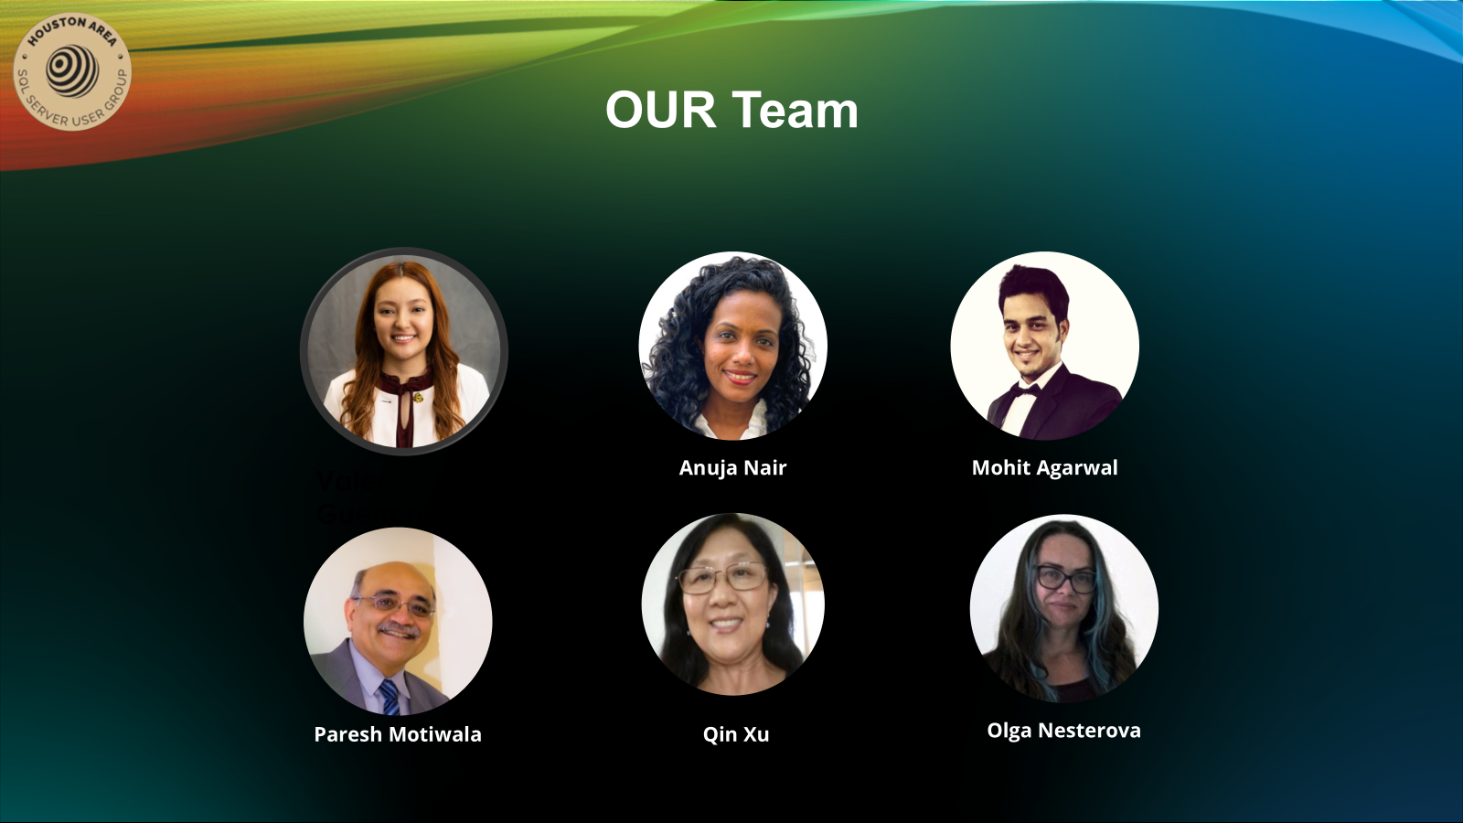

Slide 5





34 years database experience
DBA, developer, manager, writer, speaker in a variety of companies and industries using SQL Server, Oracle, and other database platforms.
Founder, SQL Server Central
Currently the editor in chief, with the goal of helping you learn to be a better data professional every day
Steve Jones
Advocate, Redgate Software
Editor, SQL Server Central
President, SQL Saturday 501.c.3 charity
he/him
18-year Microsoft Data Platform MVP
I have been honored to be recognized by Microsoft for the as a Data Platform MVP working with SQL Server
/in/way0utwest
@way0utwest
sjones@sqlservercentral.com
www.voiceofthedba.com
Notes:
Steve Bio

Slide 6
A Quick Demo
Querying a model without the Internet

Slide 7
Overview of LLMs
What is this AI hype?

Slide 8
AI > GenAI
Most of the hype today is around GenAI and LLMs
The OpenAI Chatbot was released in 2022
This started most of the AI hype, however …
AI includes a number of technologies
  Machine learning
  Neural networks
  Generative Pre-trained Transformers
  more

Slide 9
LLMs
Large Language Models (LLM) are one type of GPT model
They are trained on large amounts of test*
They can have specific aims for their training
Most of us models trained fairly generally
Most of those we use are GPT models
  OpenAI GPT, Claude Sonnet, Google Gemini, etc.
  These aim to allow easy human interaction with an “understanding” of what is being asked
There are different types of LLMS
  Some are for text
  Some are multi-modal (text/audio/video)
Think of these as contained algorithm or library

Slide 10
Uses for LLMs
Translation
Text Summarization
Speech recognition
Text Summarization
Text Completion
Image/Video processing
Semantic Analysis
Code Generation
A very wide variety of things you might not expect

Slide 11
Public Web LLMs
ChatGPT
Claude
Gemini
Perplexity
Deepseek
Dall-E
Grok
Mistral

Slide 12
Model Sources
There are many places to get models
Hugging Face – Large open source repo
GitHub – various curated lists, commercial models, more
Amazon Bedrock – models AWS hosts
Google Vertex
Azure AI
Plenty of other places

Slide 13
The Reasons for Running Local Models
Why note use the web?

Slide 14
The case for local models
Custom training
  focus on the thing you need
  Update and re-train as needed
Contained costs and performance
  Choose your own hardware
  Upgrade as needed
  Known Latency
  Predictable costs
Fewer Dependencies
  Not limited by network requirements
  Can reduce reliance on other vendors

Slide 15
More Benefits
Security and Privacy
  Control over your data processing
  Ensure no data is used for training
  Ensure no sensitive data is retained
Regulatory Compliance
  Some auditors or authorities might not approve public/cloud services
  Can ensure data respects geographical boundaries

Slide 16
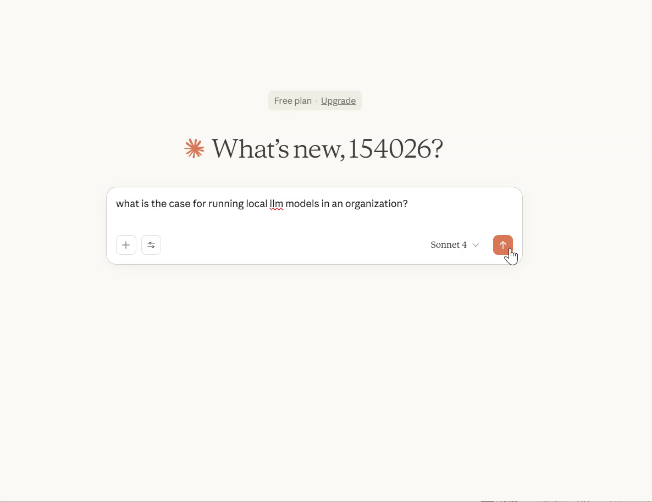

Slide 17
The Downsides
Costs
  Infrastructure costs can be high
  Might need HA (non trivial to architect and engineer)
Technical Complexity
  Need staff that can train or re-train models
  Security of models is complex (prompt injection)
  Staff retention can be an issue
Model Limitations
  Might not easily be able to upgrade and train on the latest models
  Potentially your expertise here falls far behind vendors (or Open Source)

Slide 18
A Local Chatbot
A simple local setup

Slide 19
Setting up a Local Chatbot
You need
  A way to run models (Ollama, llama.cpp, vLLM)
  A model (hugging face or somewhere)
  An interface (open-webui)
  Hardware (a pc)
A few things to note
  This really uses CPU and/or GPU
  This eats battery
  This is way, way, way slower than using a cloud service
  Models are big (or really big)

Slide 20
My Setup
Docker
  Technically, Rancher Desktop for me
  This hosts the ollama runner and interface
Containers
  Ollama/ollama – Docker registry
  open-webui - ghcr.io/open-webui/open-webui:main
Chrome
  Localhost:3000

Slide 21
Demo
Let’s look at running the local bot
https://ollama.com/library?sort=newest

Slide 22
Using Python to train a Local LLM
Custom setup if you have the time

Slide 23
Training a model
This is a way to develop custom models for your use case.
Based on a process by Jeff Foster at Redgate
Fine Tuning a Small Language Model
  Uses gemma3 from Google
  Runs python to download and train a model
  A training file guides this
It is slow on my laptop

Slide 24
The Process
Get a lot of Python modules (requirements.txt)
Adjust the training weights for your case
Train the model (python train.py)
Run and enter text

Slide 25
Demo
A look at the results

Slide 26
A Local RAG Setup with SQL Server
Influencing your model

Slide 27
SQL Server 2025 and RAG
SQL Server 2025 includes support for AI integration
  Create external model
  Vector datatype
  Vector indexes
Retrieval Augmented Generation
  This is a process by which your prompt is used to search resources
  In this case a SQL Server 2025 database
  Results are sent to the LLM with your prompt
  The LLM has more complete information to answer your question

Slide 28
A Quick Setup
Anthony Notencino - https://www.nocentino.com/
  Pure Storage Senior Principal Field Solution Architect
  Microsoft MVP
He has a quick start
  https://github.com/nocentino/ollama-sql-faststart
  This creates multiple containers and addresses security concerns between SQL Server and Ollama

Slide 29
Demo
Let’s see the results

Slide 30
Demo
A Local App

Slide 31
Summary
GenAI uses LLMs
  This is a subset of AI technology
  Changing and maturing all the time
Local Models
  Provide a lot of control and security
  Can be expensive and hard
Chatbots can be easy to setup and test
Python can be used to train models (slow w/o GPU)
SQL Server has integration for working with LLMs

Slide 32



www.voiceofthedba.com
/in/way0utwest
sjones@sqlservercentral.com
@way0utwest
@way0utwest

Slide 33
Thank you for coming
www.voiceofthedba.com
sjones@sqlservercentral.com
@way0utwest
/in/way0utwest
@way0utwest

Slide 34
References
https://github.com/open-webui/open-webui
https://www.openwebui.com/
https://ollama.com/
https://fffej.substack.com/p/fine-tuning-a-small-language-model
https://github.com/nocentino/ollama-sql-faststart

