Slide 1
Day of Data Albany 2026 (#1144)
Architecting Zero Downtime Database Deployments

Slide 2
Agenda
Introduction
Defining Zero Downtime for Databases
Architecting Changes
Adding Not Null Columns
Splitting a column
Rename a field
Changing a Procedure
Best Practices
Notes:
Setup:
SSMS (open folder), run 01, 02
VS – open app

Slide 3


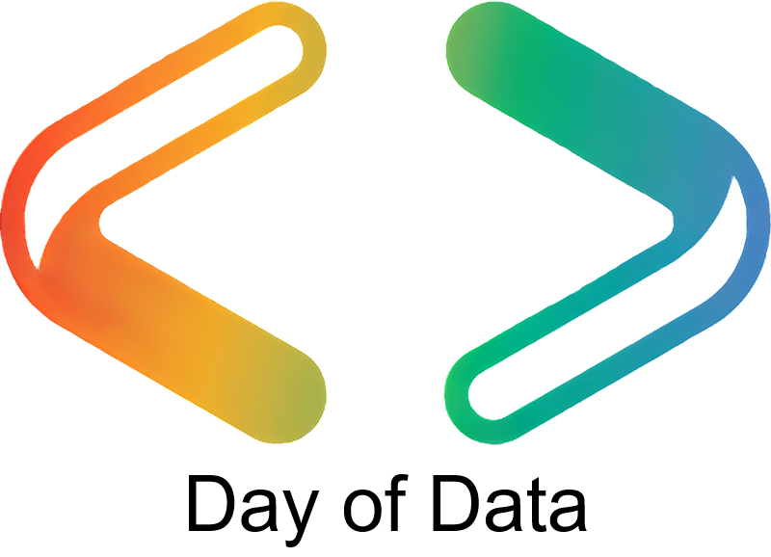
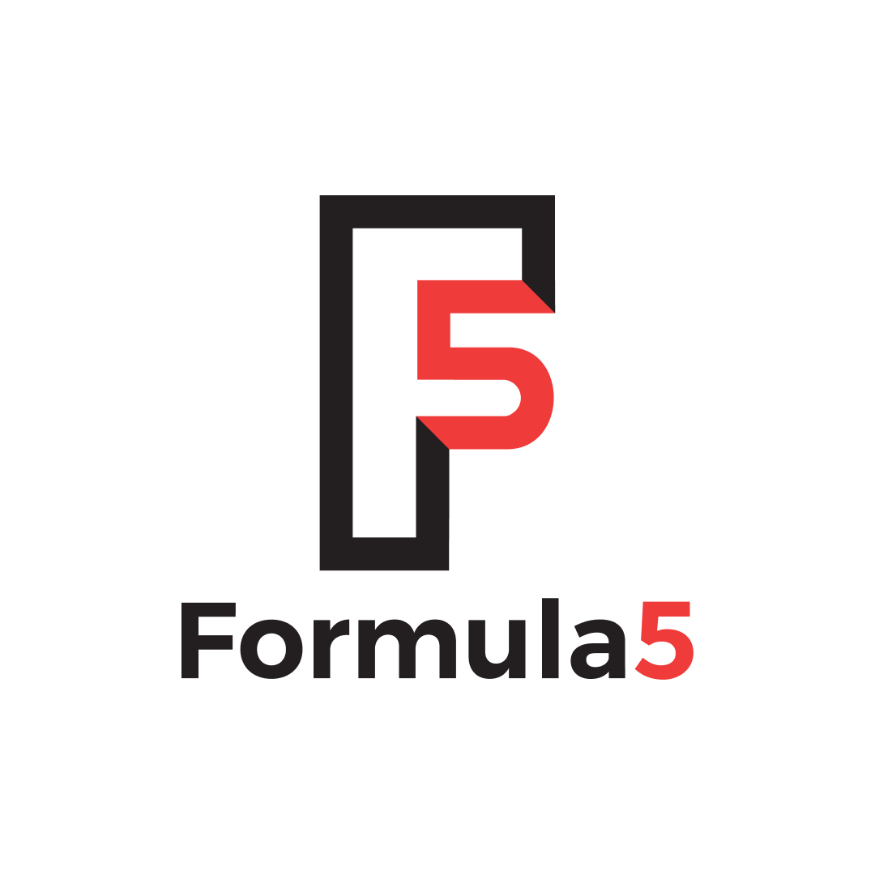


Thank You to Our Sponsors!
Global Sponsors
Platinum Sponsor
Silver Sponsors
Bronze Sponsor

Slide 4


35 years database experience
DBA, developer, manager, writer, speaker in a variety of companies and industries using SQL Server, Oracle, and other database platforms.
Founder, SQL Server Central
Currently the editor in chief, with the goal of helping you learn to be a better data professional every day
Steve Jones
Advocate, Redgate Software
Editor, SQL Server Central
President, SQL Saturday 501.c.3 charity
he/him
20-year Microsoft Data Platform MVP
I have been honored to be recognized by Microsoft for the as a Data Platform MVP working with SQL Server
/in/way0utwest
@way0utwest
sjones@sqlservercentral.com
www.voiceofthedba.com
Notes:
Steve Bio

Slide 5
Defining Zero Downtime for Databases

Slide 6
Zero Downtime is
Not interrupting the customer (unnecessarily)
Not stopping business from running
Not stopping software from improving
  Enhancements
  Bug fixes
  Maintenance
The appearance of 24/7 operation

Slide 7
Who Needs Zero Downtime?

Slide 8
Everyone

Slide 9
Zero Downtime is Important
We already have enough issues with customers
Technical Issues
  Slow networks / broken connectivity
  Software bugs
  Database slowdowns
  Machine failures
  Design Complaints
If our competition has less issues, customers will churn

Slide 10
DevOps Needs Zero Downtime
If we want to move at DevOps speed
  We can’t have the database be a bottleneck
  We can’t have database deployments be extraordinary
  We can’t require humans to make (all) changes
  We need review and automation just like apps

Slide 11
Architecting Zero Downtime
Making better decisions

Slide 12
Database Zero Downtime is Complex
Databases are more complex than software
Relational databases are stateful machines
Schema has to evolve
Zero downtime isn’t possible (almost always)
The goal is no interruptions to the client

Slide 13
Planning for Zero Downtime
Use the Expand/Contract model (Martin Fowler)
Trade space for time
  Store copies or new/old objects
  Recover space later – puts pressure on app devs
Break up work
  Ensure deployments are backwards compatible
  If not, use multiple deployments
Blue/Green doesn’t work with databases

Slide 14
Use Good Development Practices
  “Baby steps”: If a change is backward-incompatible, split it
  Ensure the db can rev 1 version without the app
  Never add and delete dependent objects in the same deployment
  Be prepared to deploy multiple times:
    Database, then app, then DB, then app
  Must be able to split out/reorder work

Slide 15
Demo App
This code/app is on GitHub
https://github.com/way0utwest/ZeroDowntime
SQL Server database code
VS 2019 C# project
Flyway (optional) for deployments

Slide 16
General Database Guidelines
  App always calls for columns by names (no SELECT * or 1,2,3 columns)
  Feature flag all items dependent on database schema change
  “Baby steps”: If a change is backward-incompatible, split it into multiple backward-compatible steps.
  Use triggers to keep new and old structures in sync
  If in doubt, save copies of data until the deployment completes

Slide 17
Splitting a column
Working towards normalization

Slide 18
The Scenario
We have a CustomerName column in dbo.Customers
We want this split to two columns:
  FirstName
  LastName
A common occurrence when we realize we’ve modeled incorrectly
Multiple types of information are in one column
We are becoming more normalized

Slide 19
The Typical Process
We deploy this in one transaction:
  Add columns to the table: FirstName and LastName
  UPDATE the columns by splitting the data in CustomerName
  Drop the CustomerName column
Challenges
  We might have applications using CustomerName
  The UPDATE statement might block users while running
  We will not split some data properly (George von Trapp)

Slide 20
Demo
Splitting a column

Slide 21
The Zero Downtime Process: Splits
We trade space for time
We use multiple deployments
  1 - Add columns to the table: FirstName and LastName
  2 - UPDATE the columns by splitting the data in CustomerName
    2a – rename CustomerName
  3 - Drop the CustomerName column
Advantages
  We can start this move independently of the application
  We can batch the update if needed
  We can delay the final step until ready

Slide 22
Splitting Tables
The process is similar for splitting tables
Add a new table, use triggers to sync data
  Only columns being moved
Remove the columns from the original table later
Coordinate with apps to ensure feature toggles all flip

Slide 23
Merges
A merge is the reverse of a split
Can be table or column level
Similar process
  New storage location
  Merge data
  If possible, keep the original values
  Drops occur later

Slide 24
Adding NOT NULL Columns
Tracking data changes

Slide 25
The Scenario
Avoiding NULLs is often a good idea
We want to add a new column to a table that is NOT NULL
Two ways to do this (platform dependent):
Two-step process
  Add a NOT NULL column with a default
  Fix existing rows
Three-step process:
  Add a NULL column
  Update existing rows with some value
  Change to NOT NULL

Slide 26
Demo
Adding NOT NULL columns

Slide 27
The Zero Downtime Process
Feature Flag the application
Use 2 or 3 Deployments
  Add a NULL column
  Update data/defaults
  Change to NOT NULL
Make sure you understand how the app behaves with NULL/default/incomplete data

Slide 28
Renaming
Don’t do this, but if you must…

Slide 29
The Scenario
Someone doesn’t like a column name
They want to change the name to something else
  Currently dbo.OrderHeader.OrderDate
  Change to: dbo.OrderHeader.OrderedbyDate
NOTE: You should NEVER need to do this
  We have aliases
  We an adjust ordering, naming, etc. in queries

Slide 30
The Typical Process
Multiple options here (platform dependent):
Often, we use a rename procedure (sp_rename)
We can use the swap variable process:
  Multi-step (add new, rename old, rename new, drop old)
Challenges
  Updating all app calls challenging
  We might deploy and rollback many times

Slide 31
Demo
Renames

Slide 32
The Zero Downtime Process: Renames
If possible, a quick one-step is preferred
  Coordination with app is hard
  NOT Zero downtime usually
Use sp_rename in SQL Server/Azure/Synapse
  Only if you are sure all apps can rev
  Verify this in testing
  Usually requires a deployment window so all apps can rev/toggle
Safer process is:
  Adding a new column/view
  Flip feature toggle in apps
  Use xEvents to check access to the old name (maybe)
  Search all code for the old name
  Drop the new col/view and rename the old one later

Slide 33
Changing a Procedure
Altering your API

Slide 34
The Scenario
There is a stored procedure in production
We need to add functionality
  New parameters
  Change logic

Slide 35
The Typical Process
Update procedure code:
  Add new parameters
  Remove old parameters
  Update proc logic
Challenges
  Updating all app calls
  Syncing with application deployment

Slide 36
Demo
Enhancing a Stored Procedure

Slide 37
The Zero Downtime Process
Add parameters in one deployment, remove in another
Use defaults so old code works
  Prefer old
  Prefer new
  New only
Verify logical functionality with/without default parameter
  Without, must return same results are before the deployment
  Use switching logic inside if necessary
  Write tests!!!!
Log the calls without a parameter somewhere
  This helps to determine when all clients have rev’d.
  Provide feedback to app teams

Slide 38
Best Practices
The things that work well

Slide 39
Best Practices for Applications
Use Feature Toggles
Use column names
  Result sets
  SQL code
  No numbers for columns
Ensure INSERTs use column lists
Parameterize stored procedures and functions
  Or use named parameters in calls
No SELECT *
Use good error handling and log db errors for quick resolution

Slide 40
Best Practices for Database Code
Break deployments up into stages
Use defaults wherever possible
No SELECT * in code (views/procs/functions)
Use INSERT column lists (no INSERT..SELECT)
Only add parameters in procs
  Use defaults
  Removal is a separate deployment
Use parameter names in calls
Avoid renames (aliases, synonyms, views can help here)
Order of columns DOESN’T MATTER

Slide 41
Best Practices for Deployments
Never add and drop in the same deployment (for related objects)
Trade space for time, keeping copies of data for a period
Write the cleanup code with the enhancement code
  Test this together with the enhancement
  Make a separate branch/PR with a FUTURE DATE for deployment

Slide 42
Summary
Understand and apply the DevOps principles to the db
Learn what impacts your environment and what doesn’t
Use the impact analysis to decide where to split your deployments
Be patient, make changes across time
Never add and drop together
Feature toggles make it easier to separate db from app changes

Slide 43
Thank You to Our Sponsors!
Global Sponsors
Platinum Sponsor
Silver Sponsors
Bronze Sponsor

Slide 44


Thank you for coming
www.voiceofthedba.com
sjones@sqlservercentral.com
@way0utwest
/in/way0utwest

