Slide 1

Using Data API Builder to Speed Up Application Development
Steve Jones
Advocate/Architect
Redgate Software/SQL Server Central
Level: Intermediate

Slide 2
Agenda
Introduction
Data API Builder Introduction
Getting Your Database Into the API
Updating the API
Using the REST API
Using the GraphQL API
The DAB MCP Server

Slide 3





35 years database experience
DBA, developer, manager, writer, speaker in a variety of companies and industries using SQL Server, Oracle, and other database platforms.
Founder, SQL Server Central
Currently the editor in chief, with the goal of helping you learn to be a better data professional every day
Steve Jones
Advocate, Redgate Software
Editor, SQL Server Central
President, SQL Saturday 501.c.3 charity
he/him
20-year Microsoft Data Platform MVP
I have been honored to be recognized by Microsoft for the as a Data Platform MVP working with SQL Server
/in/way0utwest
@way0utwest
sjones@sqlservercentral.com
www.voiceofthedba.com
Notes:
Steve Bio

Slide 4
Data API Builder Overview
What is this thing?

Slide 5
The Data API Builder (DAB)
A service that presents and API over your database
This is designed to replace CRUD operations by developers
Removes the need for a data access layer
Builds endpoints
  Swagger for REST
  Banana Cake Pop for GraphQL
  MCP for agents
Works on Windows/Linux/MacOS
Authentication with Entra, OAuth2, JWT, EasyAuth
Open source: repo

Slide 6
Platform Support
RDBMS and NoSQL
    SQL Server
    Azure SQL
    Azure Cosmos DB for NoSQL
    PostgreSQL
    Azure Database for PostgreSQL
    Azure Cosmos DB for PostgreSQL
    MySQL
    Azure Database for MySQL
    Azure SQL Data Warehouse

Slide 7
Platform support
Varies by platform
Not all features on all platforms on all versions
Not all data types supported
Make sure you check docs
https://learn.microsoft.com/en-us/azure/data-api-builder/feature-availability

Slide 8
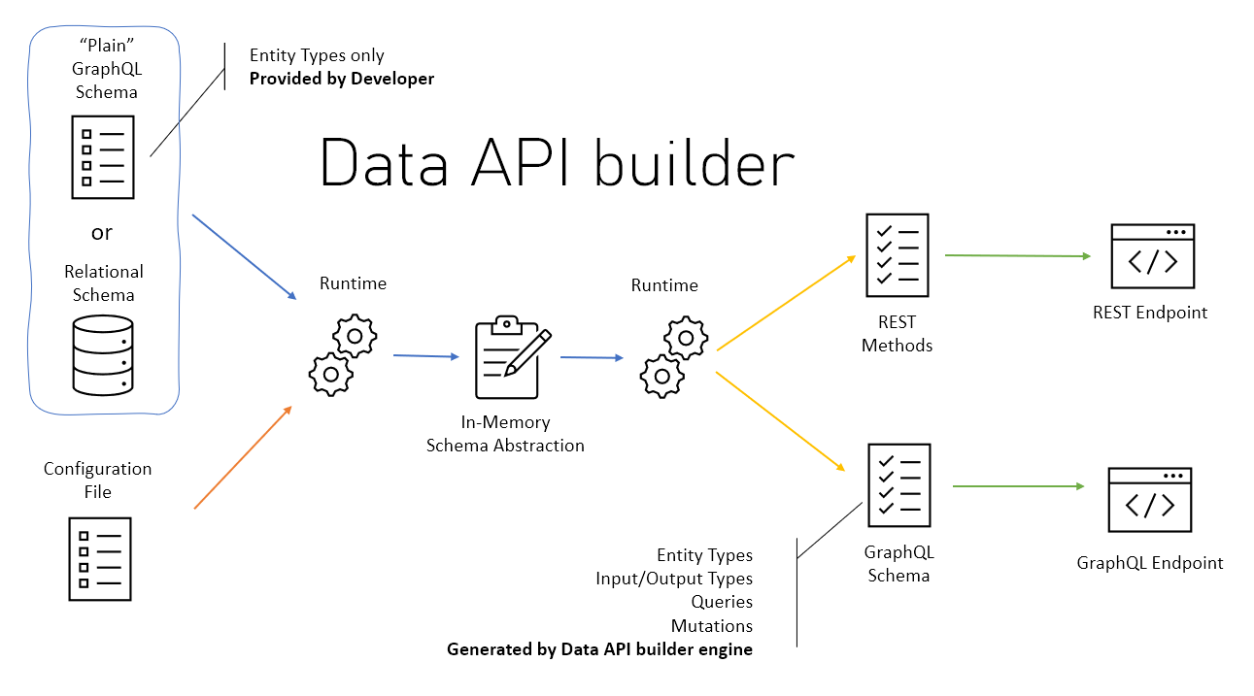
Architecture
From: https://learn.microsoft.com/en-us/azure/data-api-builder/overview#architecture

Slide 9
Deployment Options
The engine can be run as a CLI process
The engine can run as a docker container
Azure support
  Azure Container Apps
  Azure Container Instances
  Azure App Service
  Azure Kubernetes Service
  Azure Static Web Apps (preview as of May 2025)

Slide 10
Installing DAB
Installation and Upgrade

Slide 11

Install
dotNet 8 required
DAB installs from dotnet CLI
  dotnet tool install --global Microsoft.DataApiBuilder
dab.exe is the CLI
Check installs with dab --version

Slide 12
Container
Image is: mcr.microsoft.com/azure-databases/data-api-builder
Run with a docker command:
docker run \
--name dab \
--publish 5000:5000 \
--detach \
--mount type=bind,source=$(pwd)/dab-config.json,target=/App/dab-config.json,readonly \
mcr.microsoft.com/azure-databases/data-api-builder

Slide 13
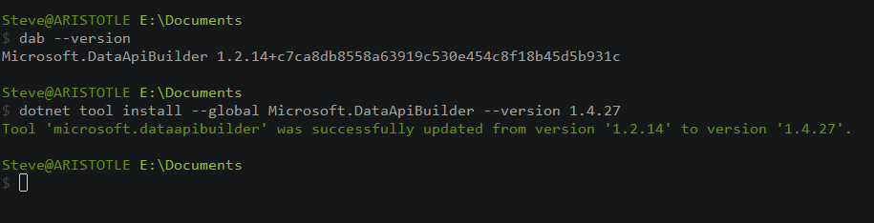
Upgrade
Latest:
  dotnet tool update --global Microsoft.DataApiBuilder --version 1.4.27
Specific Version
  dotnet tool install --global Microsoft.DataApiBuilder --version 1.4.27

Slide 14
Getting Started with DAB
Configuration and Running and API interface

Slide 15
The Basic Steps
Create a database (Northwind)
Create a configuration file (init)
Add API items (add)
Stand up the API (start)
Add/modify API items

Slide 16
Init
Creates a configuration file
  Default is dab.config.json
  Can be overridden with --config
Requires a type of database
Can include a connection to the database
Values can be read from an environment file
dab configure changes settings

Slide 17
Start
Starts the API process
Exposes the APIs configured
Can include the specific config file you want

Slide 18
Demo
Init an API – Demo 1-3

Slide 19
Updating the API
DAB CLI makes config easy
dab add - Adds items to the API
We can add
  Tables
  Views
  Stored procedures
Lots of limitations
dab update – changes existing items
dab validate – checks the config file

Slide 20
Demo
Demo 4-5
Query the API from a browser - http://localhost:5000
Notes:
Go to the URL

Slide 21
Using the DAB API
How would developers access data

Slide 22
Accessing the API
The API will be available as an http request
  Rest uses SWAGGER style API
  GraphQL uses Banana Cake Pop
For REST developers
  System.Net.Http.HttpClient
  Spring has RestClient
For GraphQL developers
  Use Strawberry Shortcake
Bruno is a great way to query - https://www.usebruno.com/
MCP – I’ll use VSCode

Slide 23
Using the REST API
How this works when querying a database

Slide 24
Rest API
REpresentative State Transfer
Well-known by most developers
Typically, this is accessed with an http/https access point.
  http://myserver/api/customer
  http://myserver/api/order
Typically, each separate “thing” is a separate URL
Often, these return JSON values, which developers can easily use in code
This doesn’t matter for db people

Slide 25
The DAB Rest API
Everything is /api (from config)
Simple GET/PUT/PATCH/POST/DELETE queries
Limited by entity (table/view/proc)
Query Parameters
  $select
  $filter
  $orderby
  $first / $after
Supports actions to change data
Docs for REST API

Slide 26
Changing Data
POST creates a new item
  queries require all fields that are not nullable
  Fields not included are NULL
PUT queries can change or update
  All fields required or they are NULL
PATCH queries allow updating specific fields
DELETE deletes items

Slide 27
Demo
Query the REST API from Bruno
Demo 6-8

Slide 28
Using the GraphQL API
Another way to retrieve data

Slide 29
What is GraphQL
A Richer API for data access
Allows more complex queries from one path
An open standard: https://graphql.org/
Used by many Microsoft products (Azure, LinkedIn, Fabric, etc.)

Slide 30
The DAB GraphQL API
A single path for queries (/graphql)
Default query actions
  Pagination
  Query by PK
  Generic Query
filter parameter for limiting rows
orderBy for ordering
Supports Mutations to alter data
DAB docs for GraphQL API

Slide 31
Relationships
The power of GraphQL comes into play with relationships
We can query across entities that are related
We can define relationships in DAB
We can set up different types of relationship
  One -> many
  Many -> one
  Many -> many

Slide 32
Views and Procedures
We can query views just like tables.
Stored procedures are their own type
  Need to add parameters in the definition
  The call contains the output.
  Needs a POST type (GraphQL and REST)
  Parameters needs to be variable (NVARCHAR v NCHAR)

Slide 33
Demo
Query the GraphQL API
Demo 9-11

Slide 34
The DAB MCP Server
A Modern API for AI

Slide 35
MCP Servers
MCP = Model Context Protocol
A way for AI agents to interact with other systems
MCP servers expose tools for AI agents to use
More info – Understanding MCP Servers

Slide 36
The DAB MCP Server
Exposes an MCP endpoint for agents
  /mcp by default (mine is http://localhost:5000/mcp
  Limited tools
Allows an agent to perform actions on your database
The dab add/update commands can add semantic descriptions and more information about entities for the LLM to use
  Can be at the object (table/view/proc) level
  Can be at the field (column) level

Slide 37
Demo
Query the MCP Server
Demo 12-13

Slide 38
Other Topics
Mode
  Development – used in demos today
  Production (default) – keeps sensitive info out of config file
GraphQL
  Depth Limit - configures depth of queries
  Multiple mutations – make many changes in one query

Slide 39
Security
Authentication
  Unauthenticated (not recommended)
  Entra/AzureAD
  Custom – 3rd party OpenID Connect or JWT
  AppService with Azure
  Simulator - simulate Entra with local auth
  On-Behalf-Of – local dev and roles
Authorization
  DB login roles map to authorized users
  Normal limits for objects (read, create, update, delete, execute)

Slide 40
Summary
Data API Builder gives a quick API over a database that is familiar to developers
Reduces the load for developers to start querying the database
The APIs available are well understood by developers
REST is familiar, but requires different URLs for each entity
GraphQL is newer, but very flexible
MCP gives a model access to your database (be careful)
This is worth experimenting with for simple CRUD apps

Slide 41

Session Survey
Your feedback is very important to us
Please take a moment to complete the session survey found in the mobile app
Use the QR code or search for “Converge360 Events” in your app store
Find this session on the Agenda tab
Click “Session Evaluation”
Thank you!

Slide 42


Thank you for coming
www.voiceofthedba.com
sjones@sqlservercentral.com
@way0utwest
/in/way0utwest
@way0utwest

Slide 43
References
DAB API builder Documentation
https://graphql.org/
What is a REST API?
What is a RESTful API?
Intro to GraphQL
GraphSQL vs. REST
Getting Started with the Data API Builder
The SQL MCP Server

Slide 44
Images

